Slide 1
Chapter 7 C Pointers
C How to Program, 8/e, GE

Slide 2
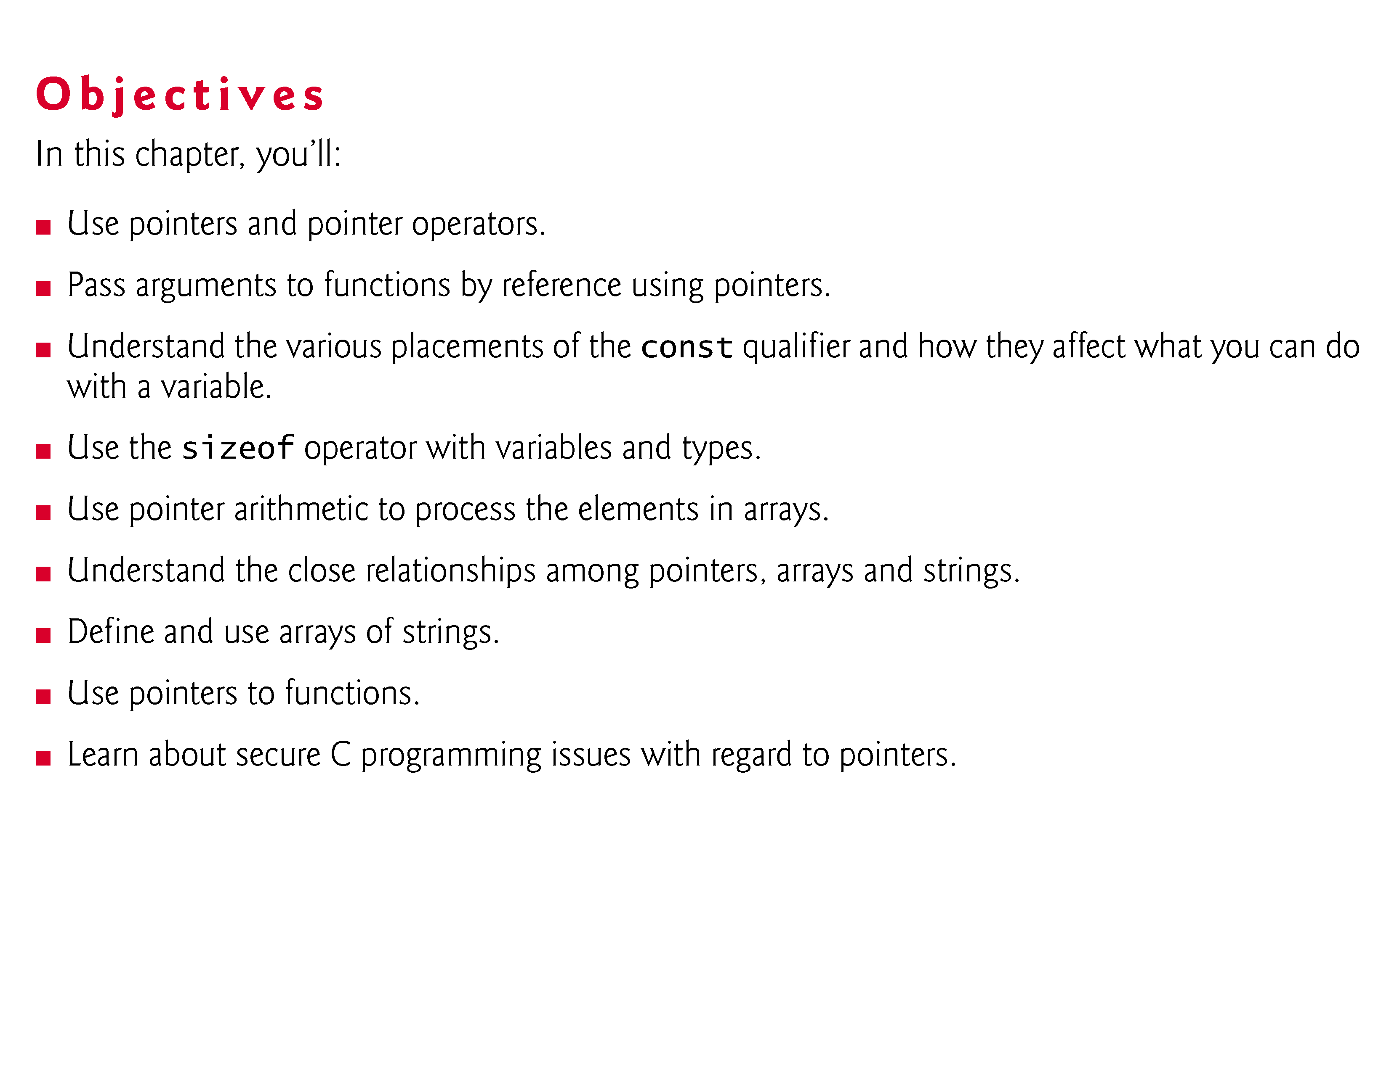

Slide 3
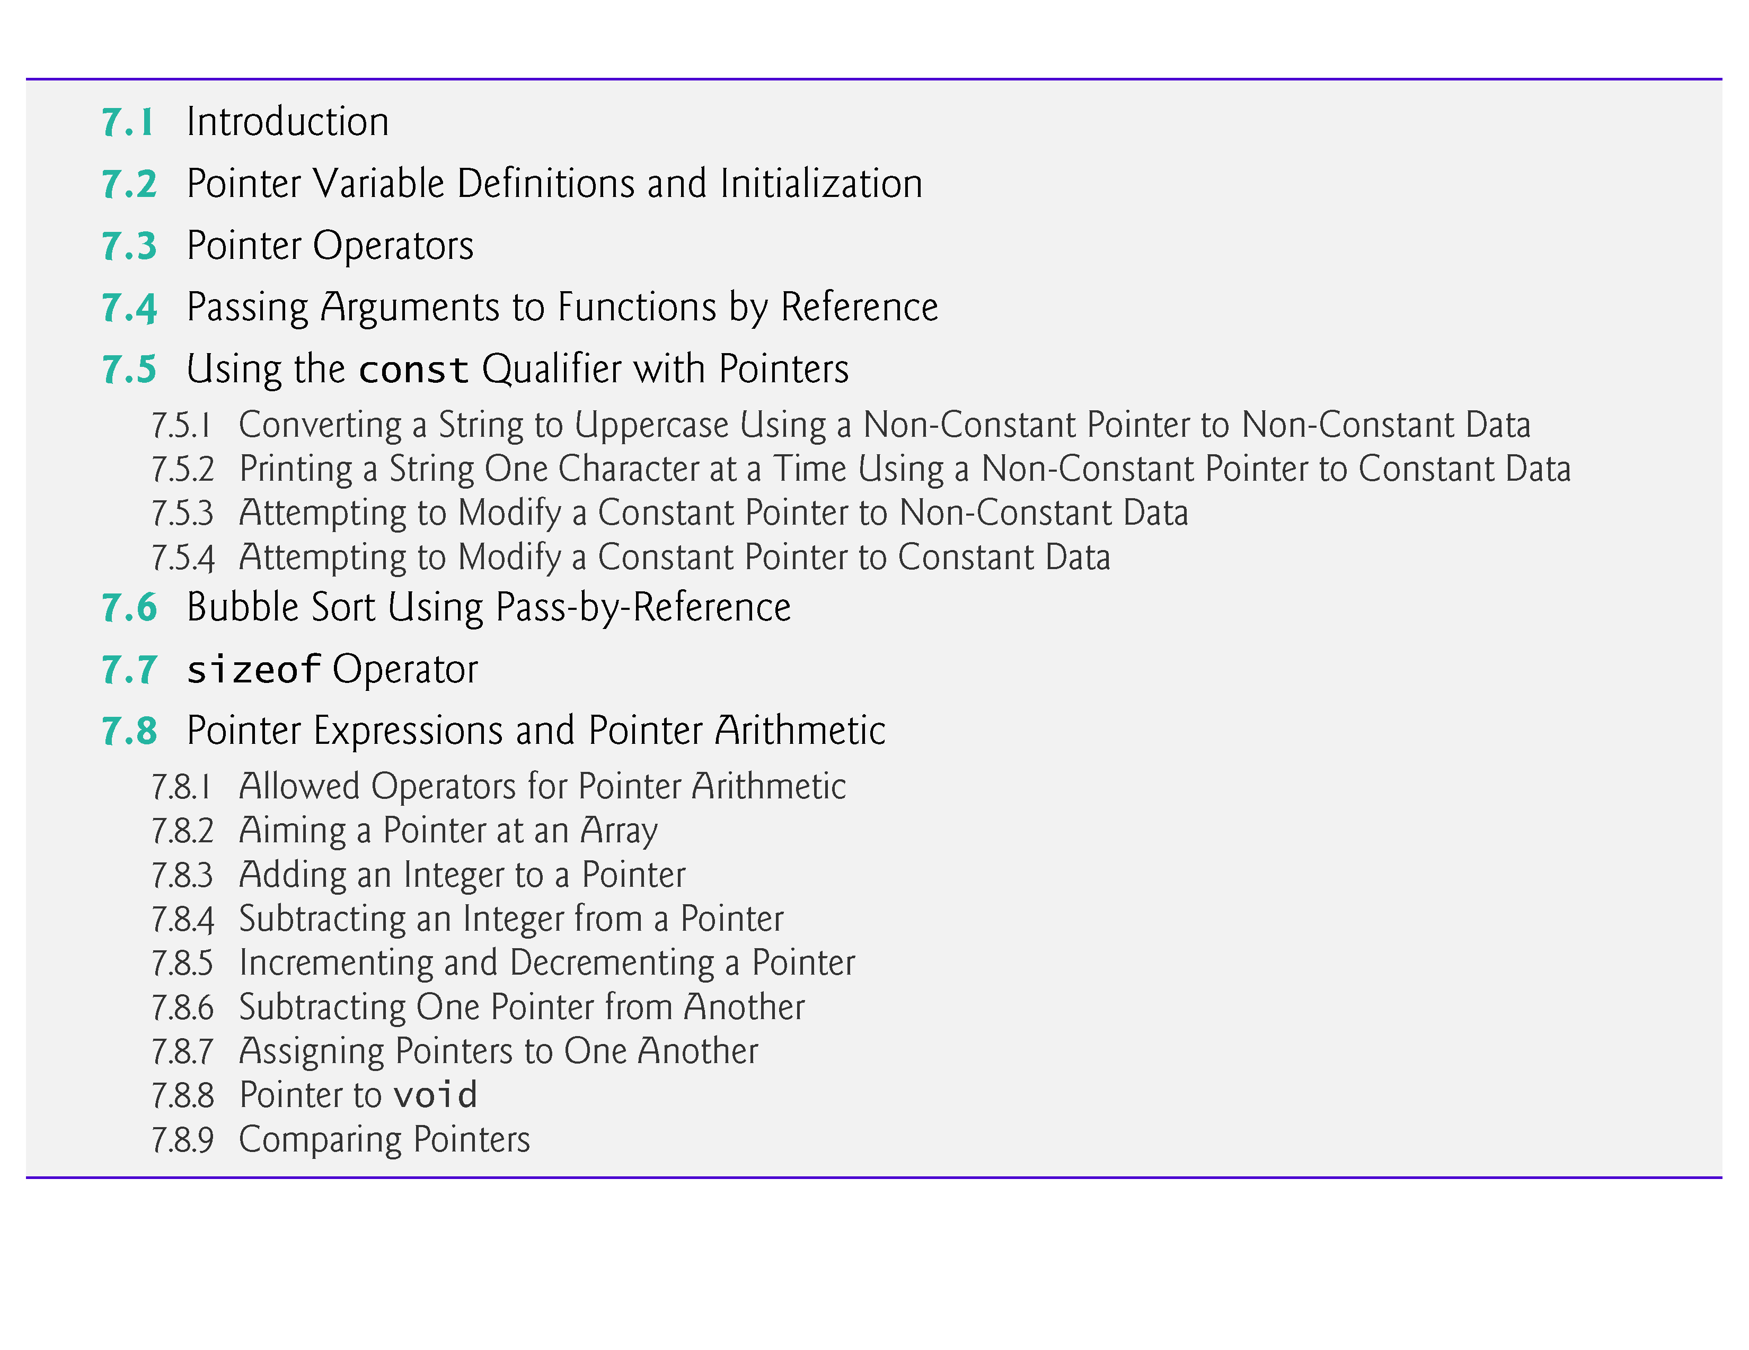

Slide 4
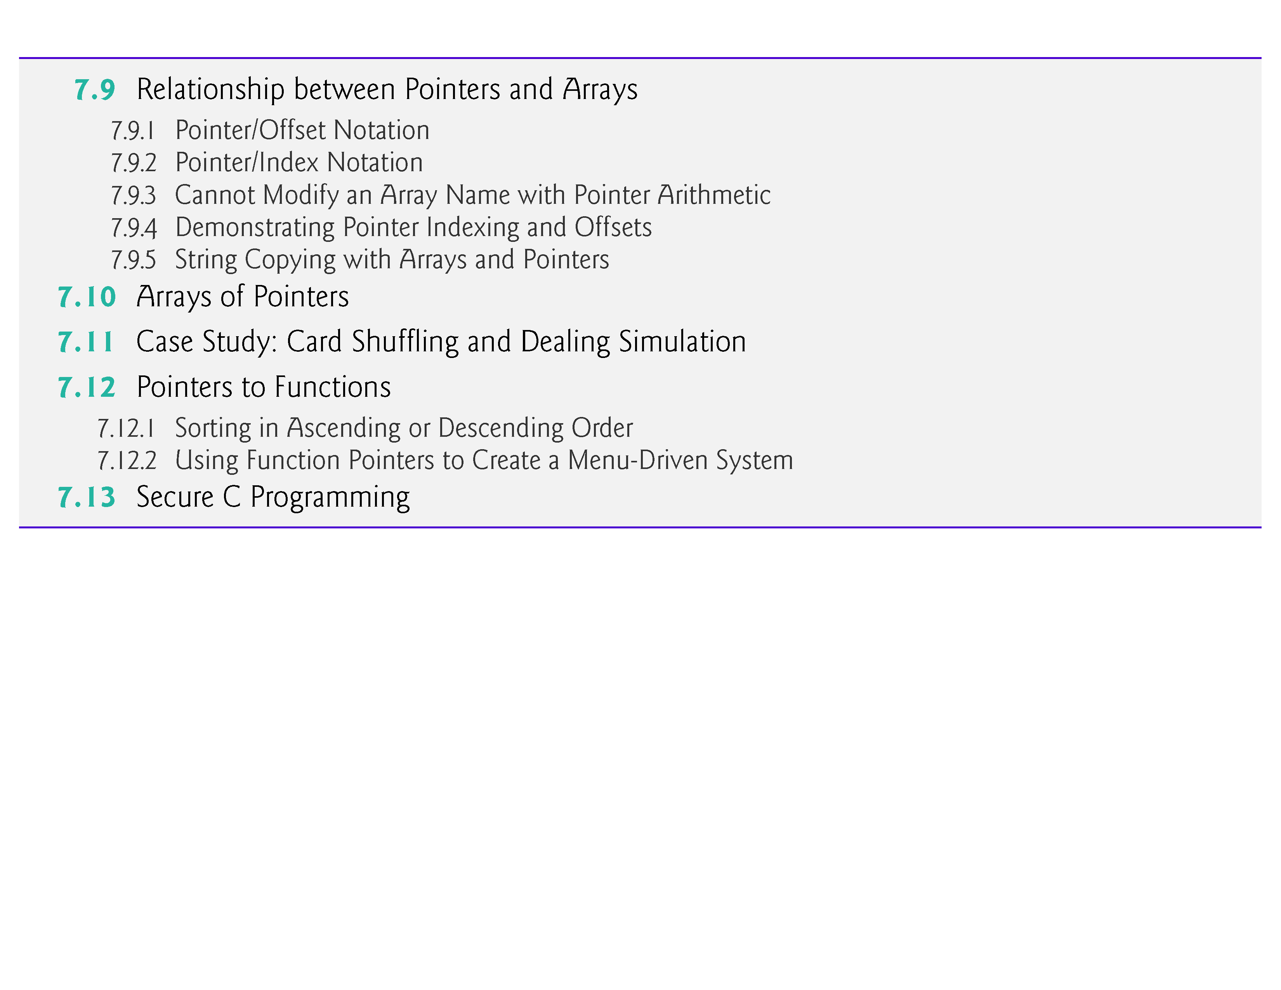

Slide 5
7.1 Introduction
In this chapter, we discuss one of the most powerful features of the C programming language, the pointer.
Pointers enable programs to simulate pass-by-reference, to pass functions between functions, and to create and manipulate dynamic data structures, i.e., data structures that can grow and shrink at execution time, such as linked lists, queues, stacks and trees.
Chapter 10 examines the use of pointers with structures.
Chapter 12 introduces dynamic memory management techniques and presents examples of creating and using dynamic data structures.

Slide 6
7.2 Pointer Variable Definitions and Initialization
Pointers are variables whose values are memory addresses.
Normally, a variable directly contains a specific value.
A pointer, on the other hand, contains an address of a variable that contains a specific value.
In this sense, a variable name directly references a value, and a pointer indirectly references a value (Fig. 7.1).
Referencing a value through a pointer is called indirection.

Slide 7
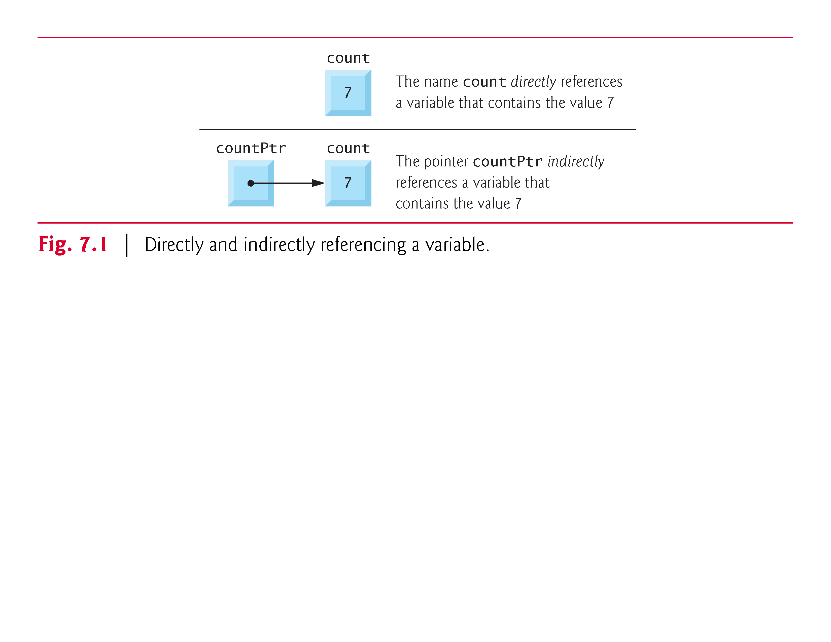

Slide 8
7.2 Pointer Variable Definitions and Initialization (cont.)
Declaring Pointers
Pointers, like all variables, must be defined before they can be used.
The definition
int *countPtr, count;
specifies that variable countPtr is of type int * (i.e., a pointer to an integer) and is read (right to left), “countPtr is a pointer to int” or “countPtr points to an object of type int.”
Also, the variable count is defined to be an int, not a pointer to an int.

Slide 9
7.2 Pointer Variable Definitions and Initialization (cont.)
The * applies only to countPtr in the definition.
When * is used in this manner in a definition, it indicates that the variable being defined is a pointer.
Pointers can be defined to point to objects of any type.
To prevent the ambiguity of declaring pointer and non-pointer variables in the same declaration as shown above, you should always declare only one variable per declaration.

Slide 10
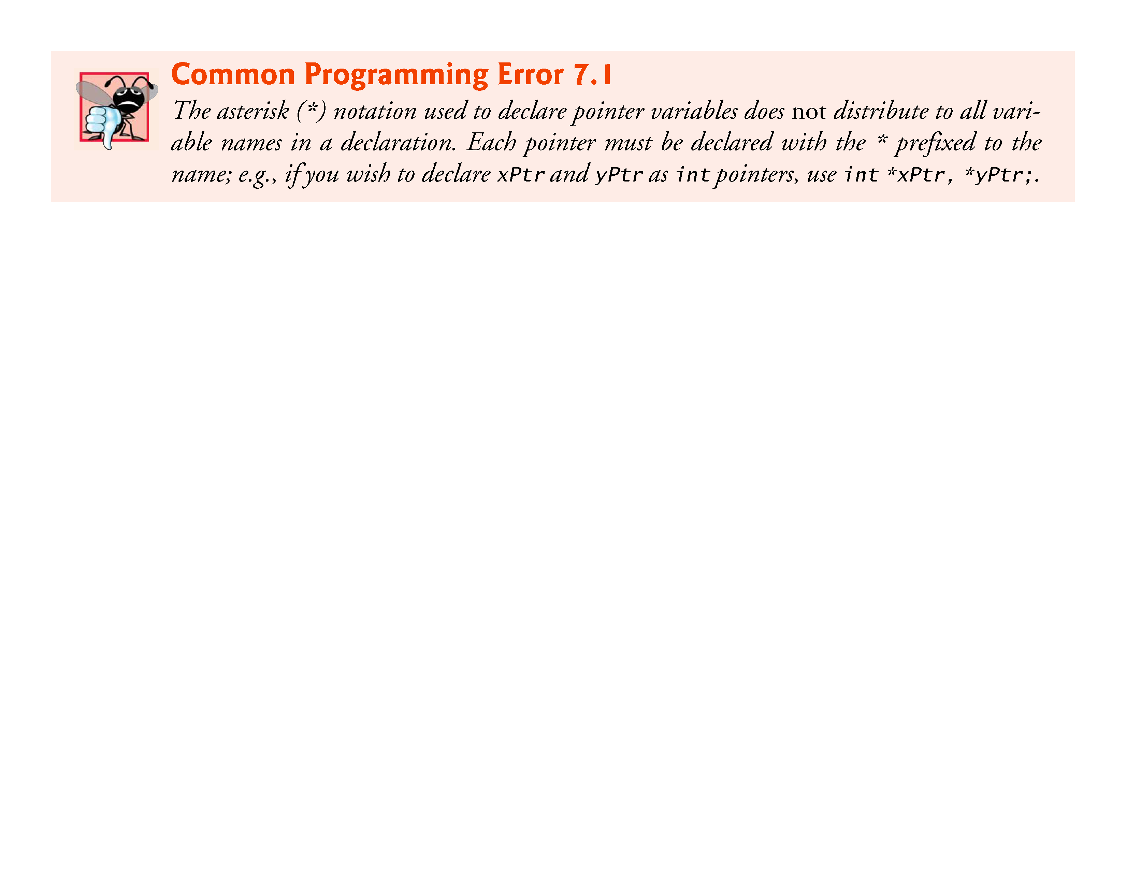

Slide 11
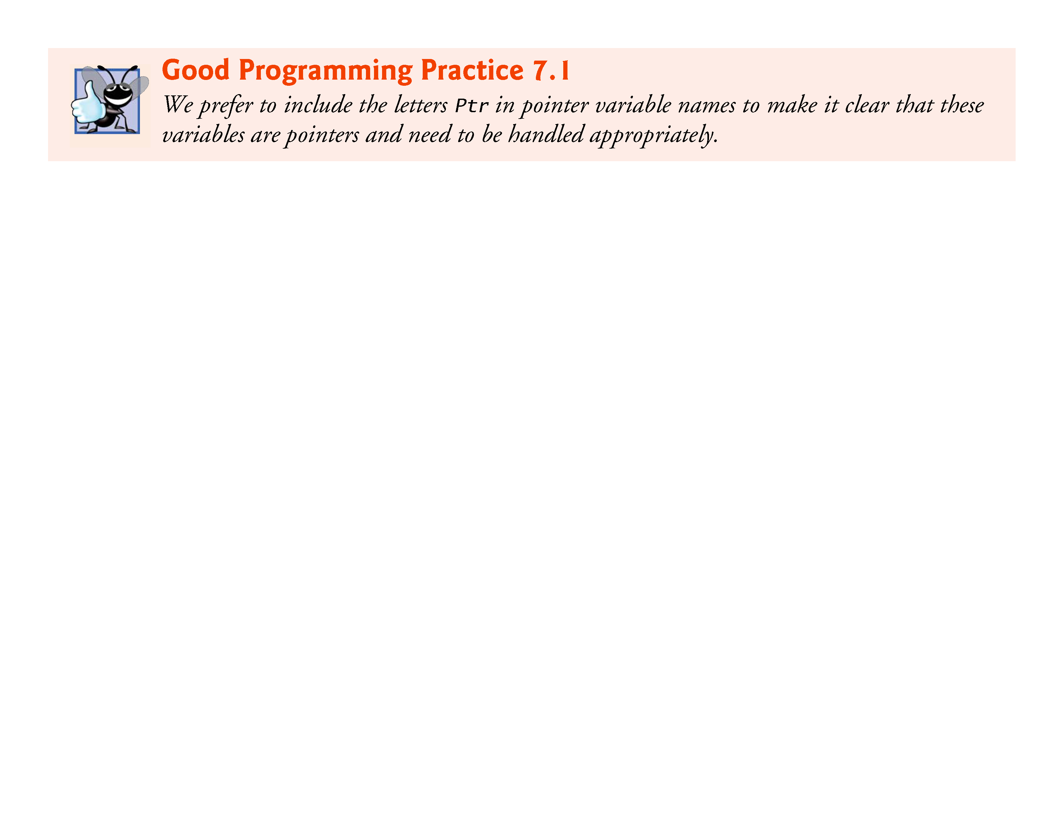

Slide 12
7.2 Pointer Variable Definitions and Initialization (cont.)
Initializing and Assigning Values to Pointers
Pointers should be initialized when they’re defined or they can be assigned a value.
A pointer may be initialized to NULL, 0 or an address.
A pointer with the value NULL points to nothing.
NULL is a symbolic constant defined in the <stddef.h> header (and several other headers, such as <stdio.h>).

Slide 13
7.2 Pointer Variable Definitions and Initialization (cont.)
Initializing a pointer to 0 is equivalent to initializing a pointer to NULL, but NULL is preferred.
When 0 is assigned, it’s first converted to a pointer of the appropriate type.
The value 0 is the only integer value that can be assigned directly to a pointer variable.

Slide 14
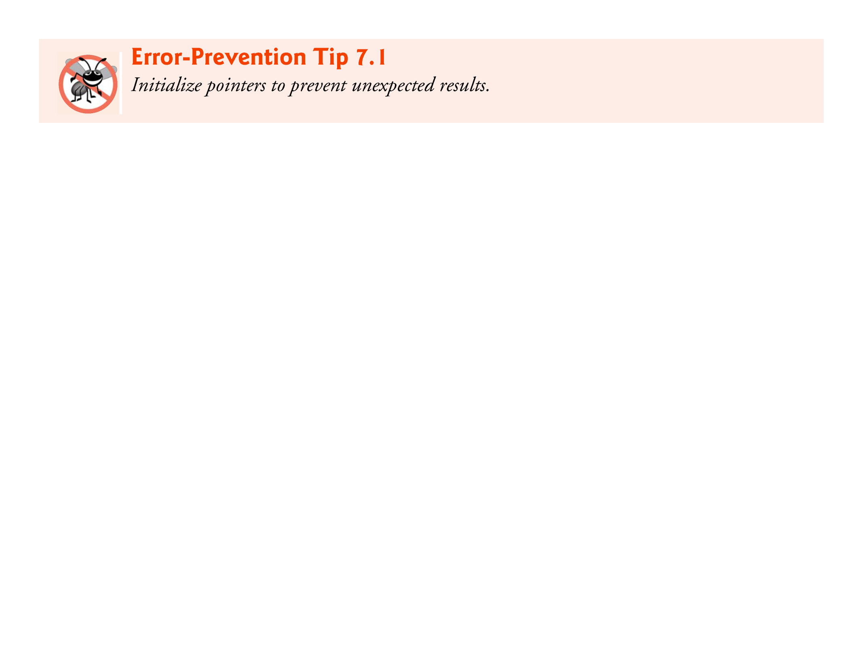

Slide 15
7.3 Pointer Operators
The &, or address operator, is a unary operator that returns the address of its operand.
For example, assuming the definitions
int y = 5; int *yPtr;
the statement
yPtr = &y;
assigns the address of the variable y to pointer variable yPtr.
Variable yPtr is then said to “point to” y.
Figure 7.2 shows a schematic representation of memory after the preceding assignment is executed.

Slide 16
7.3 Pointer Operators (Cont.)
Pointer Representation in Memory
Figure 7.3 shows the representation of the pointer in memory, assuming that integer variable y is stored at location 600000, and pointer variable yPtr is stored at location 500000.
The operand of the address operator must be a variable; the address operator cannot be applied to constants or expressions.

Slide 17
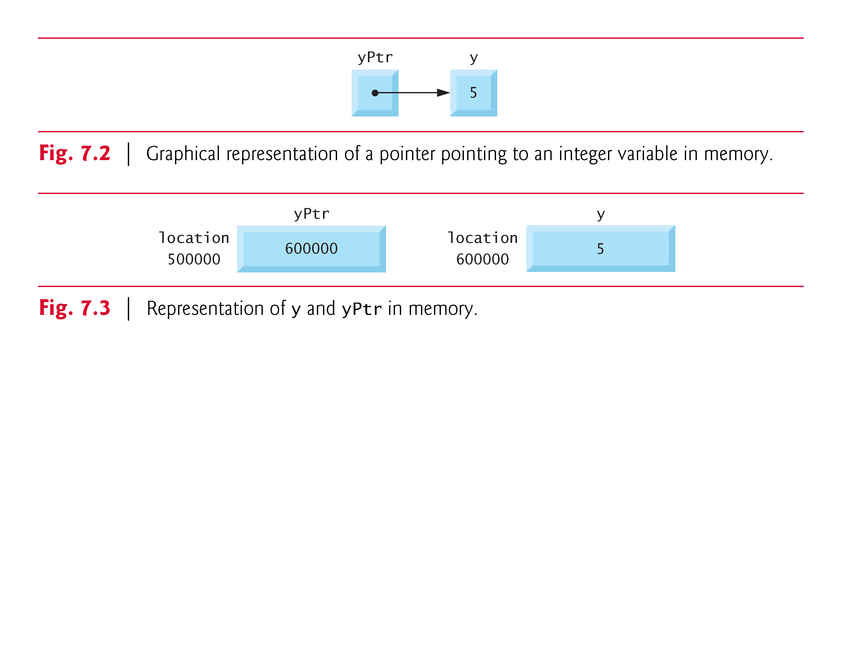

Slide 18
7.3 Pointer Operators (Cont.)
The Indirection (*) Operator
The unary * operator, commonly referred to as the indirection operator or dereferencing operator, returns the value of the object to which its operand (i.e., a pointer) points.
For example, the statement
printf("%d", *yPtr);
prints the value of variable y, namely 5.
Using * in this manner is called dereferencing a pointer.

Slide 19
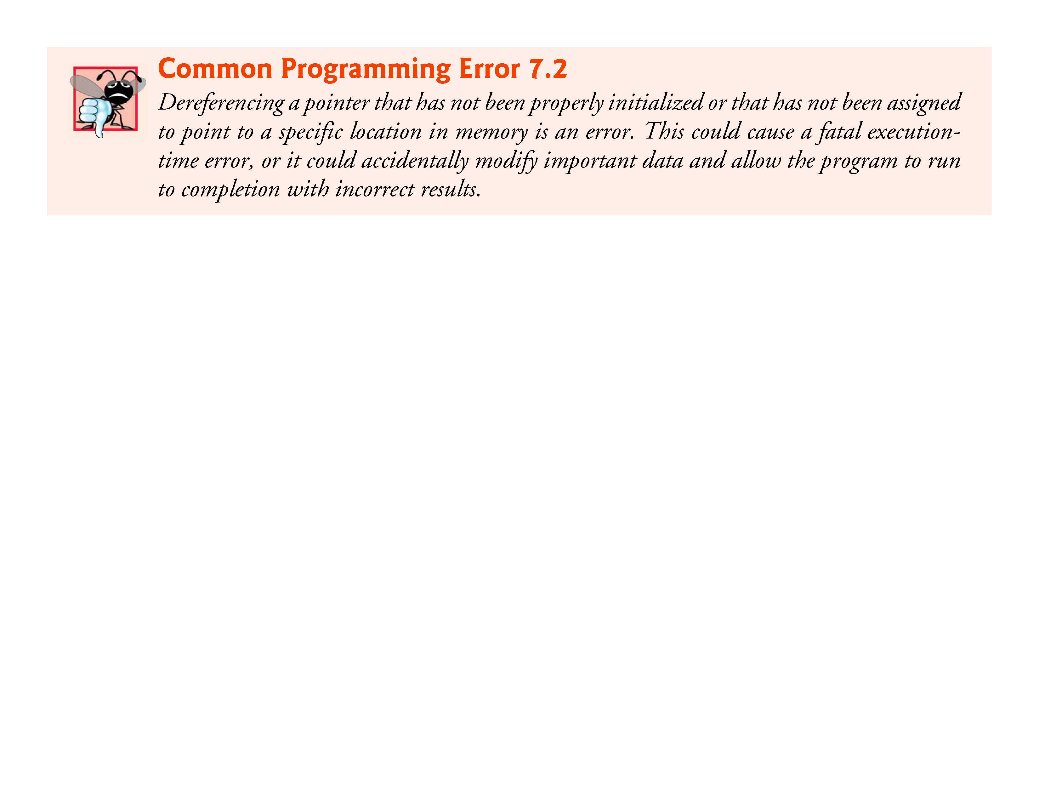

Slide 20
7.3 Pointer Operators (Cont.)
Demonstrating the & and * Operators
Figure 7.4 demonstrates the pointer operators & and *.
The printf conversion specifier %p outputs the memory location as a hexadecimal integer on most platforms.
(See Appendix C, for more information on hexadecimal integers.)
Notice that the address of a and the value of aPtr are identical in the output, thus confirming that the address of a is indeed assigned to the pointer variable aPtr
The & and * operators are complements of one another—when they’re both applied consecutively to aPtr in either order, the same result is printed.
Figure 7.5 lists the precedence and associativity of the operators introduced to this point.

Slide 21
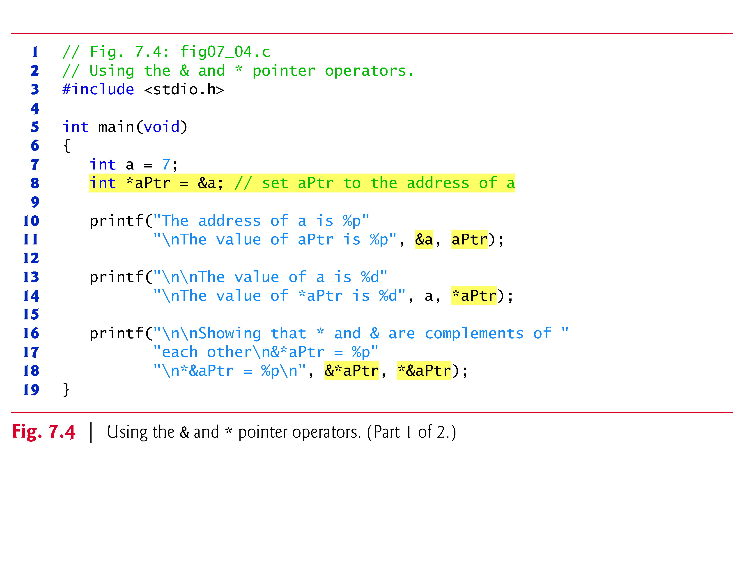

Slide 22
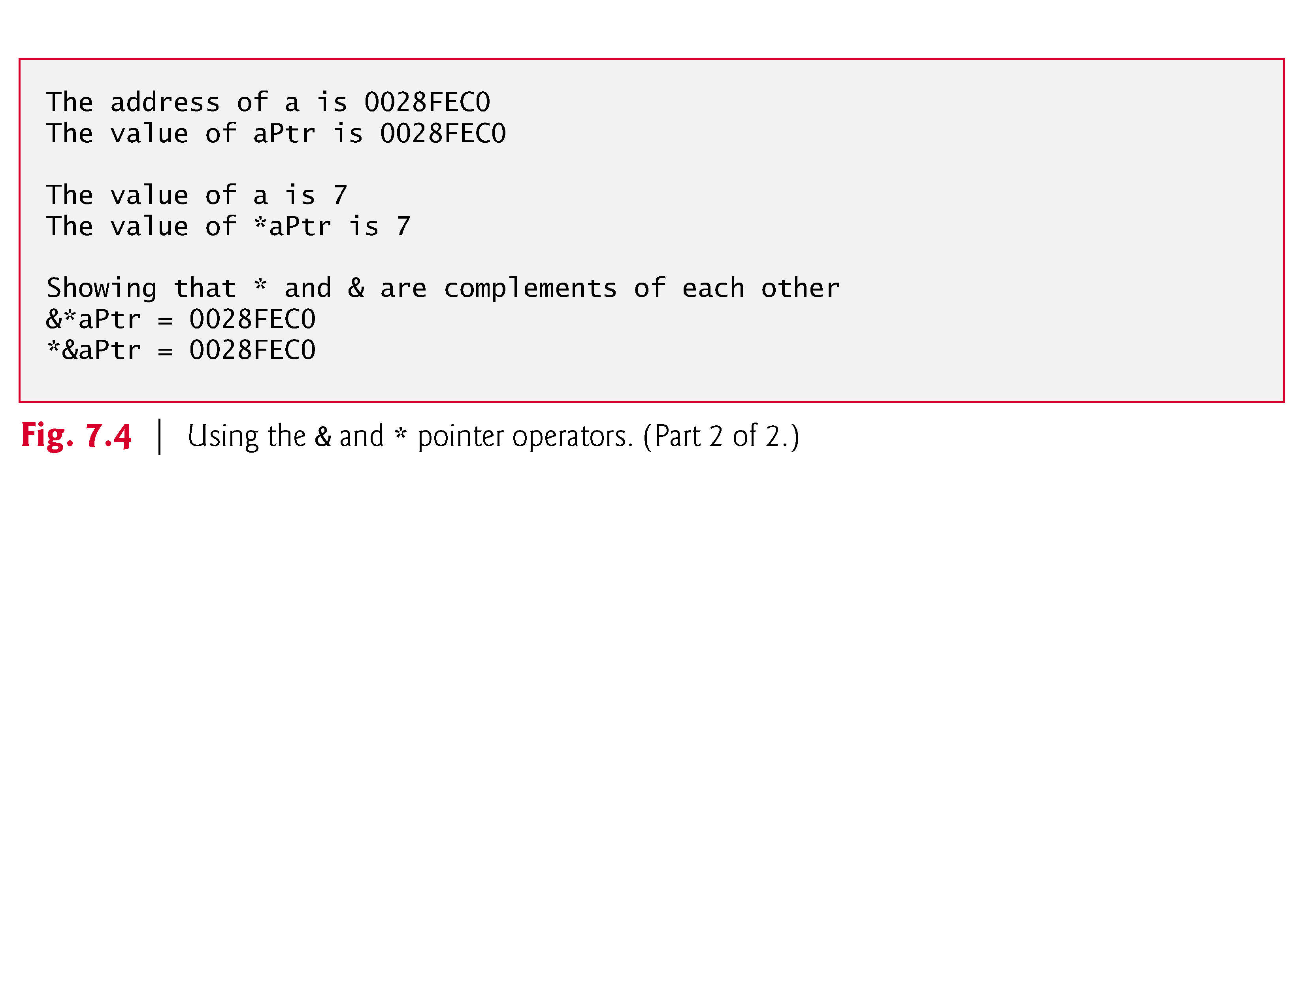

Slide 23
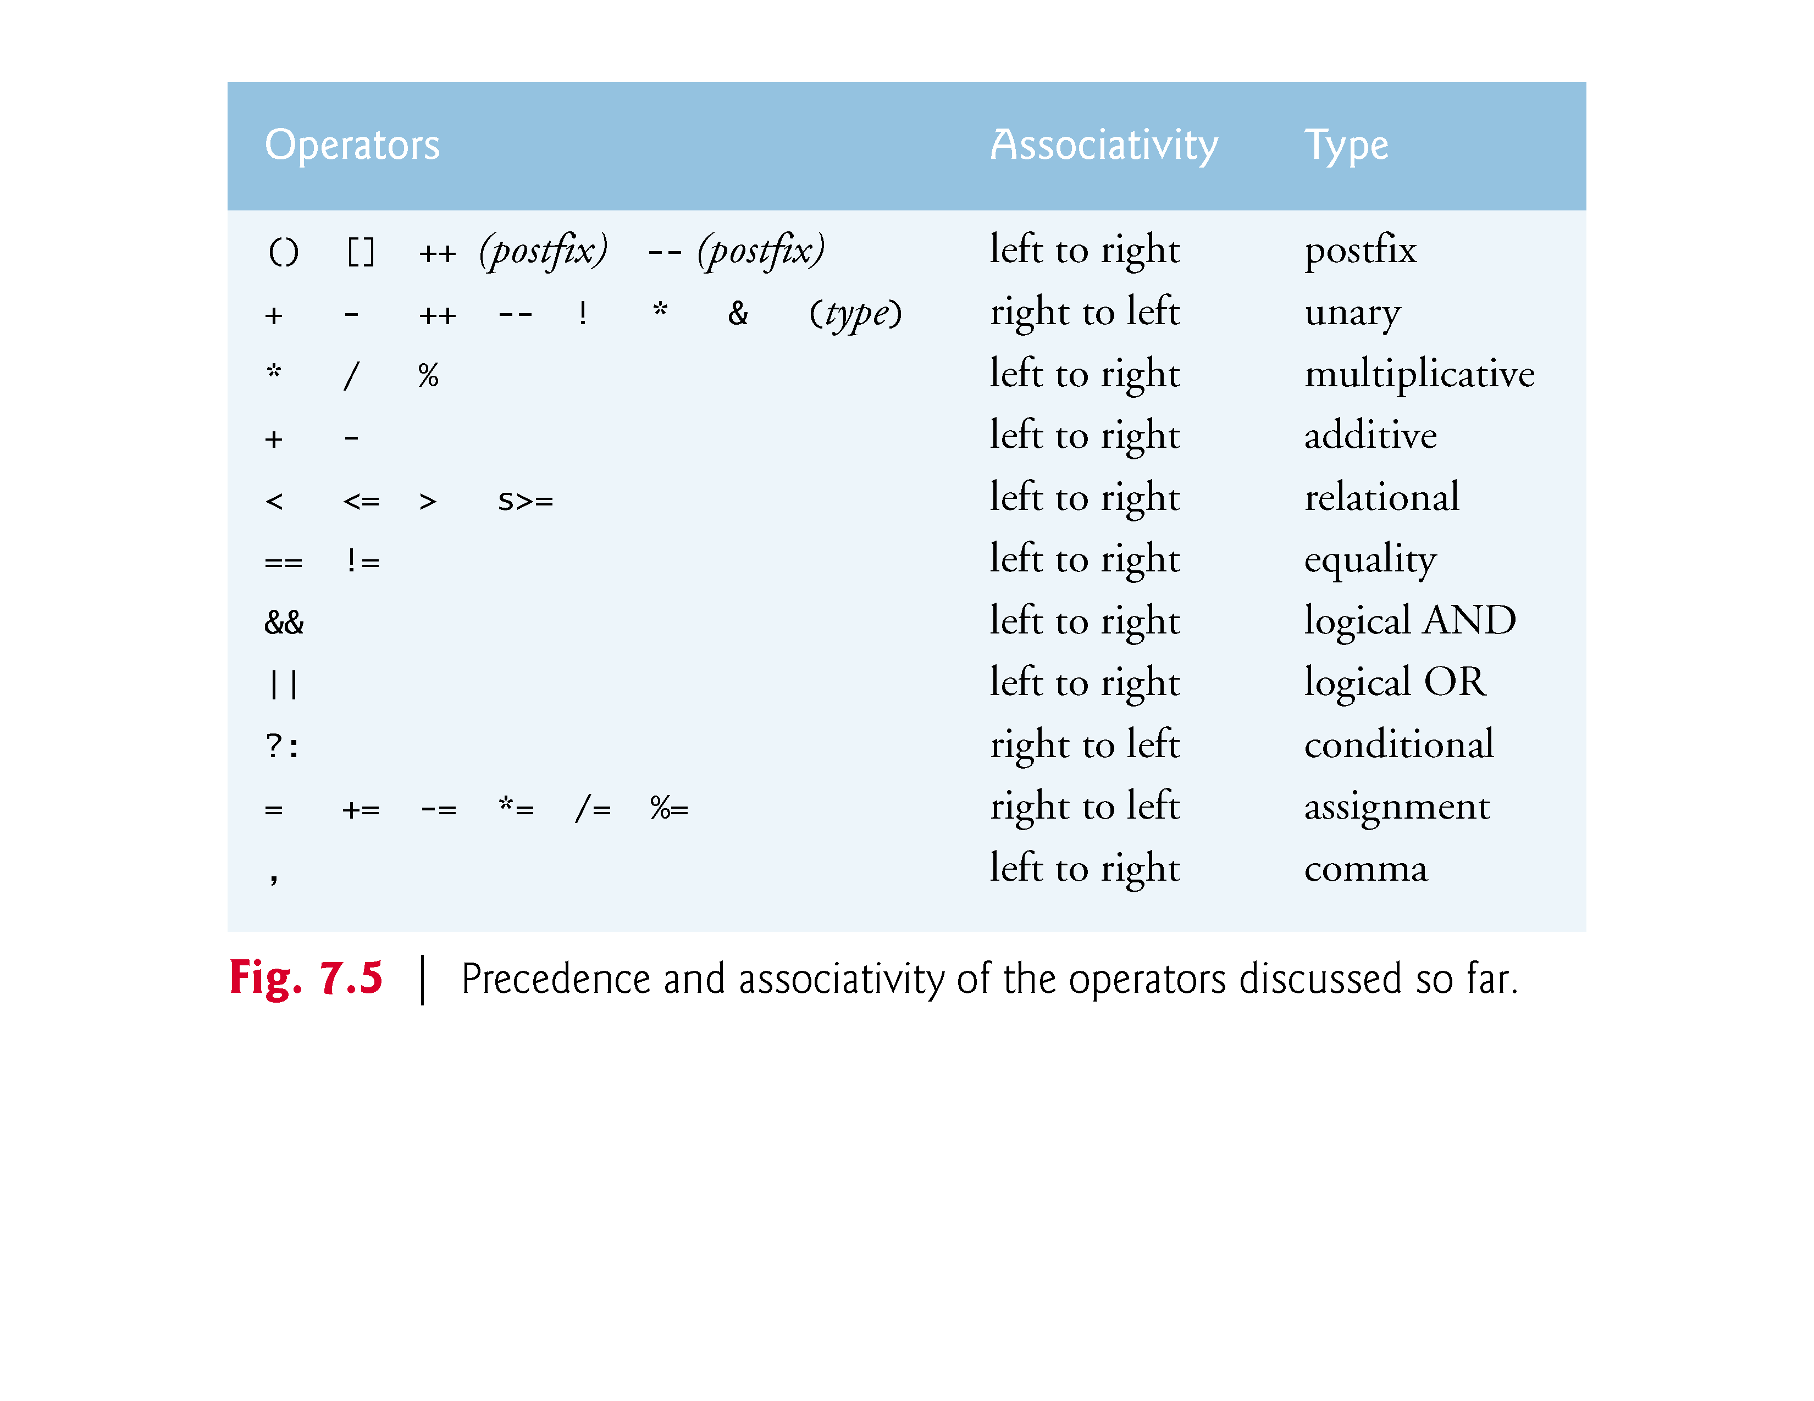

Slide 24
7.4 Passing Arguments to Functions by Reference
There are two ways to pass arguments to a function—pass-by-value and pass-by-reference.
All arguments in C are passed by value.
Many functions require the capability to modify variables in the caller or to pass a pointer to a large data object to avoid the overhead of passing the object by value (which incurs the time and memory overheads of making a copy of the object).
In C, you use pointers and the indirection operator to simulate pass-by-reference.

Slide 25
7.4 Passing Arguments to Functions by Reference (Cont.)
When calling a function with arguments that should be modified, the addresses of the arguments are passed.
This is normally accomplished by applying the address operator (&) to the variable (in the caller) whose value will be modified.
As we saw in Chapter 6, arrays are not passed using operator & because C automatically passes the starting location in memory of the array (the name of an array is equivalent to &arrayName[0]).
When the address of a variable is passed to a function, the indirection operator (*) may be used in the function to modify the value at that location in the caller’s memory.

Slide 26
7.4 Passing Arguments to Functions by Reference (Cont.)
Pass-By-Value
The programs in Fig. 7.6 and Fig. 7.7 present two versions of a function that cubes an integer—cubeByValue and cubeByReference.
Figure 7.6 passes the variable number by value to function cubeByValue
The cubeByValue function cubes its argument and passes the new value back to main using a return statement.
The new value is assigned to number in main

Slide 27
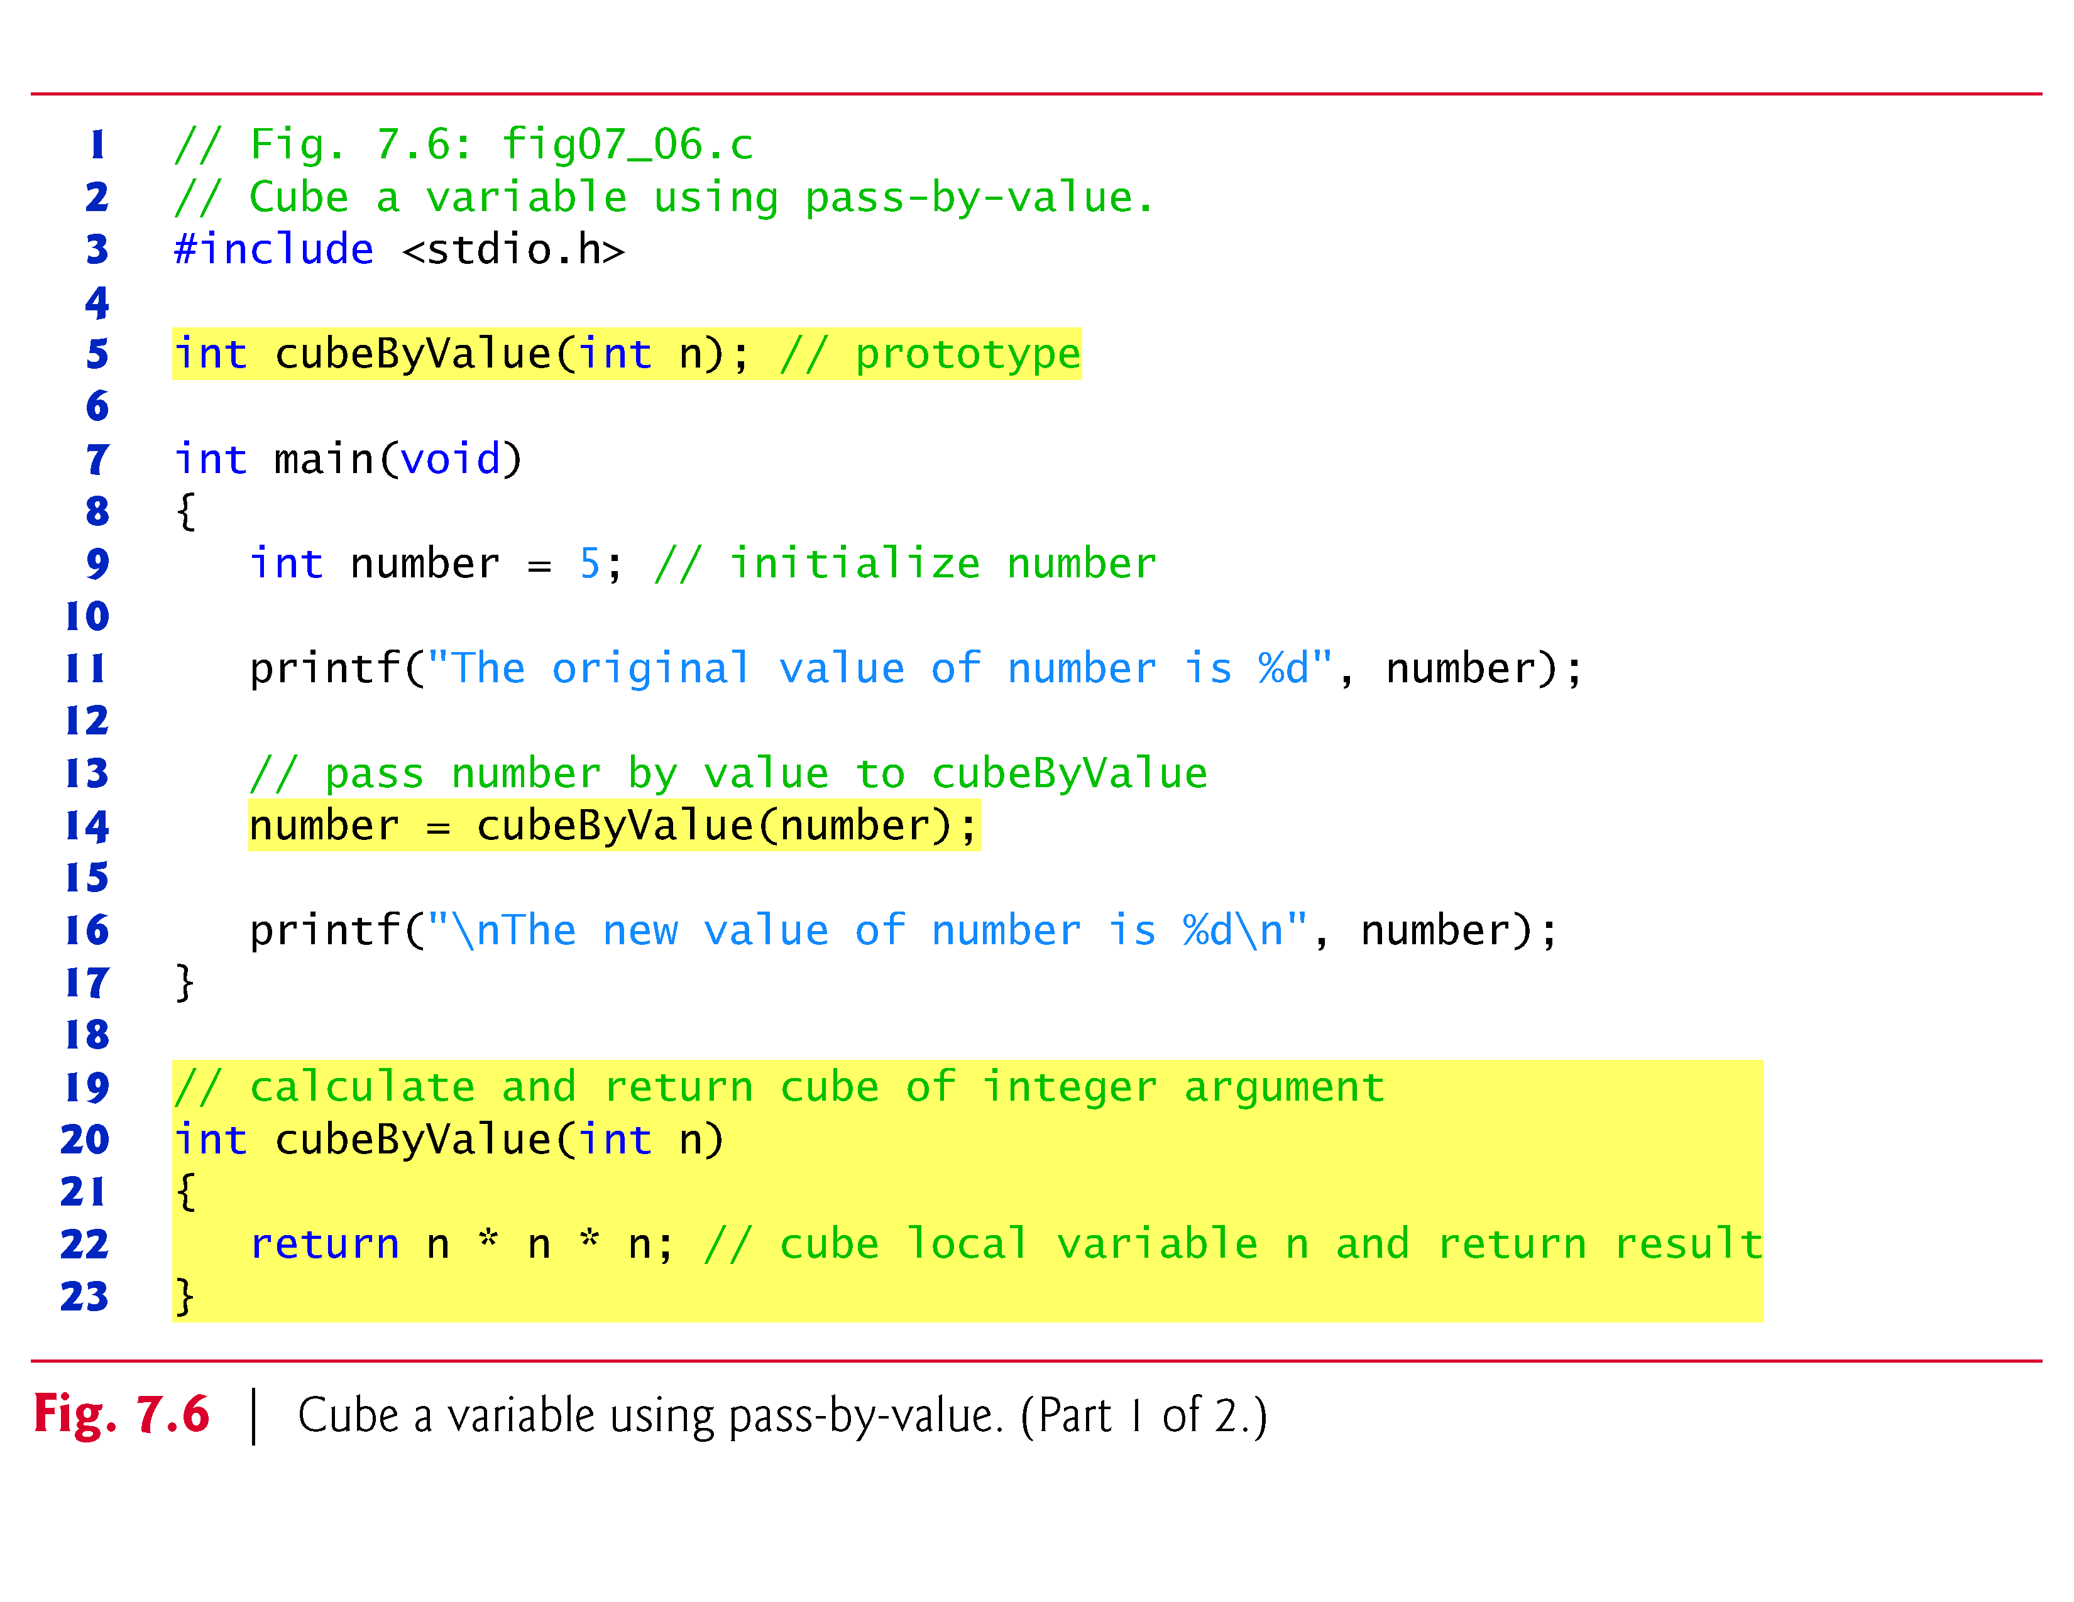

Slide 28
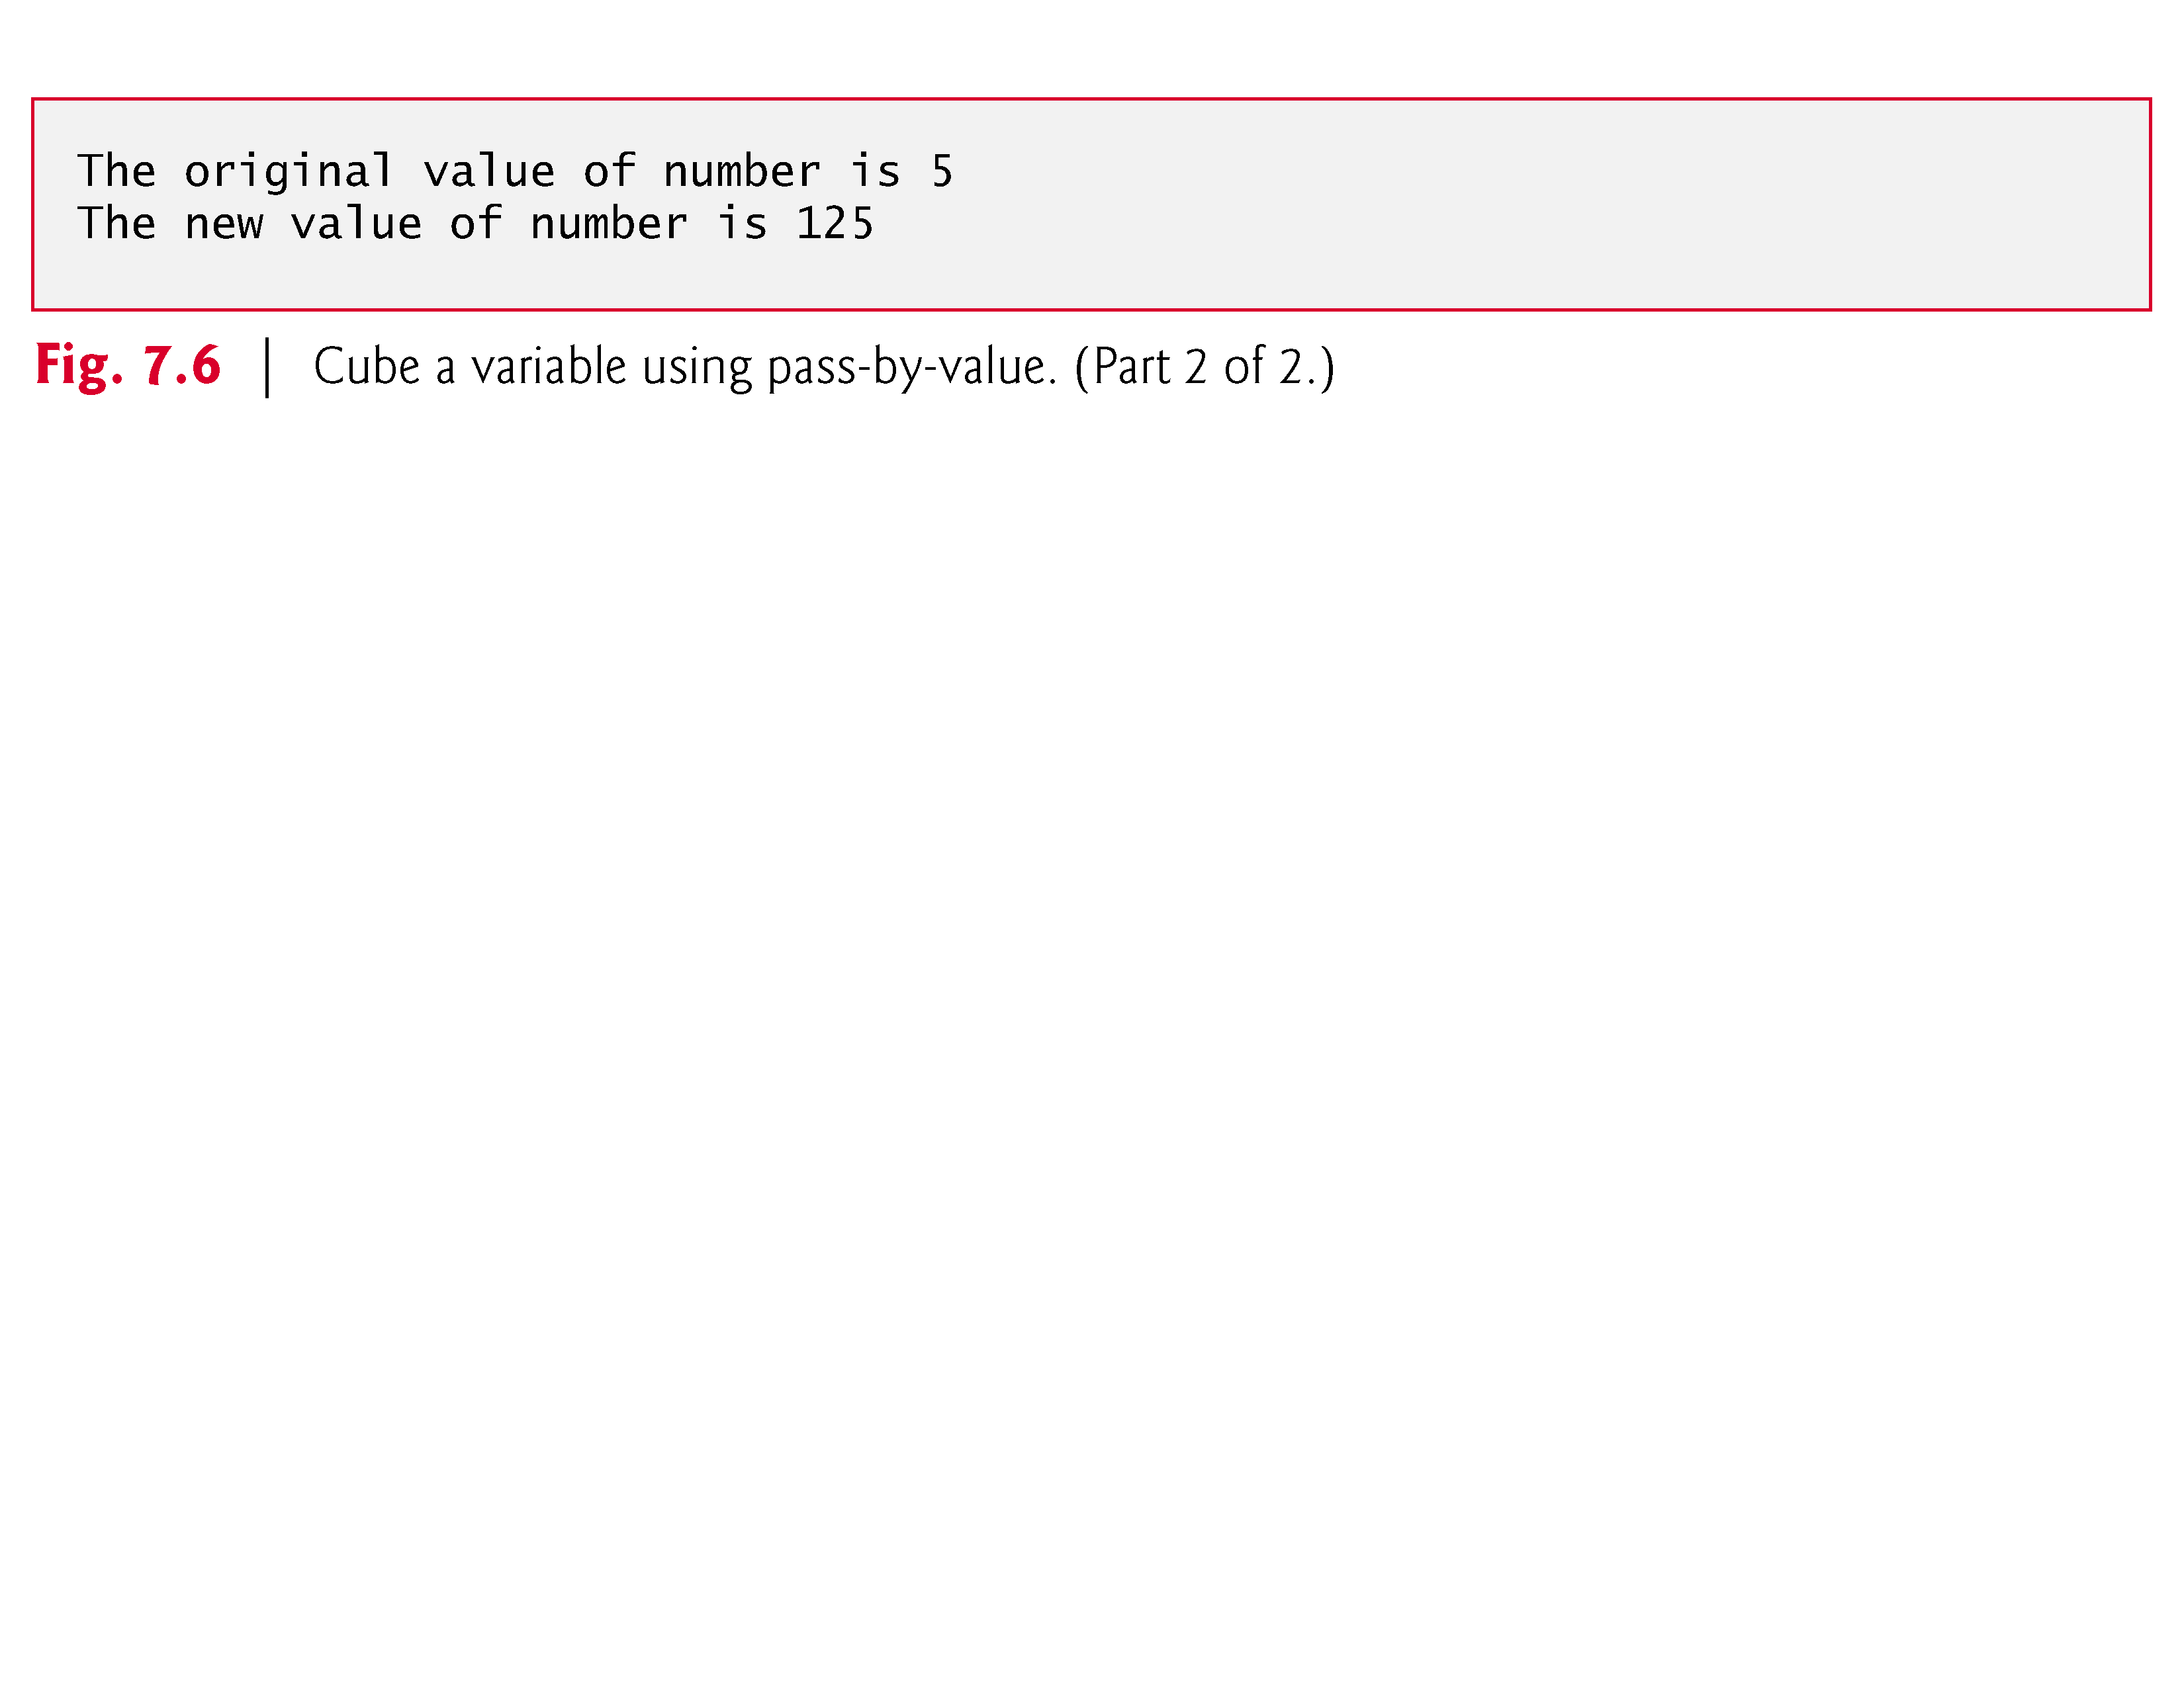

Slide 29
7.4 Passing Arguments to Functions by Reference (Cont.)
Pass-By-Reference
Figure 7.7 passes the variable number by reference—the address of number is passed—to function cubeByReference.
Function cubeByReference takes as a parameter a pointer to an int called nPtr.
The function dereferences the pointer and cubes the value to which nPtr points, then assigns the result to *nPtr (which is really number in main), thus changing the value of number in main.
Figure 7.8 and Fig. 7.9 analyze graphically and step-by-step the programs in Fig. 7.6 and Fig. 7.7, respectively.

Slide 30
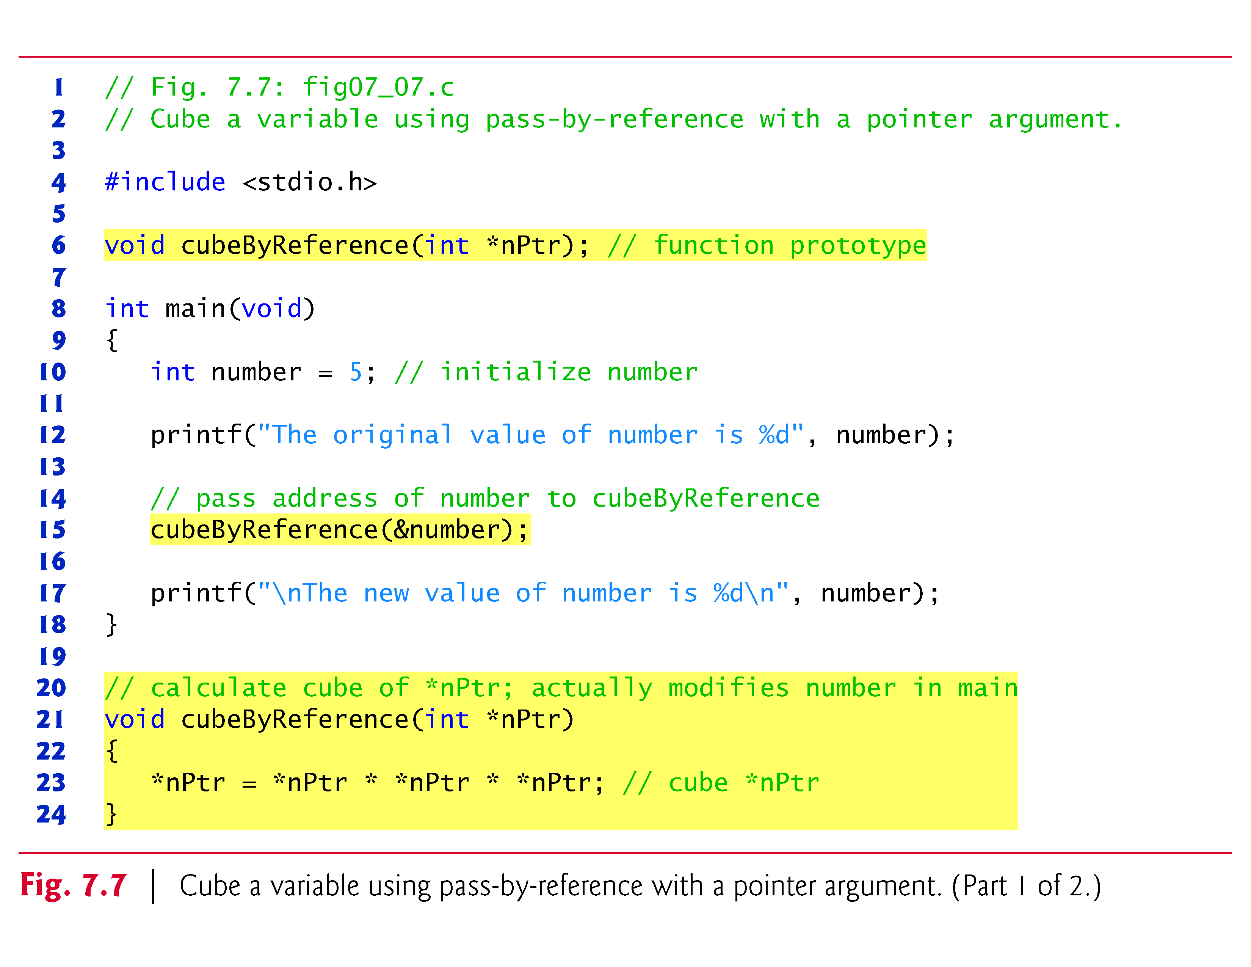

Slide 31
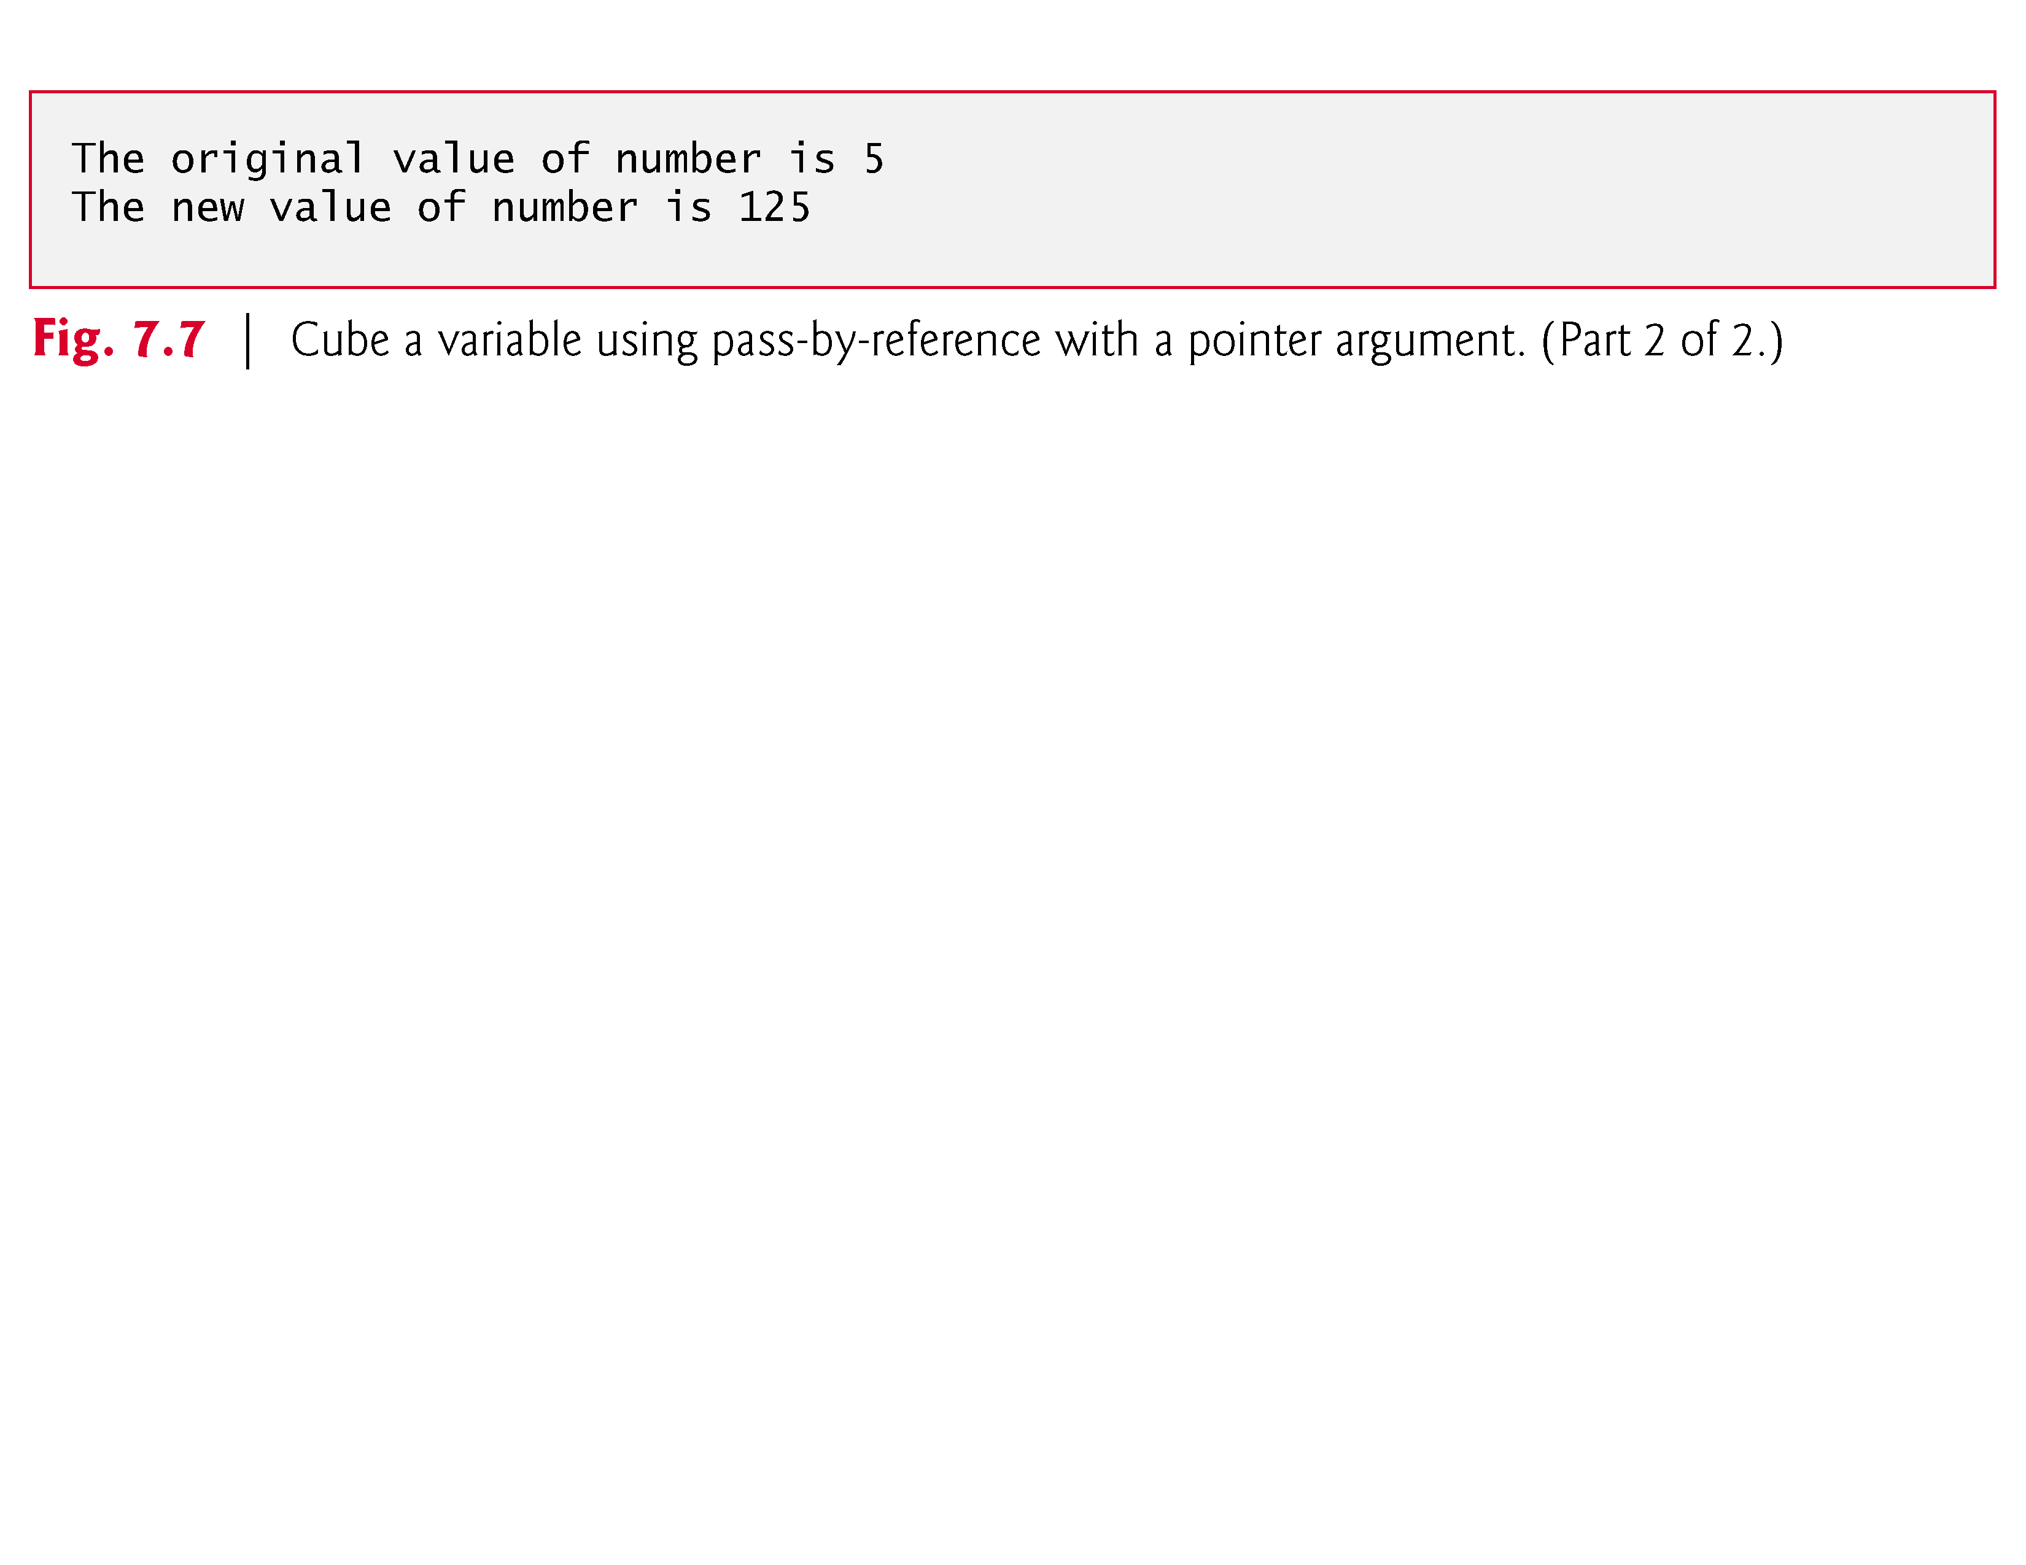

Slide 32
7.4 Passing Arguments to Functions by Reference (Cont.)
A function receiving an address as an argument must define a pointer parameter to receive the address.
For example, in Fig. 7.7 the header for function cubeByReference is:
void cubeByReference(int *nPtr)
The header specifies that cubeByReference receives the address of an integer variable as an argument, stores the address locally in nPtr and does not return a value.
The function prototype for cubeByReference contains int * in parentheses.
Names included for documentation purposes are ignored by the C compiler.

Slide 33
7.4 Passing Arguments to Functions by Reference (Cont.)
For a function that expects a one-dimensional array as an argument, the function’s prototype and header can use the pointer notation shown in the parameter list of function cubeByReference.
The compiler does not differentiate between a function that receives a pointer and one that receives a one-dimensional array.
This, of course, means that the function must “know” when it’s receiving an array or simply a single variable for which it’s to perform pass-by-reference.
When the compiler encounters a function parameter for a one-dimensional array of the form int b[], the compiler converts the parameter to the pointer notation int *b.
The two forms are interchangeable.

Slide 34
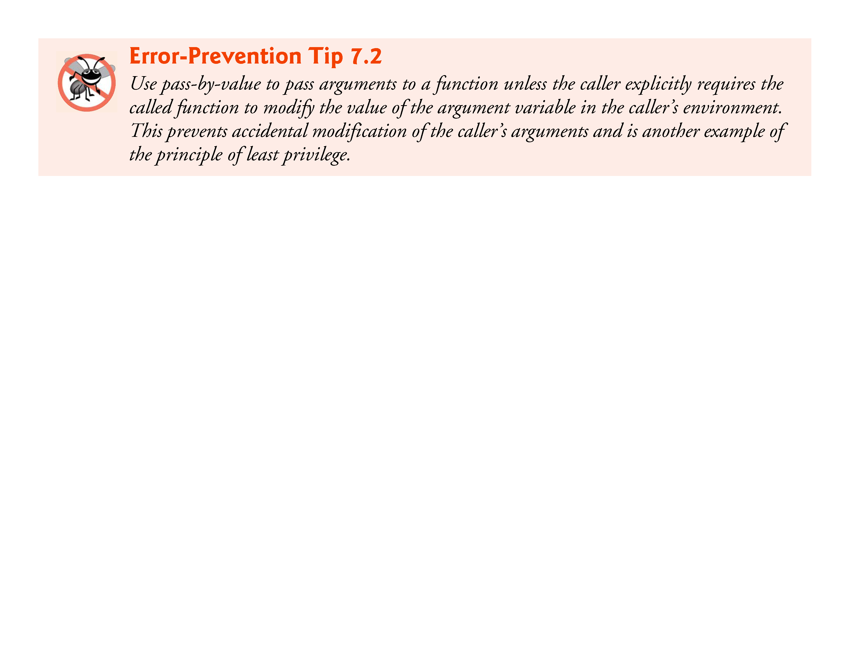

Slide 35
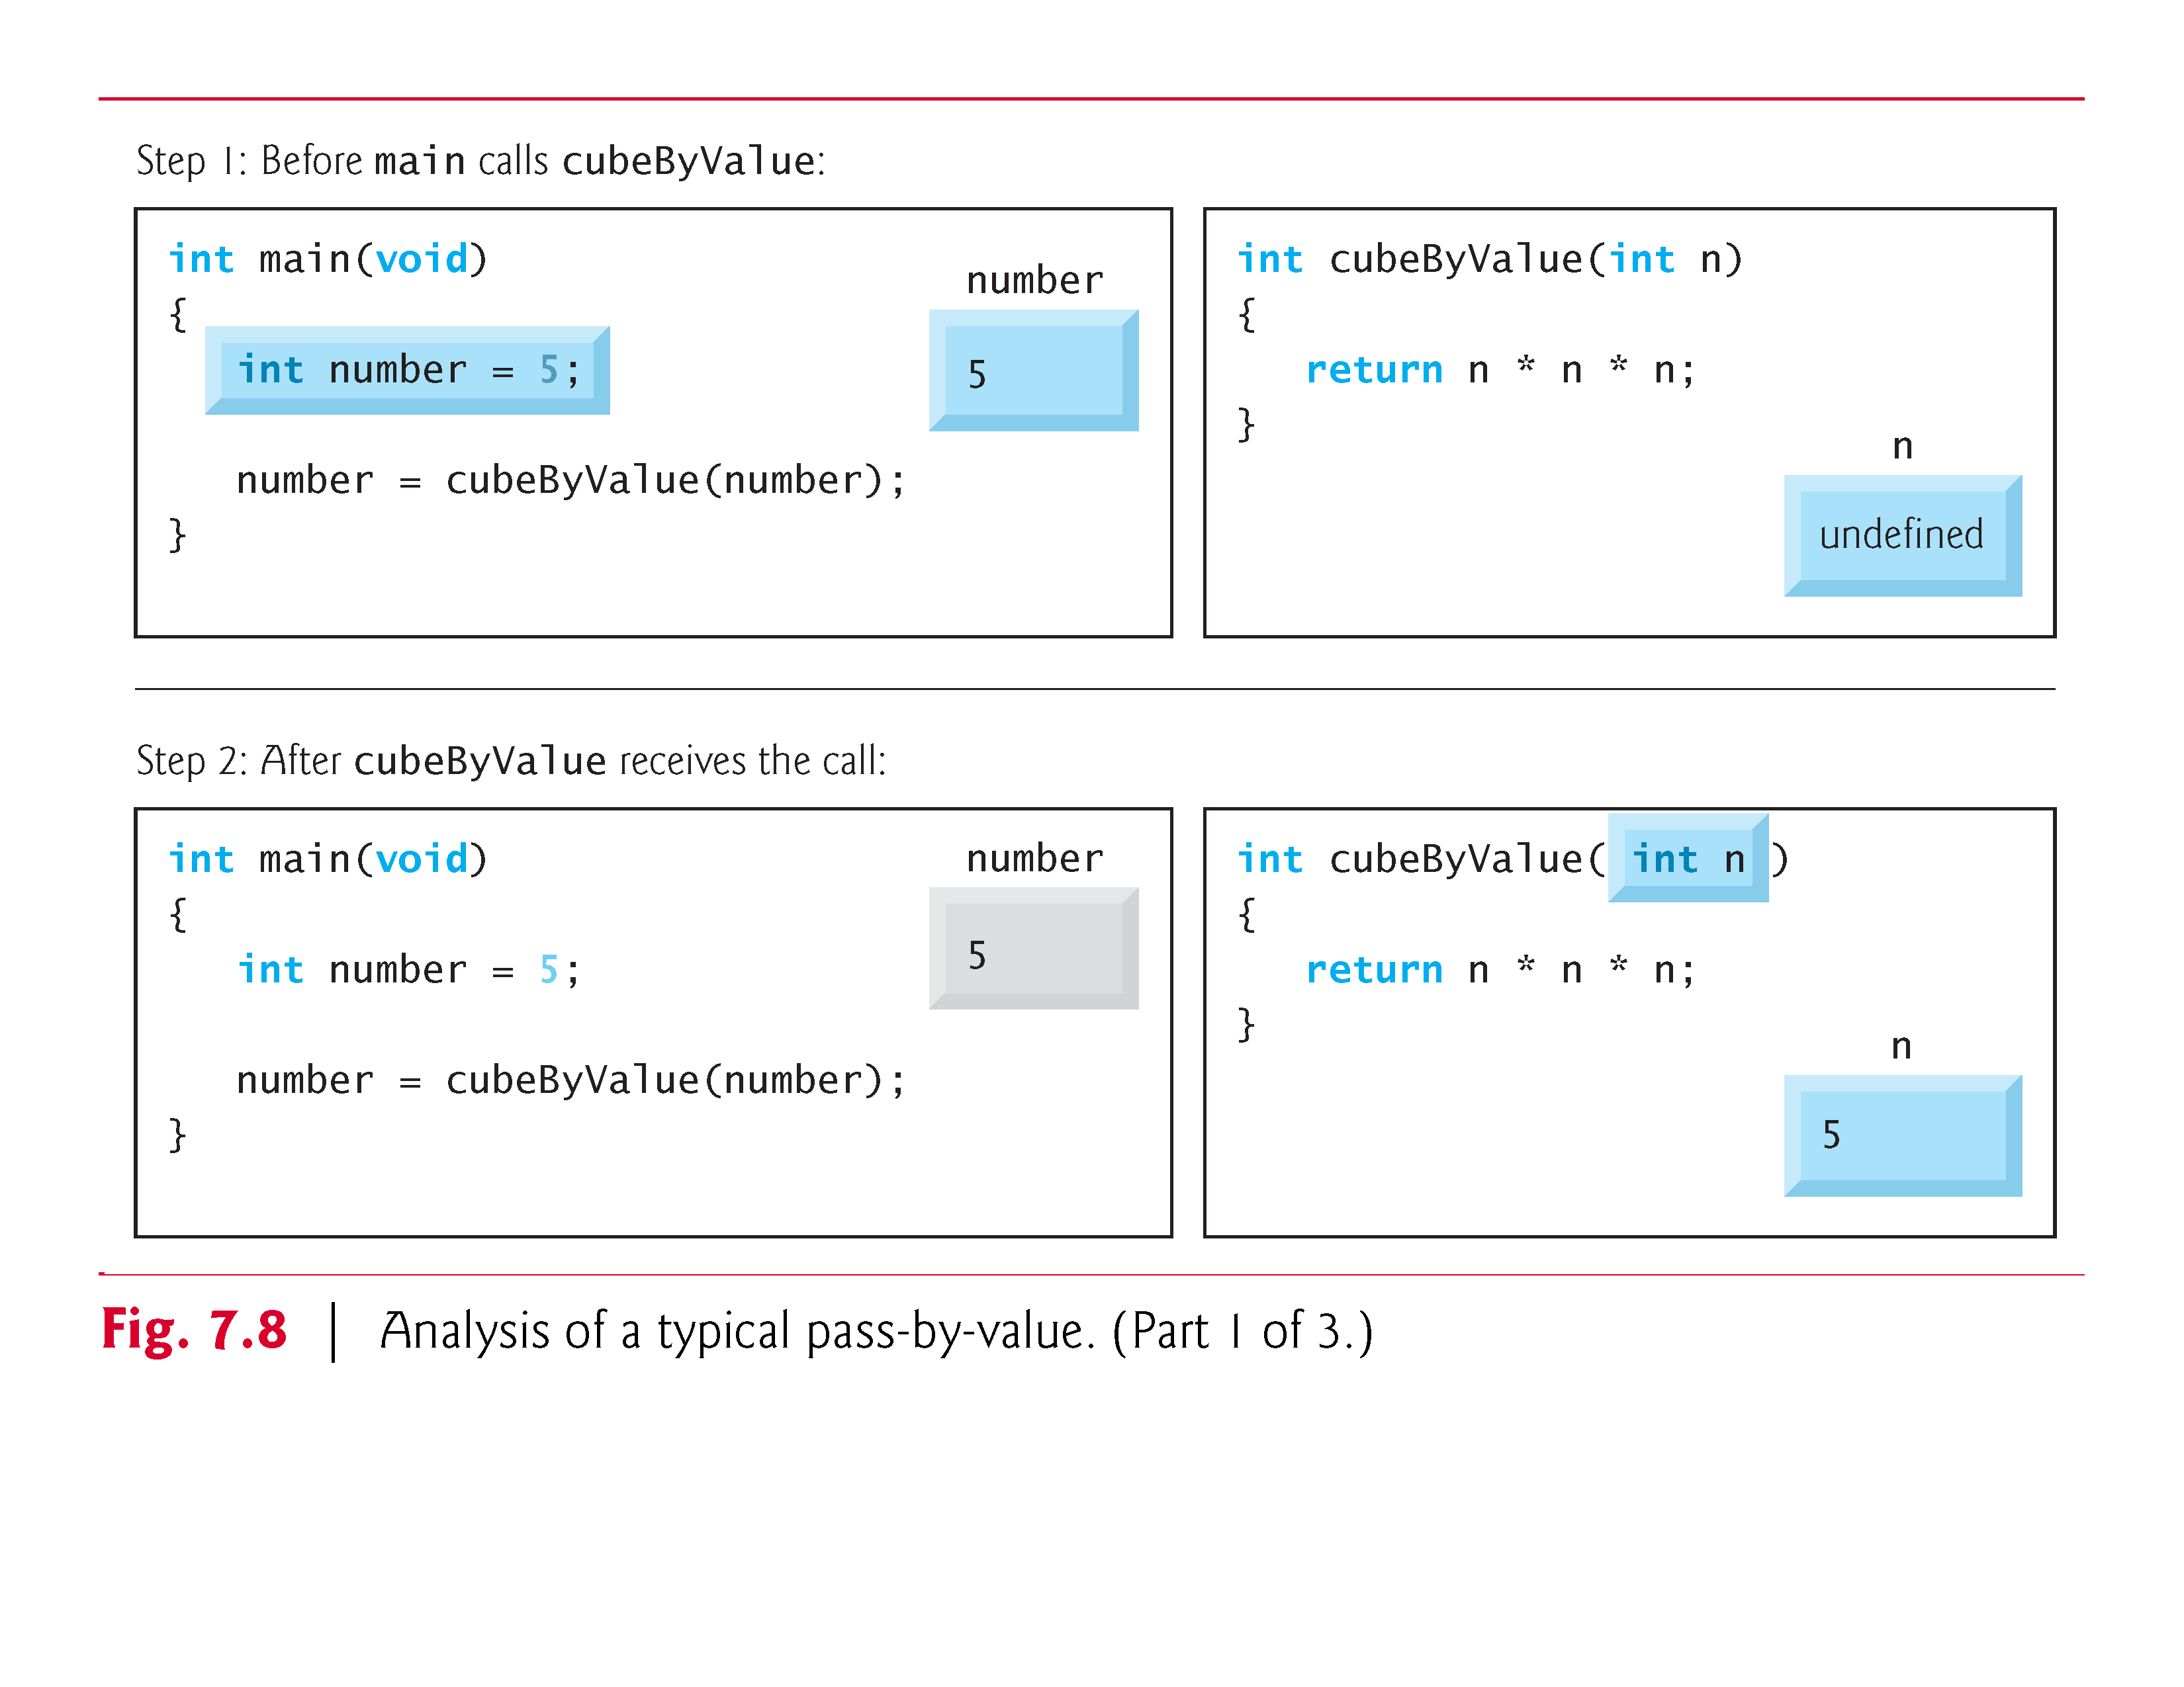

Slide 36
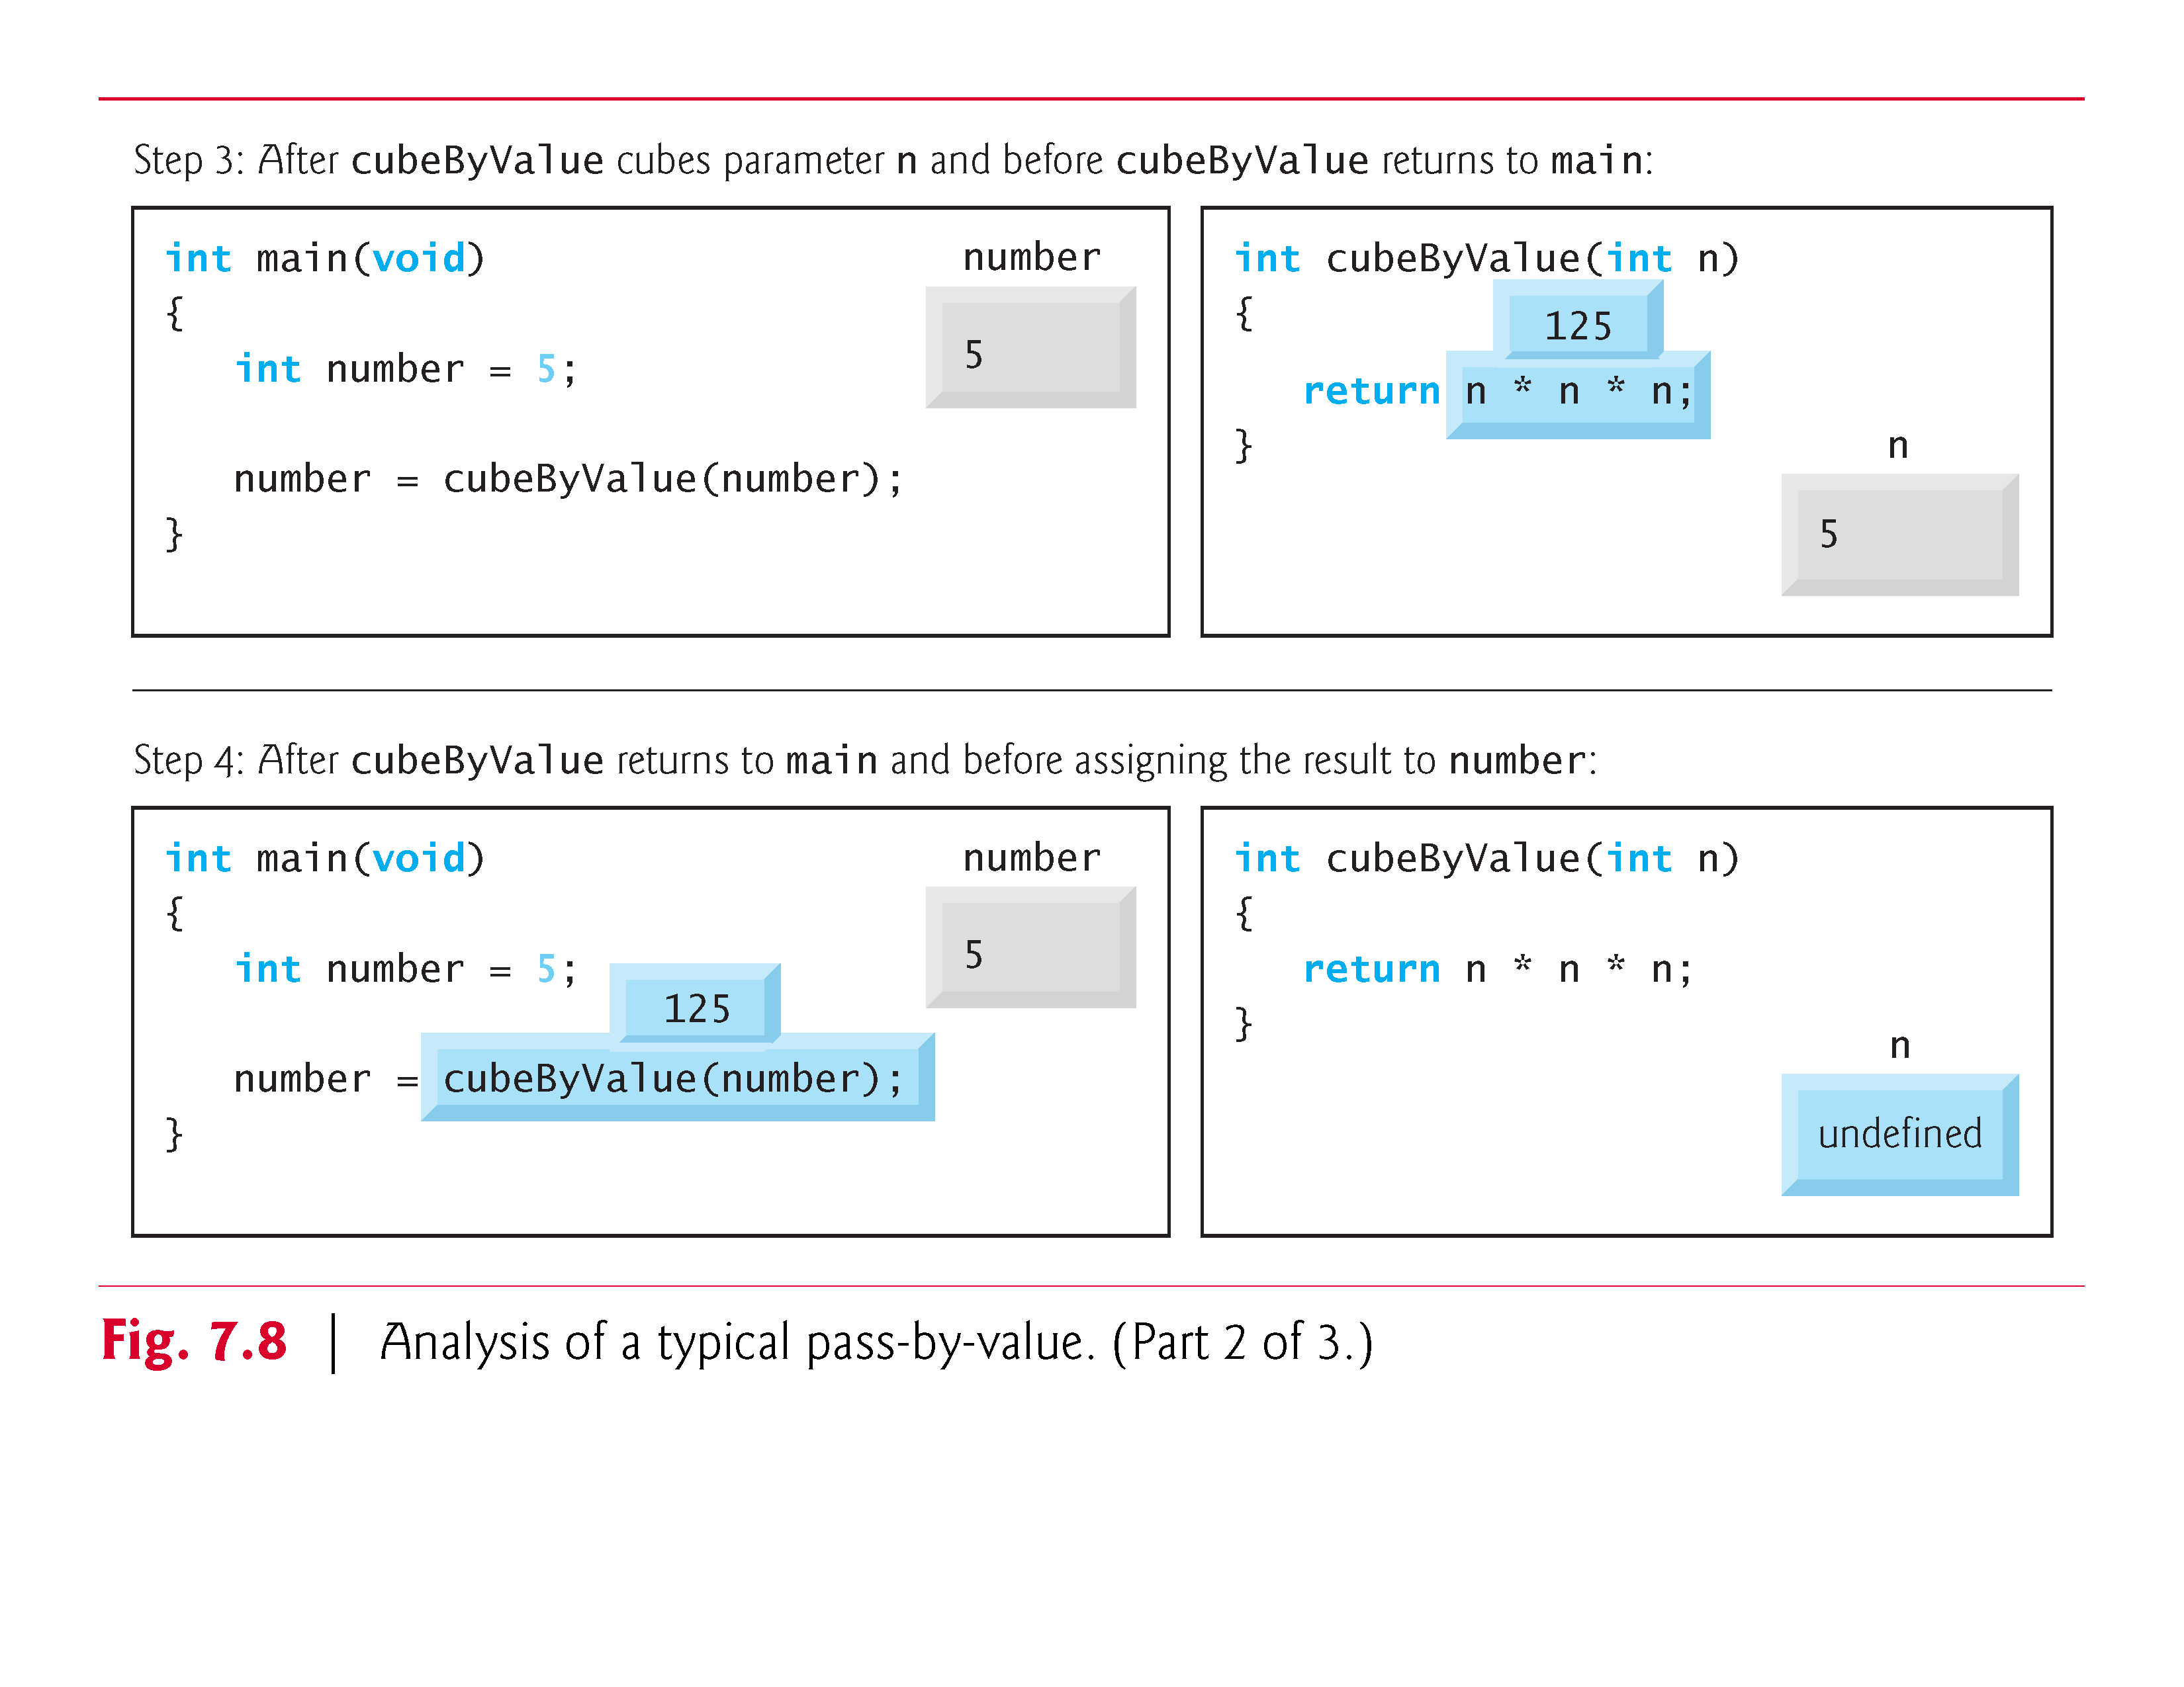

Slide 37
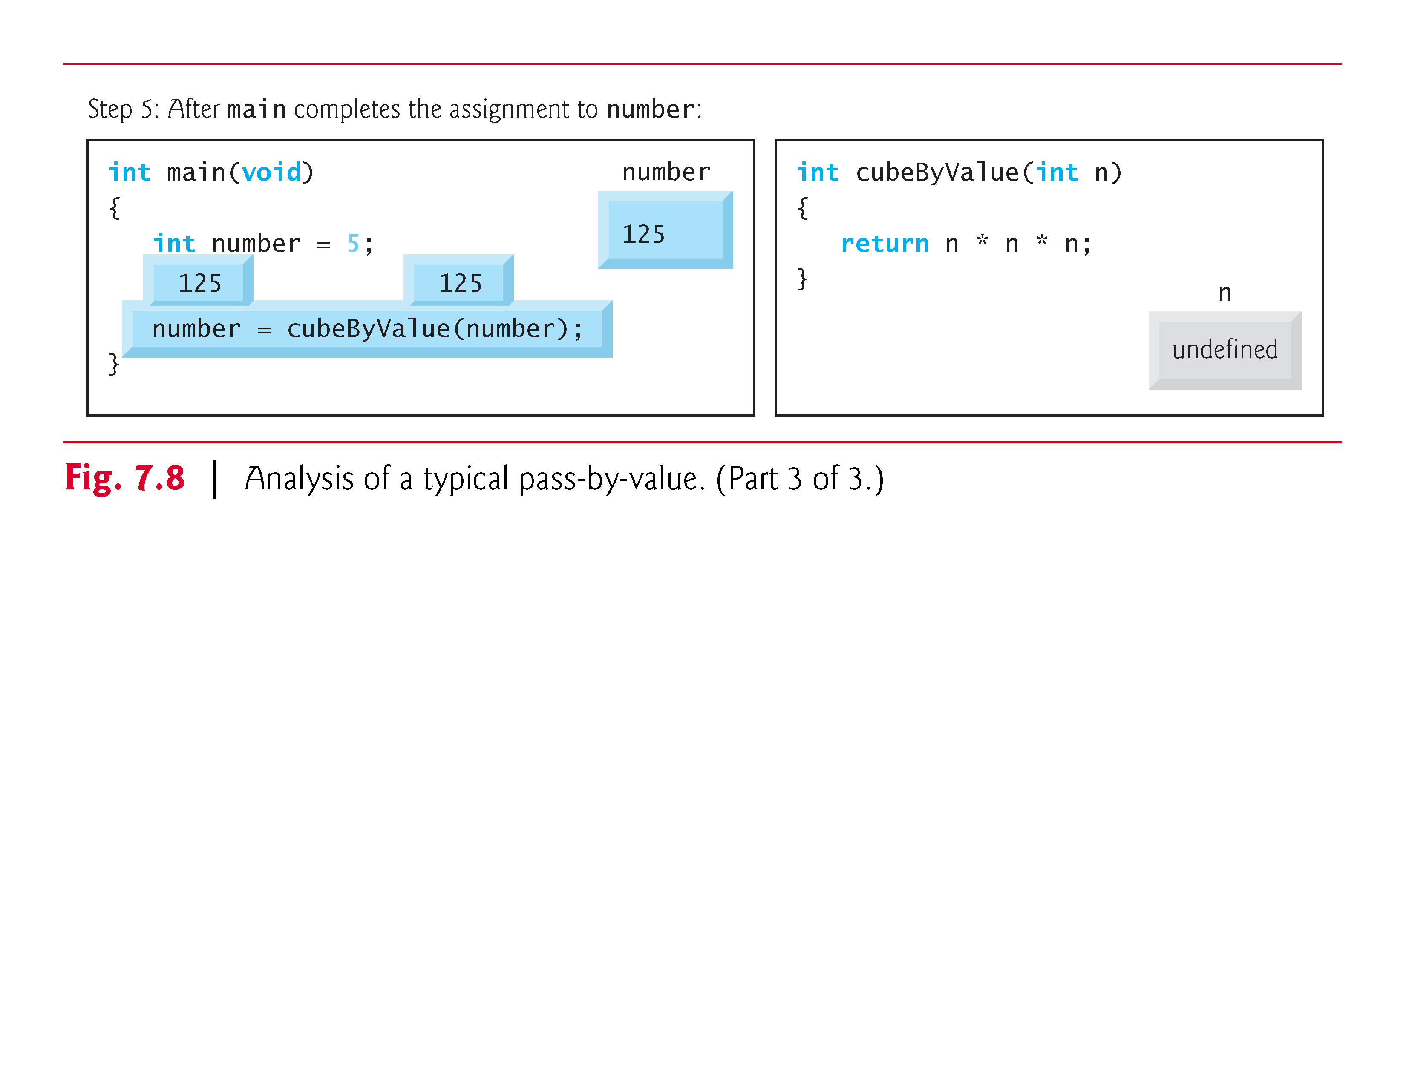

Slide 38
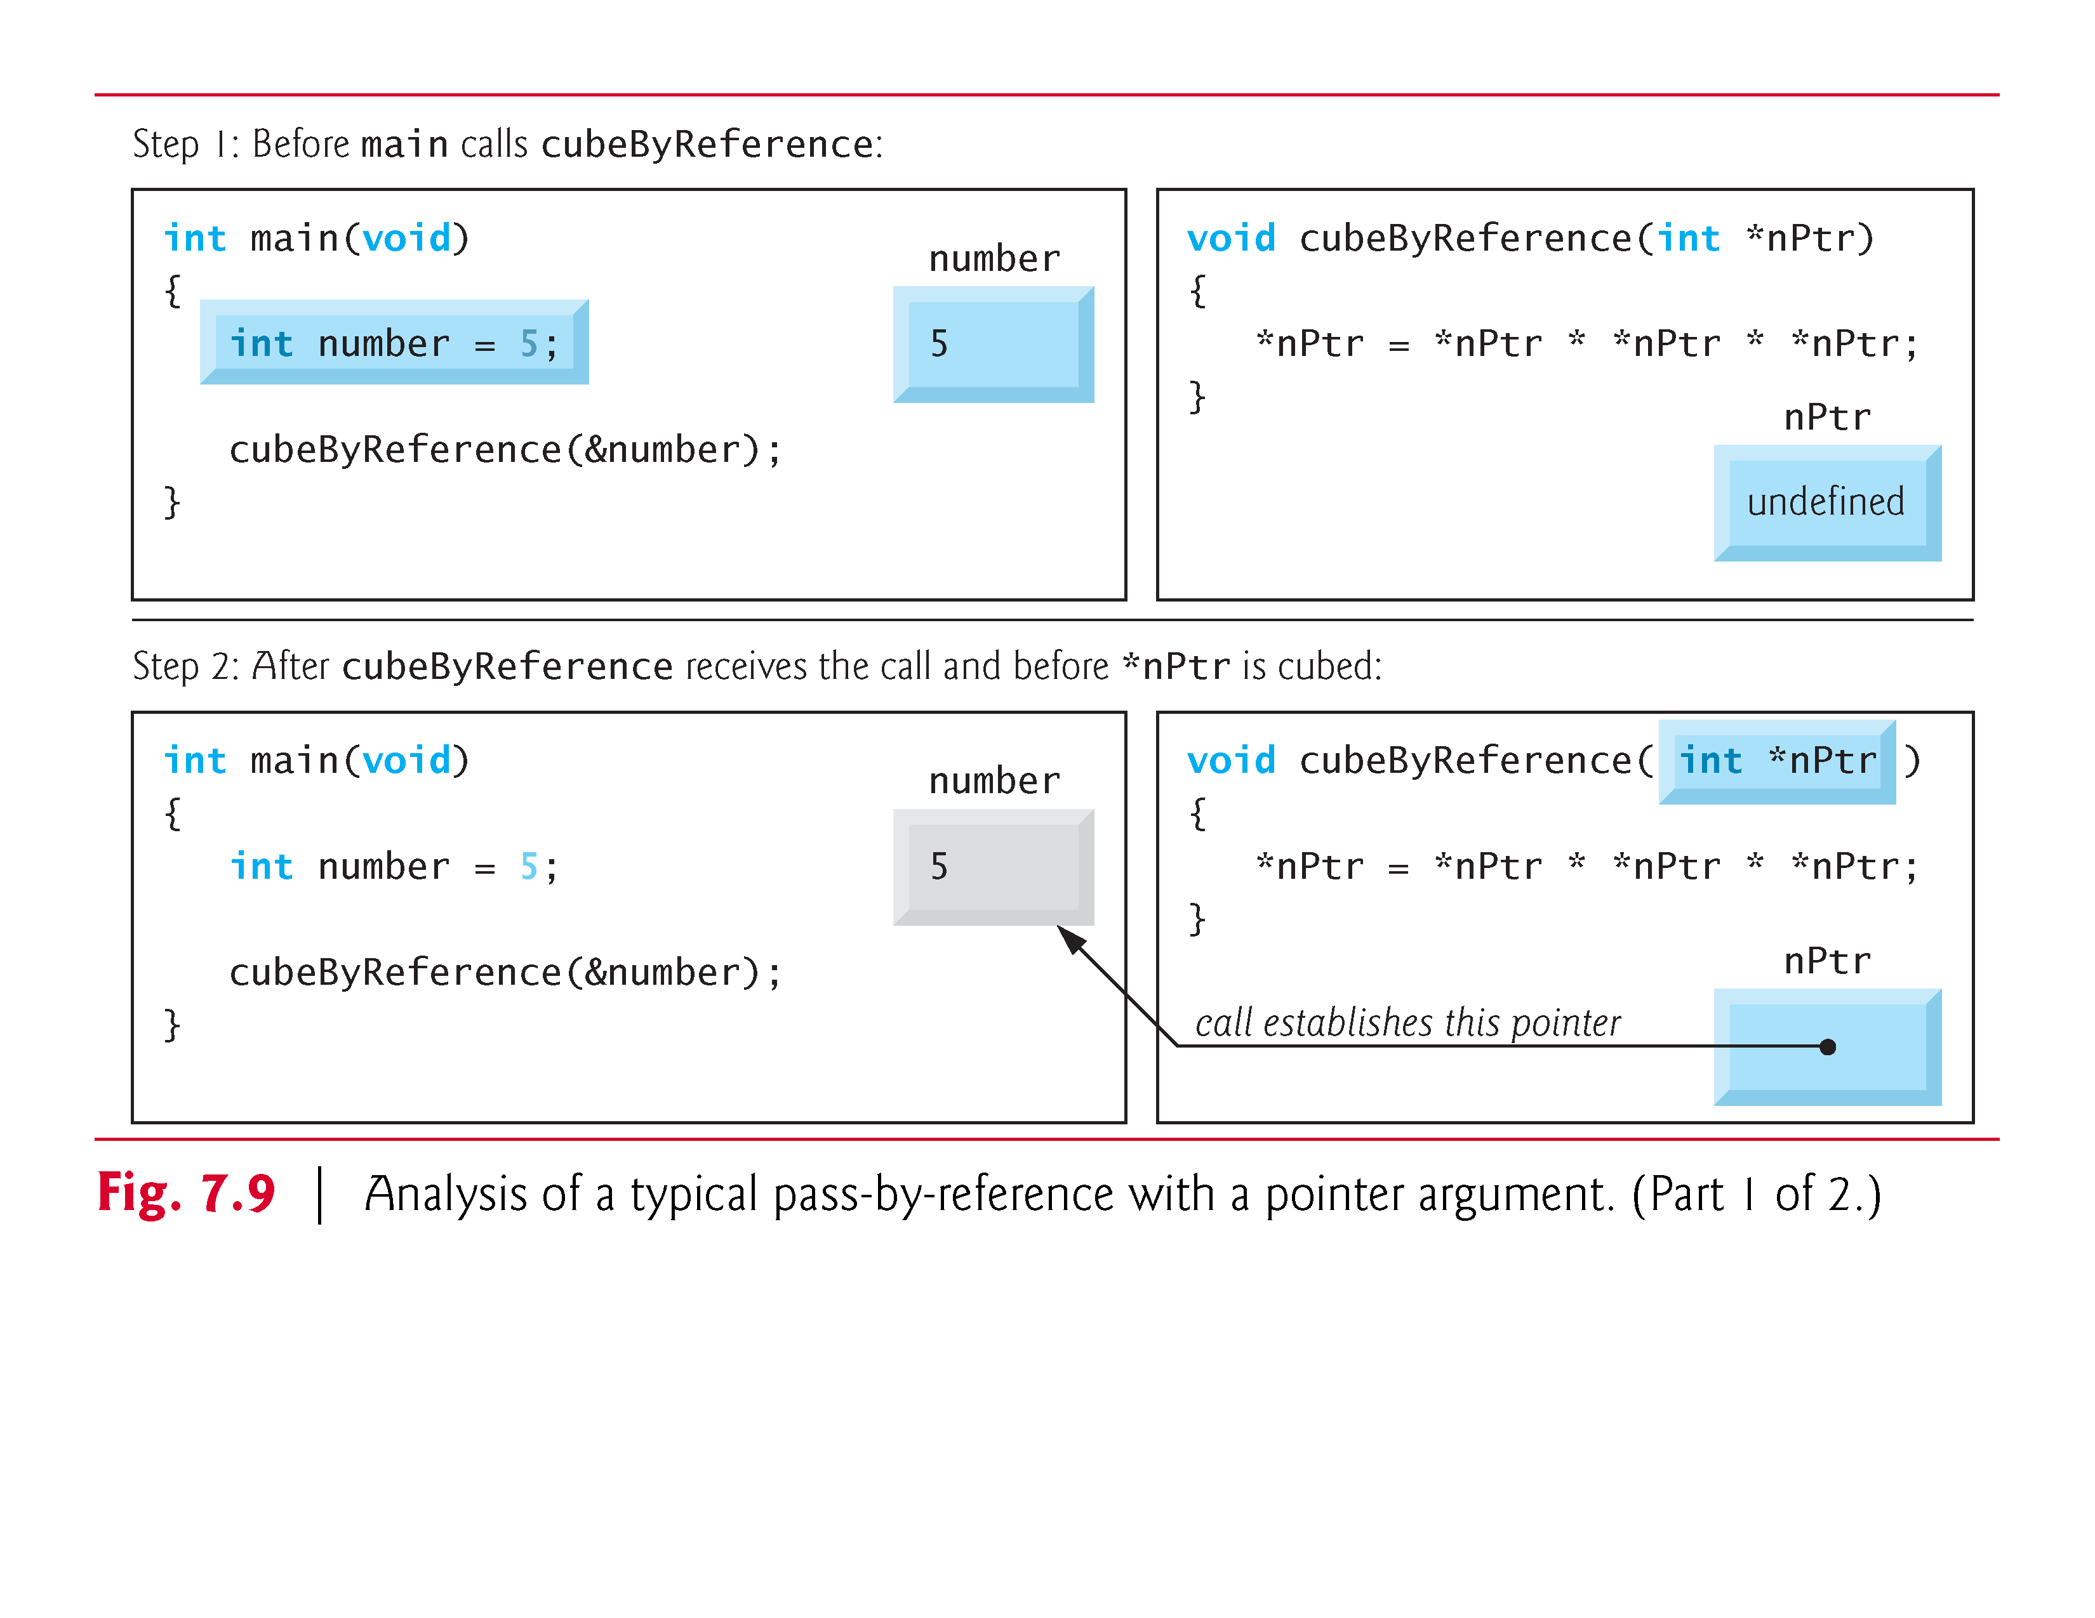

Slide 39
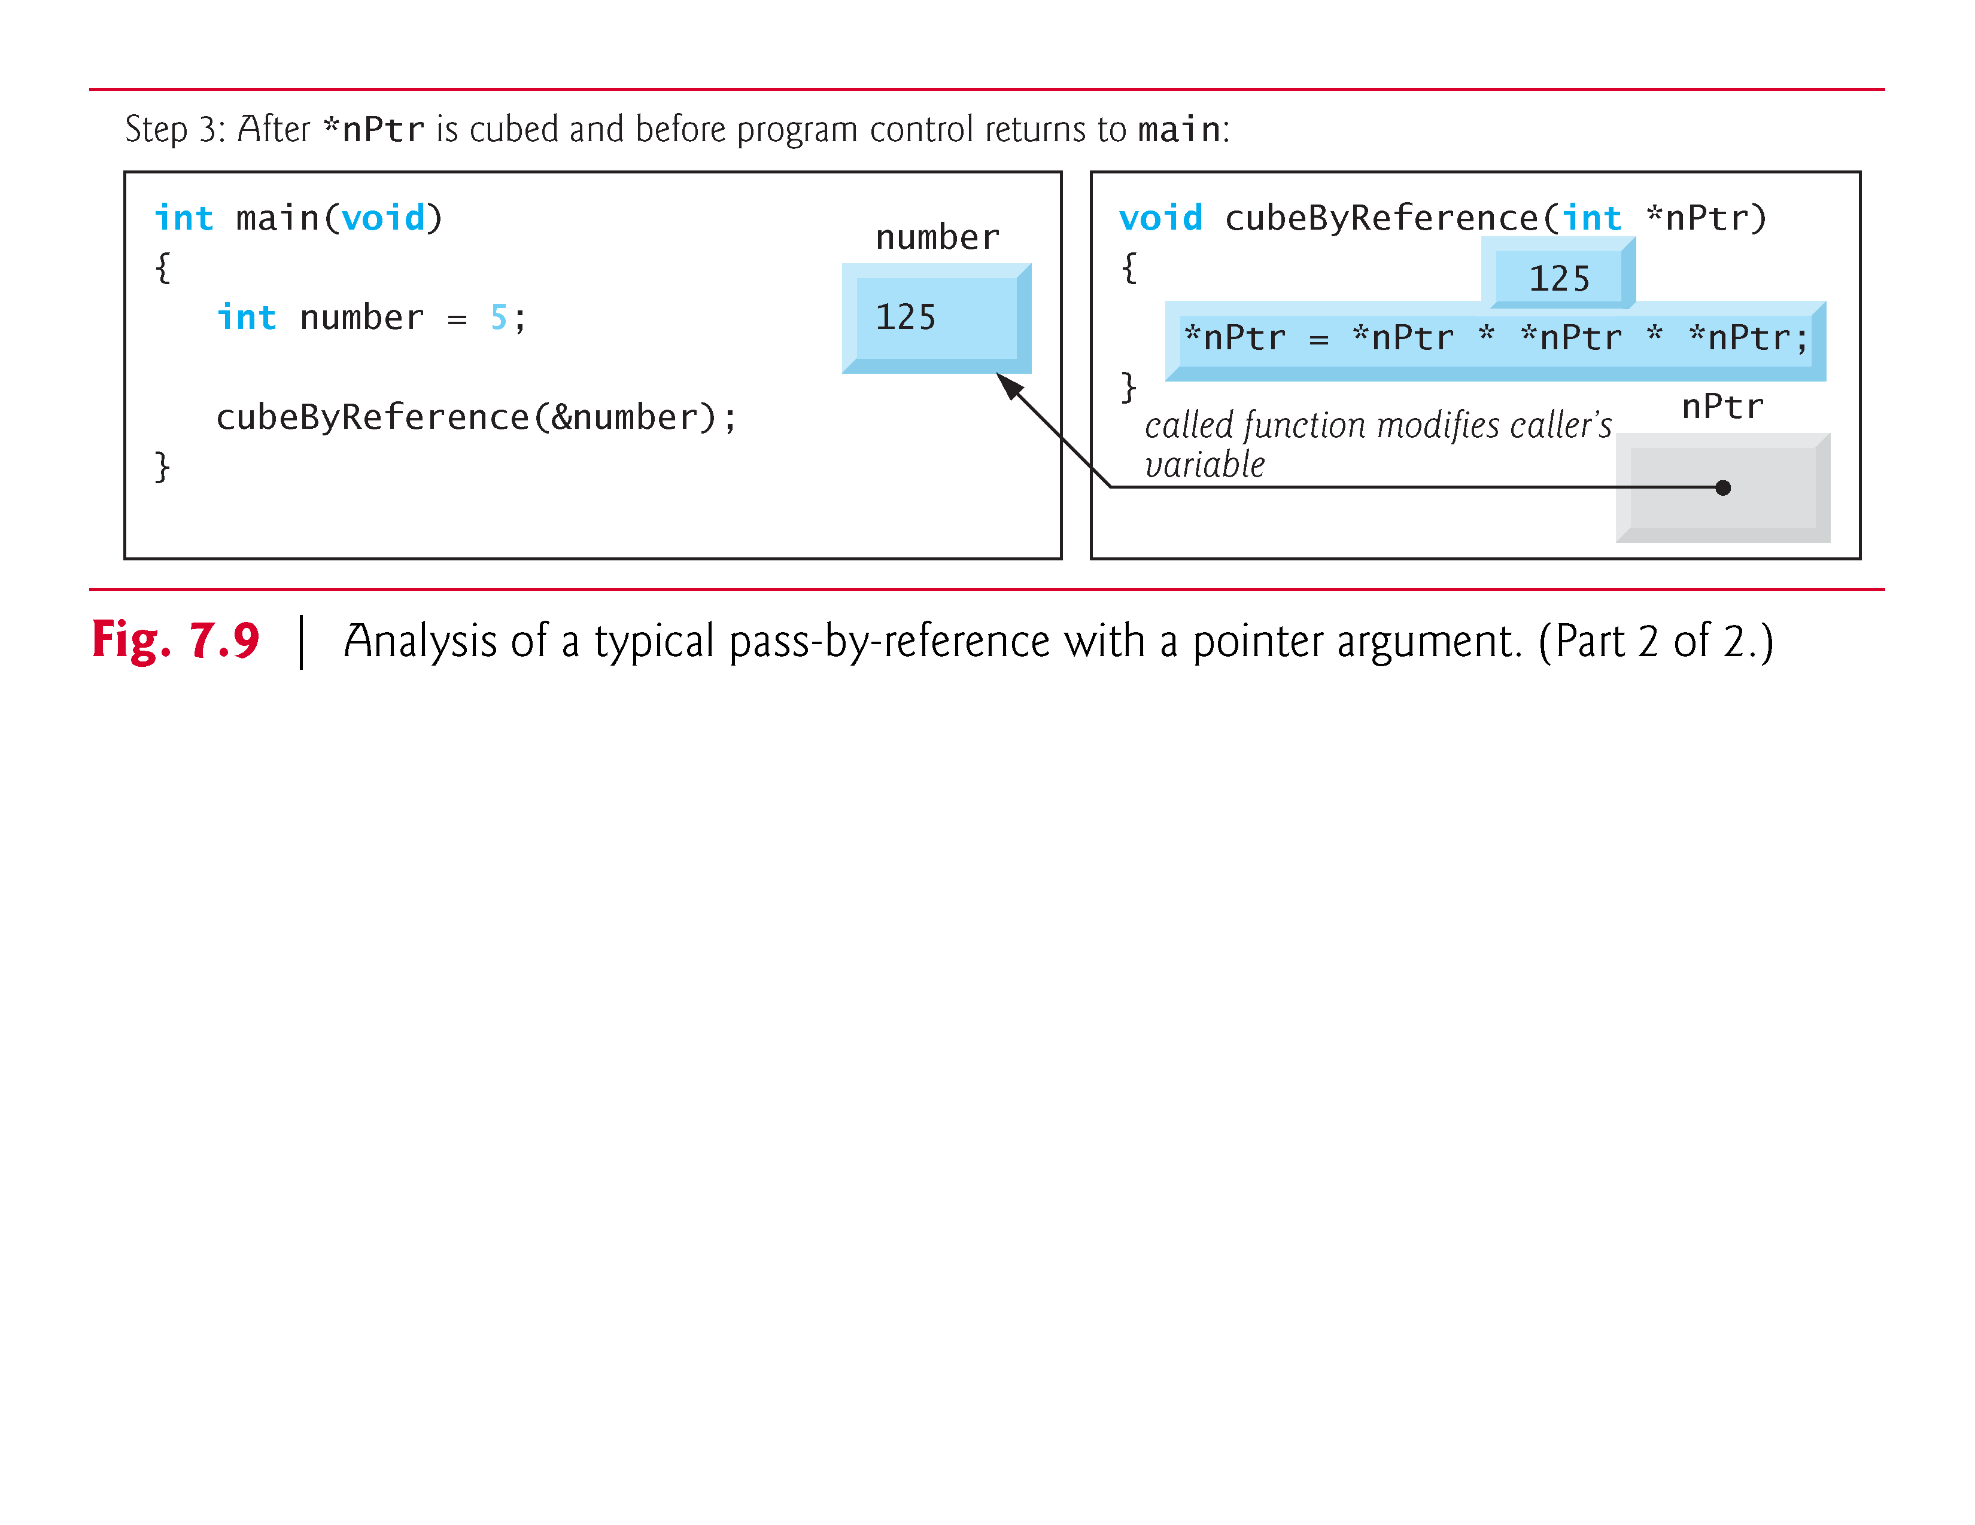

Slide 40
7.6 Bubble Sort Using Pass-by-Reference
Let’s improve the bubble sort program of Fig. 6.15 to use two functions—bubbleSort and swap.
Function bubbleSort sorts the array.
It calls function swap to exchange the array elements array[j] and array[j + 1]
Remember that C enforces information hiding between functions, so swap does not have access to individual array elements in bubbleSort.
Because bubbleSort wants swap to have access to the array elements to be swapped, bubbleSort passes each of these elements by reference to swap—the address of each array element is passed explicitly.

Slide 41
7.6 Bubble Sort Using Pass-by-Reference (Cont.)
Although entire arrays are automatically passed by reference, individual array elements are scalars and are ordinarily passed by value.
Therefore, bubbleSort uses the address operator (&) on each of the array elements in the swap call to effect pass-by-reference as follows
swap(&array[j], &array[j + 1]);
Function swap receives &array[j] in pointer variable element1Ptr.

Slide 42
7.6 Bubble Sort Using Pass-by-Reference (Cont.)
Even though swap—because of information hiding—is not allowed to know the name array[j], swap may use *element1Ptr as a synonym for array[j]—when swap references *element1Ptr, it’s actually referencing array[j] in bubbleSort.
Similarly, when swap references *element2Ptr, it’s actually referencing array[j + 1] in bubbleSort.

Slide 43
7.6 Bubble Sort Using Pass-by-Reference (Cont.)
Even though swap is not allowed to say
int hold = array[j]; array[j] = array[j + 1]; array[j + 1] = hold;
precisely the same effect is achieved by
int hold = *element1Ptr; *element1Ptr = *element2Ptr; *element2Ptr = hold;

Slide 44
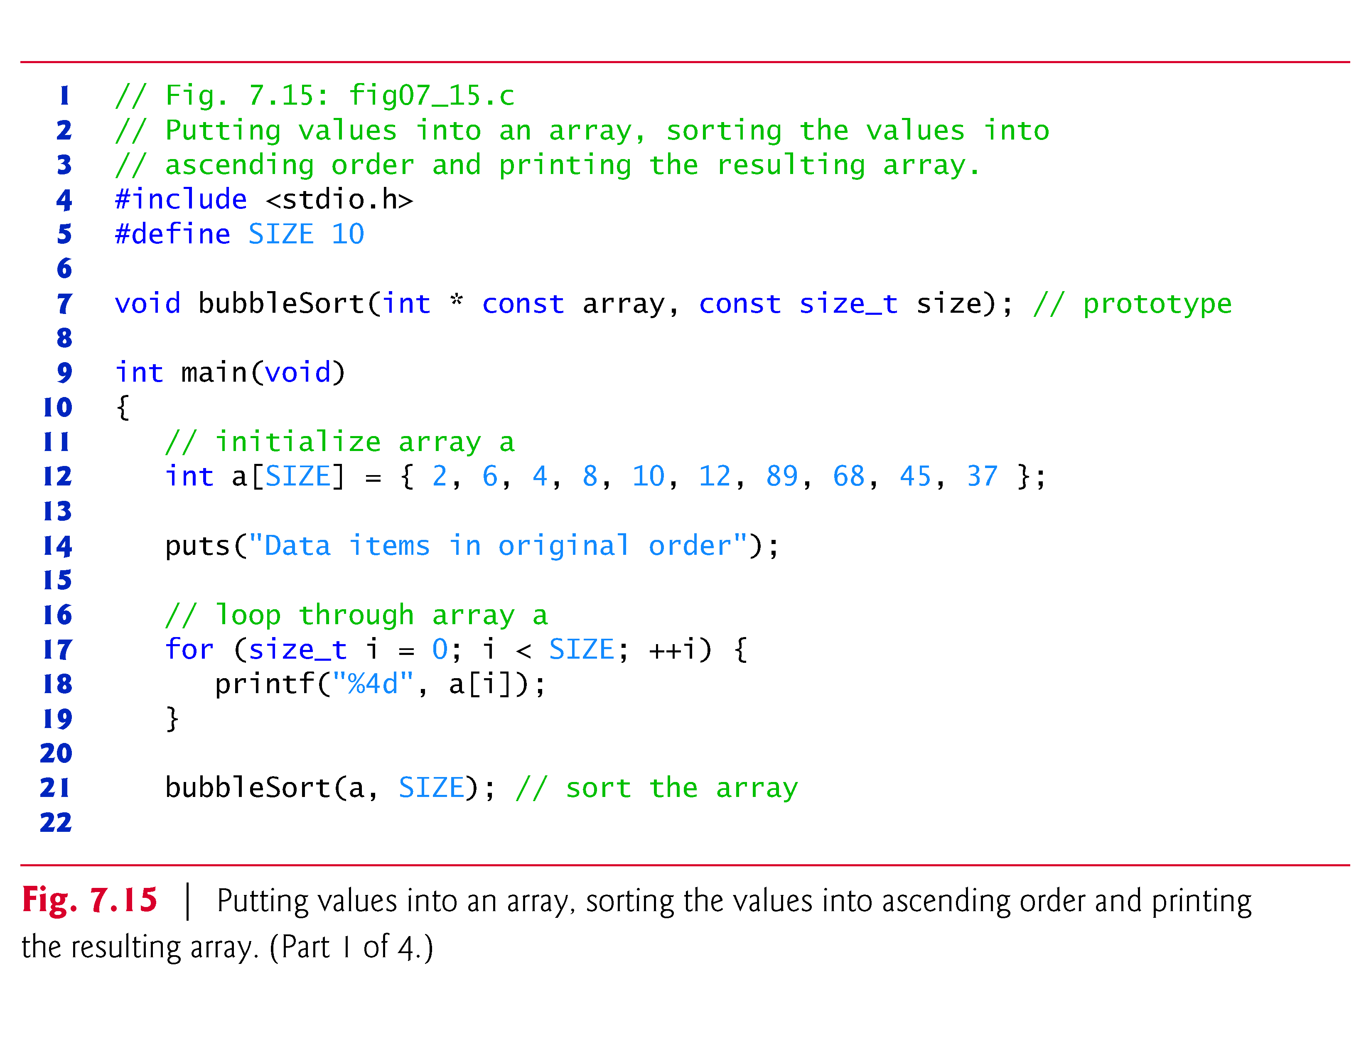

Slide 45
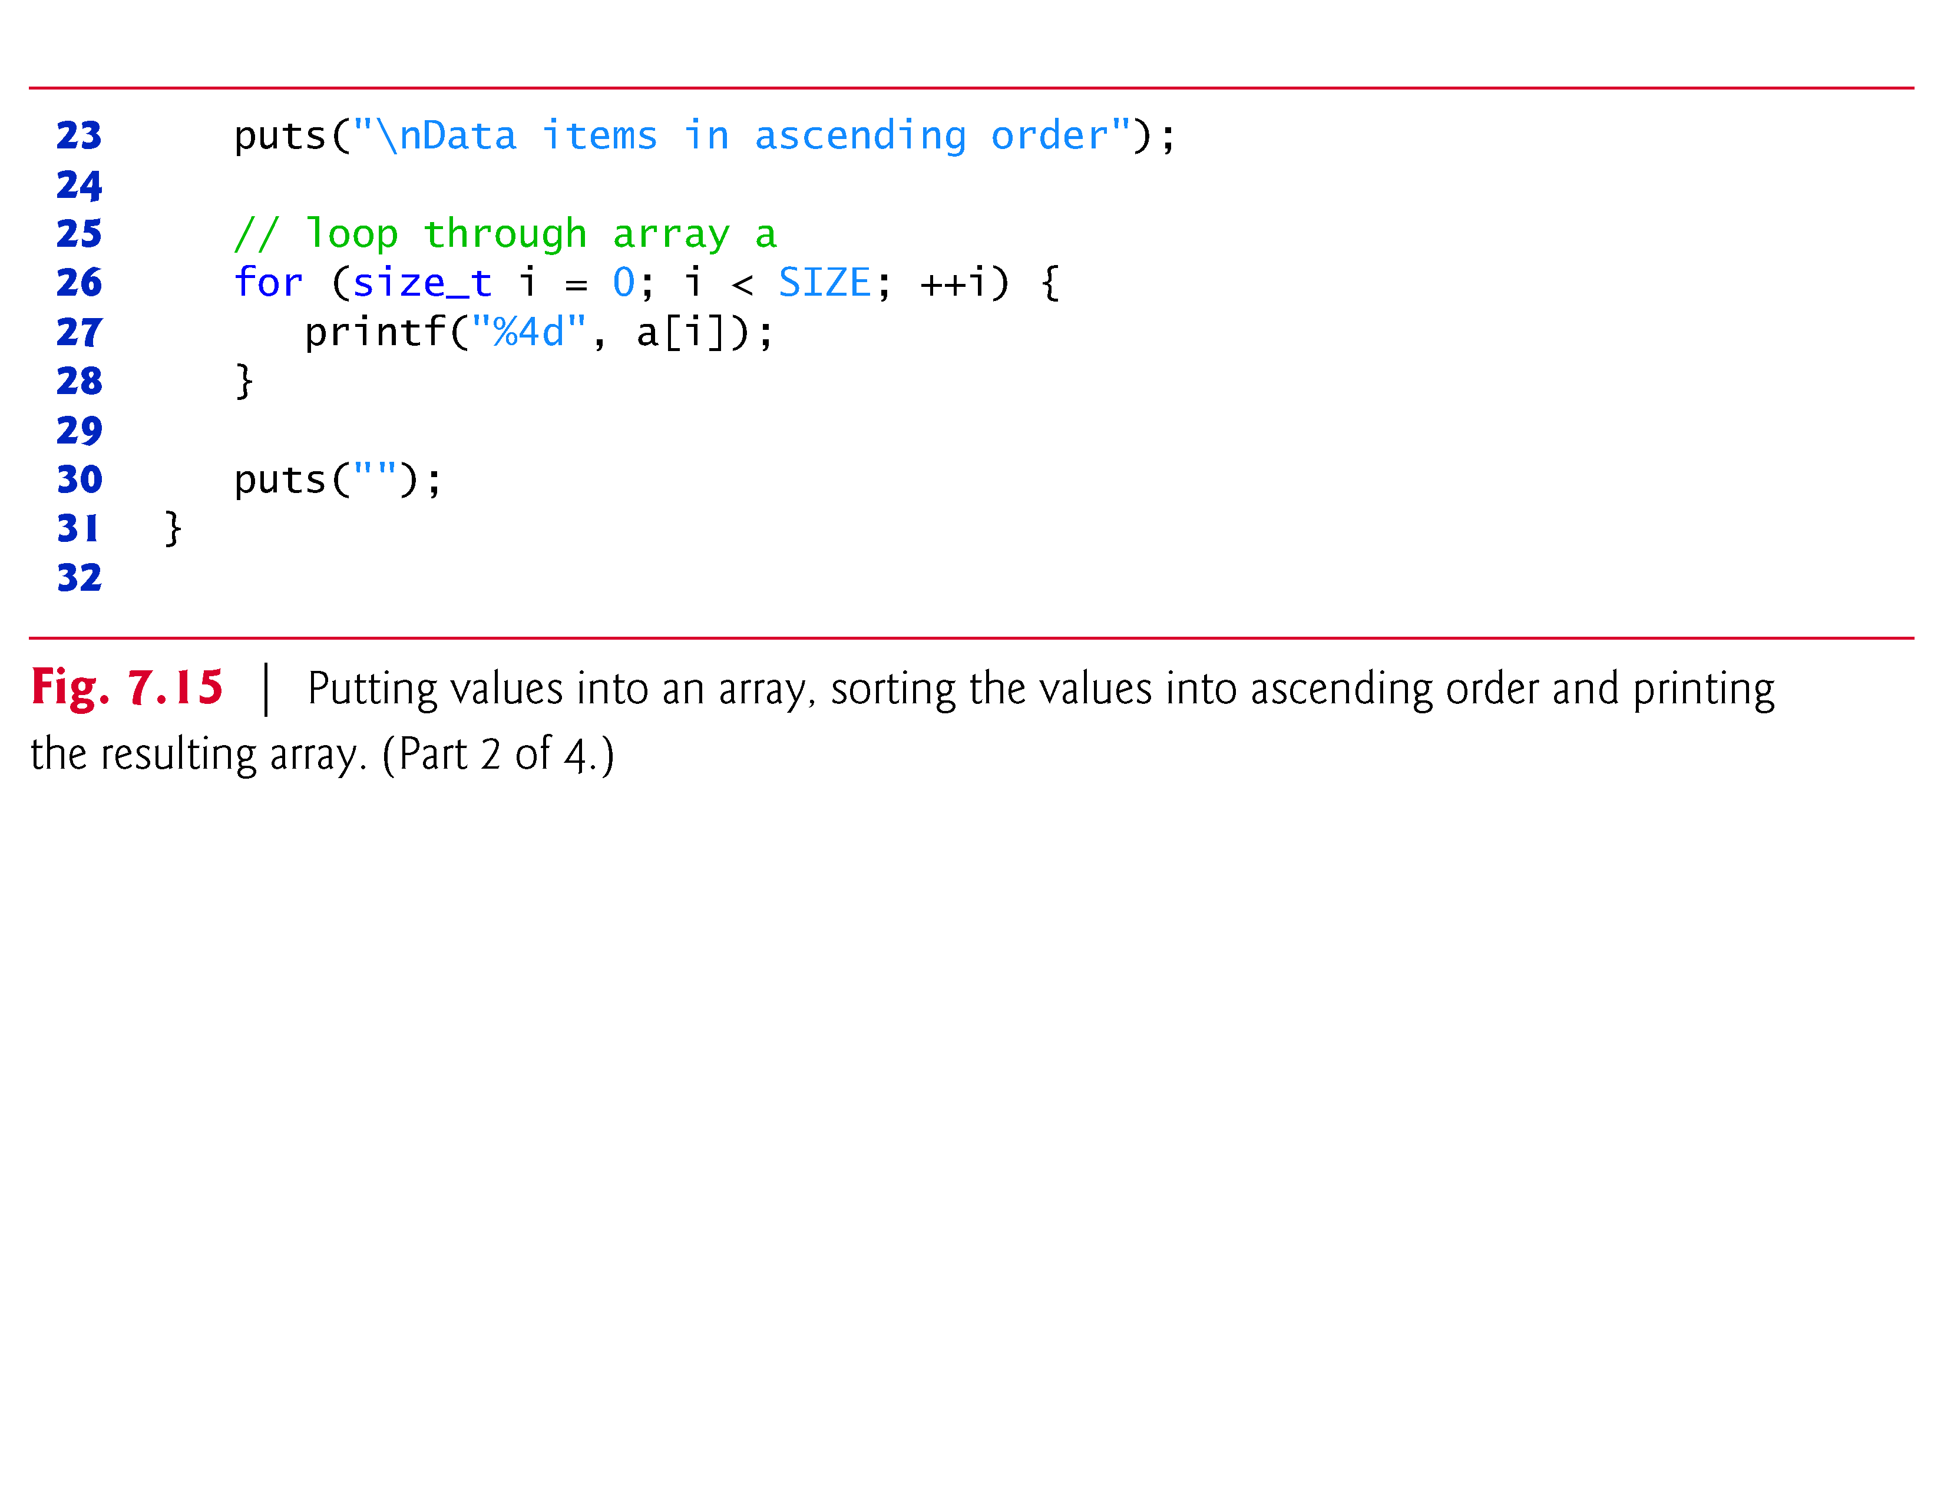

Slide 46
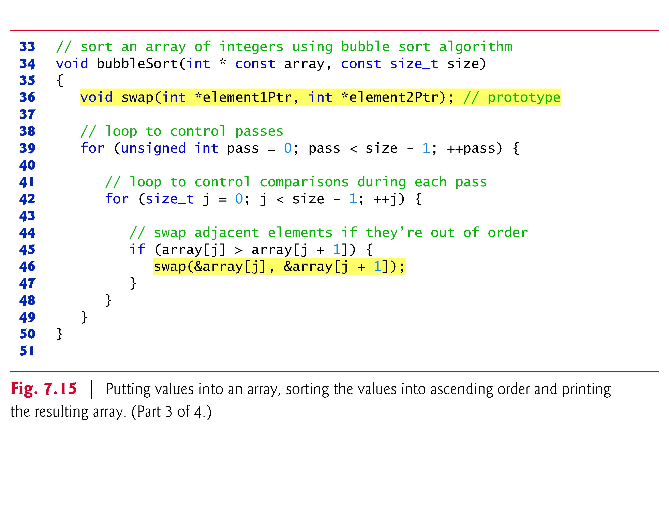

Slide 47
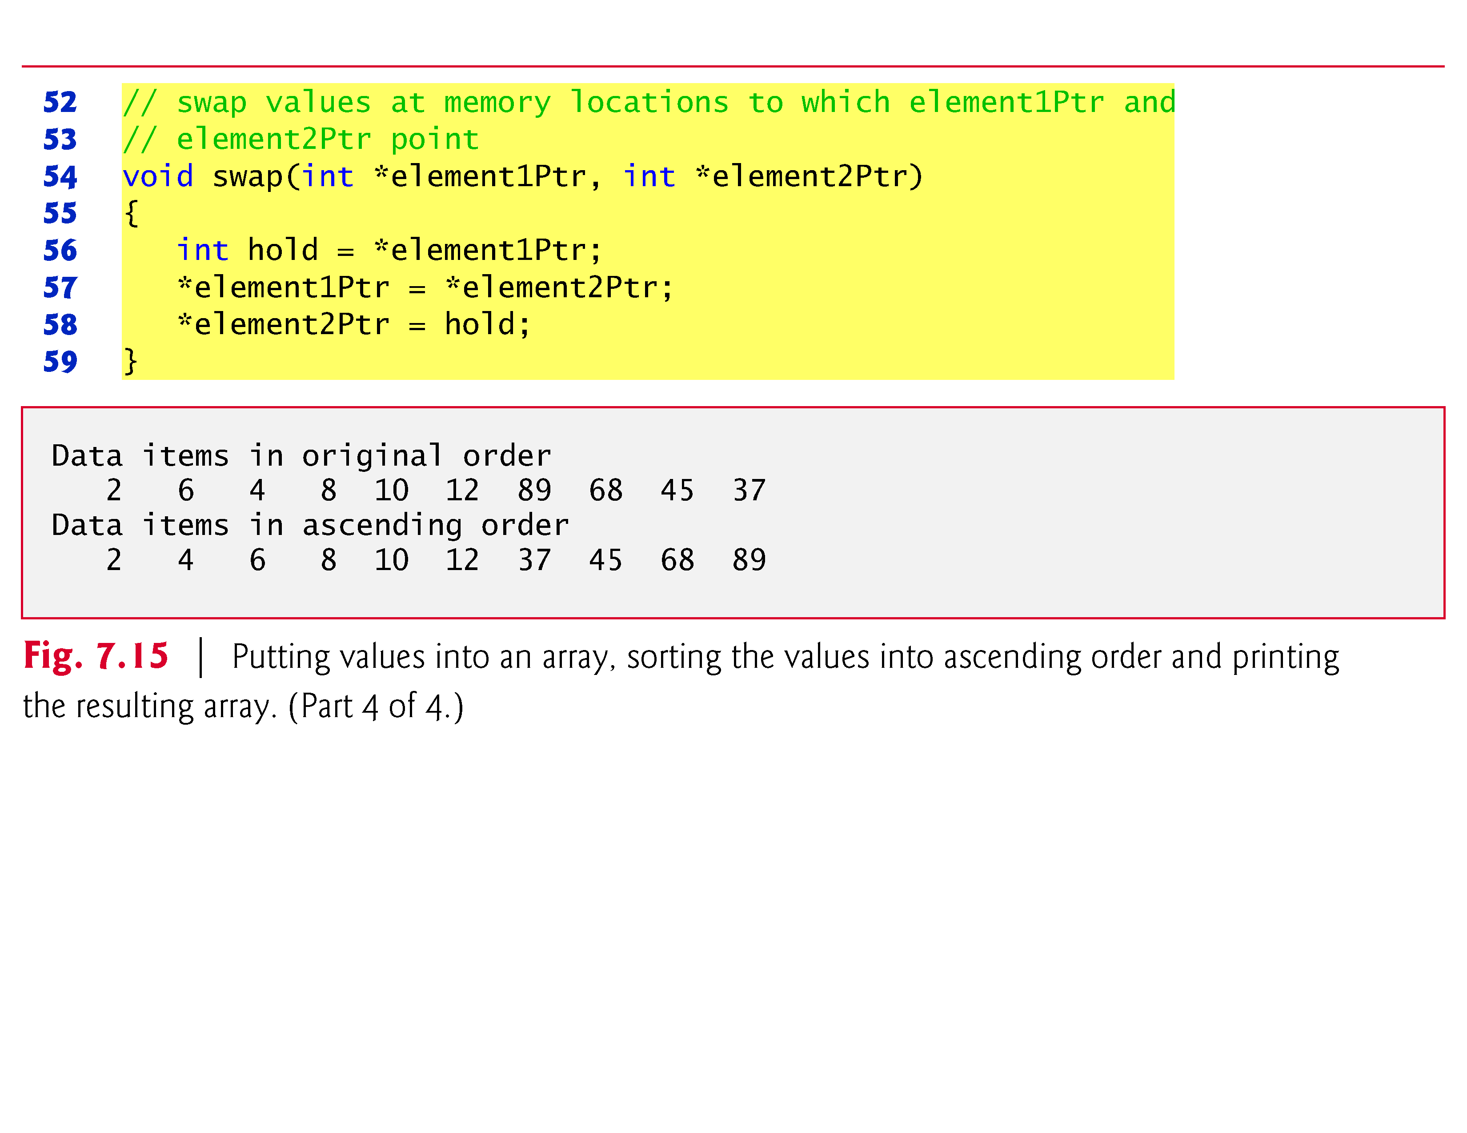

Slide 48
7.6 Bubble Sort Using Pass-by-Reference (Cont.)
Several features of function bubbleSort should be noted.
The function header declares array as int * const array rather than int array[] to indicate that bubbleSort receives a one-dimensional array as an argument (again, these notations are interchangeable).
Parameter size is declared const to enforce the principle of least privilege.
Although parameter size receives a copy of a value in main, and modifying the copy cannot change the value in main, bubbleSort does not need to alter size to accomplish its task.

Slide 49
7.6 Bubble Sort Using Pass-by-Reference (Cont.)
The size of the array remains fixed during the execution of function bubbleSort.
Therefore, size is declared const to ensure that it’s not modified.
The prototype for function swap is included in the body of function bubbleSort because bubbleSort is the only function that calls swap.

Slide 50
7.6 Bubble Sort Using Pass-by-Reference (Cont.)
Placing the prototype in bubbleSort restricts proper calls of swap to those made from bubbleSort.
Other functions that attempt to call swap do not have access to a proper function prototype, so the compiler generates one automatically.
This normally results in a prototype that does not match the function header (and generates a compilation warning or error) because the compiler assumes int for the return type and the parameter types.

Slide 51
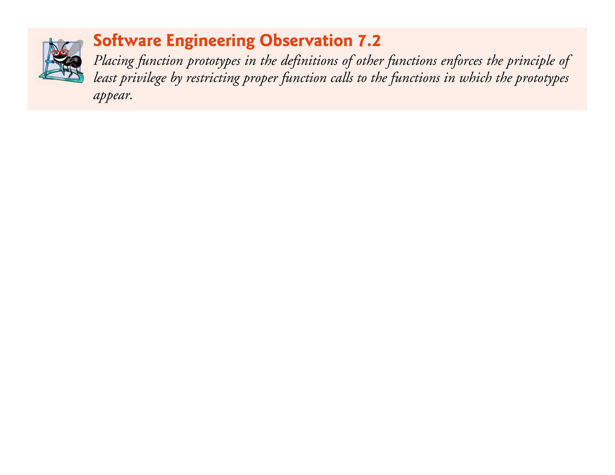

Slide 52
7.6 Bubble Sort Using Pass-by-Reference (Cont.)
Function bubbleSort receives the size of the array as a parameter
The function must know the size of the array to sort the array.
When an array is passed to a function, the memory address of the first element of the array is received by the function.
The address, of course, does not convey the number of elements in the array.
Therefore, you must pass the array size to the function.
Another common practice is to pass a pointer to the beginning of the array and a pointer to the location just beyond the end of the array—as you’ll learn in Section 7.8, the difference of the two pointers is the length of the array and the resulting code is simpler

Slide 53
7.6 Bubble Sort Using Pass-by-Reference (Cont.)
In the program, the size of the array is explicitly passed to function bubbleSort.
There are two main benefits to this approach—software reusability and proper software engineering.
By defining the function to receive the array size as an argument, we enable the function to be used by any program that sorts one-dimensional integer arrays of any size.

Slide 54
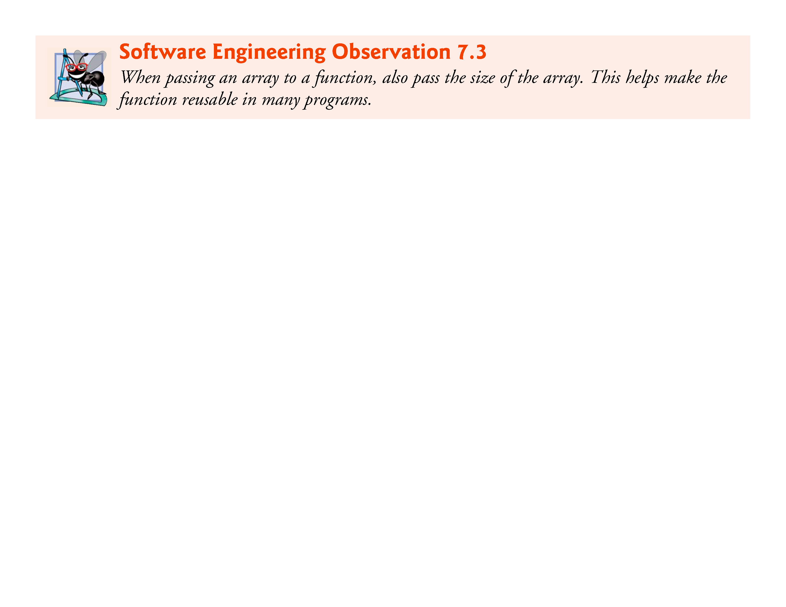

Slide 55
7.6 Bubble Sort Using Pass-by-Reference (Cont.)
We could have stored the array’s size in a global variable that’s accessible to the entire program.
This would be more efficient, because a copy of the size is not made to pass to the function.
However, other programs that require an integer array-sorting capability may not have the same global variable, so the function cannot be used in those programs.

Slide 56
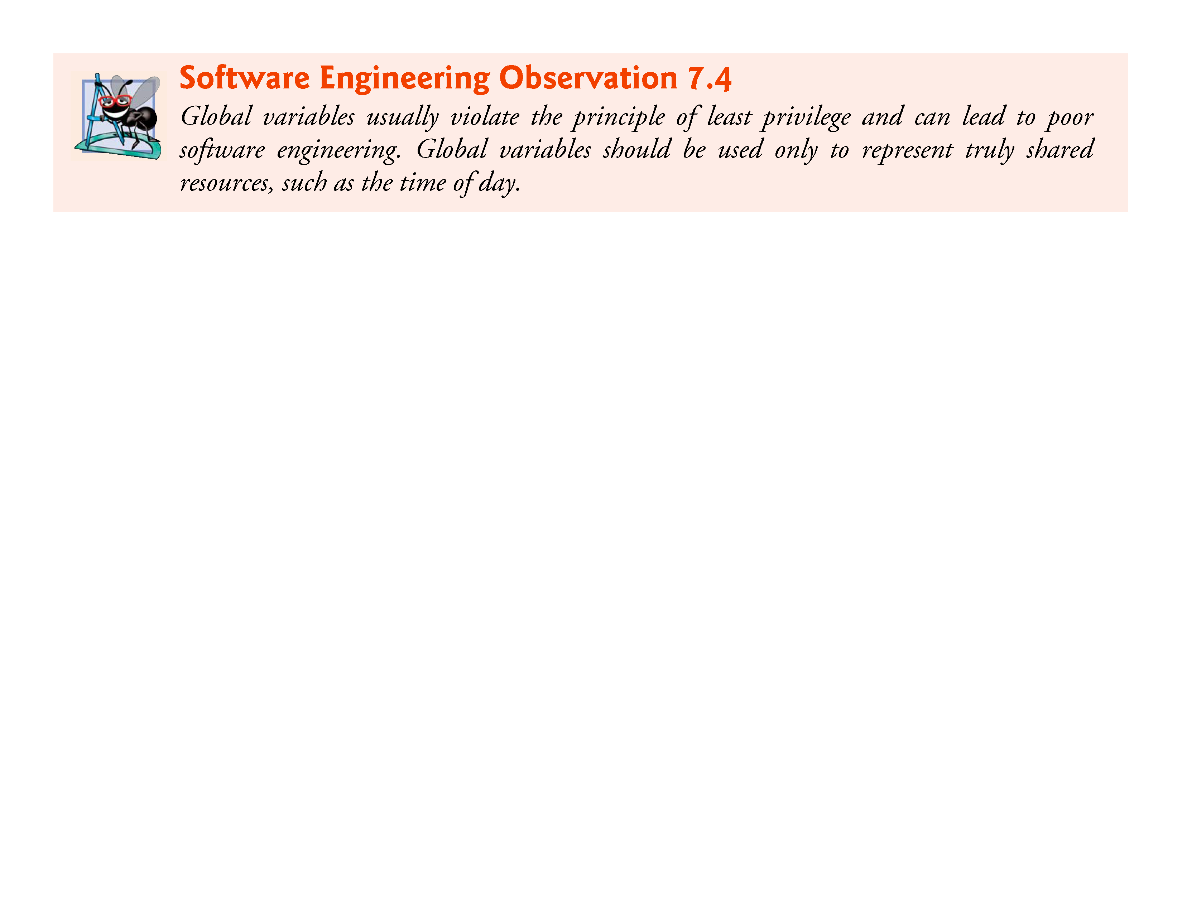

Slide 57
7.6 Bubble Sort Using Pass-by-Reference (Cont.)
The size of the array could have been programmed directly into the function.
This restricts the use of the function to an array of a specific size and significantly reduces its reusability.
Only programs processing one-dimensional integer arrays of the specific size coded into the function can use the function.

Slide 58
7.7 sizeof Operator
C provides the special unary operator sizeof to determine the size in bytes of an array (or any other data type) .
When applied to the name of an array as in Fig. 7.16, the sizeof operator returns the total number of bytes in the array as type size_t.
Variables of type float on this computer are stored in 4 bytes of memory, and array is defined to have 20 elements.
Therefore, there are a total of 80 bytes in array.

Slide 59
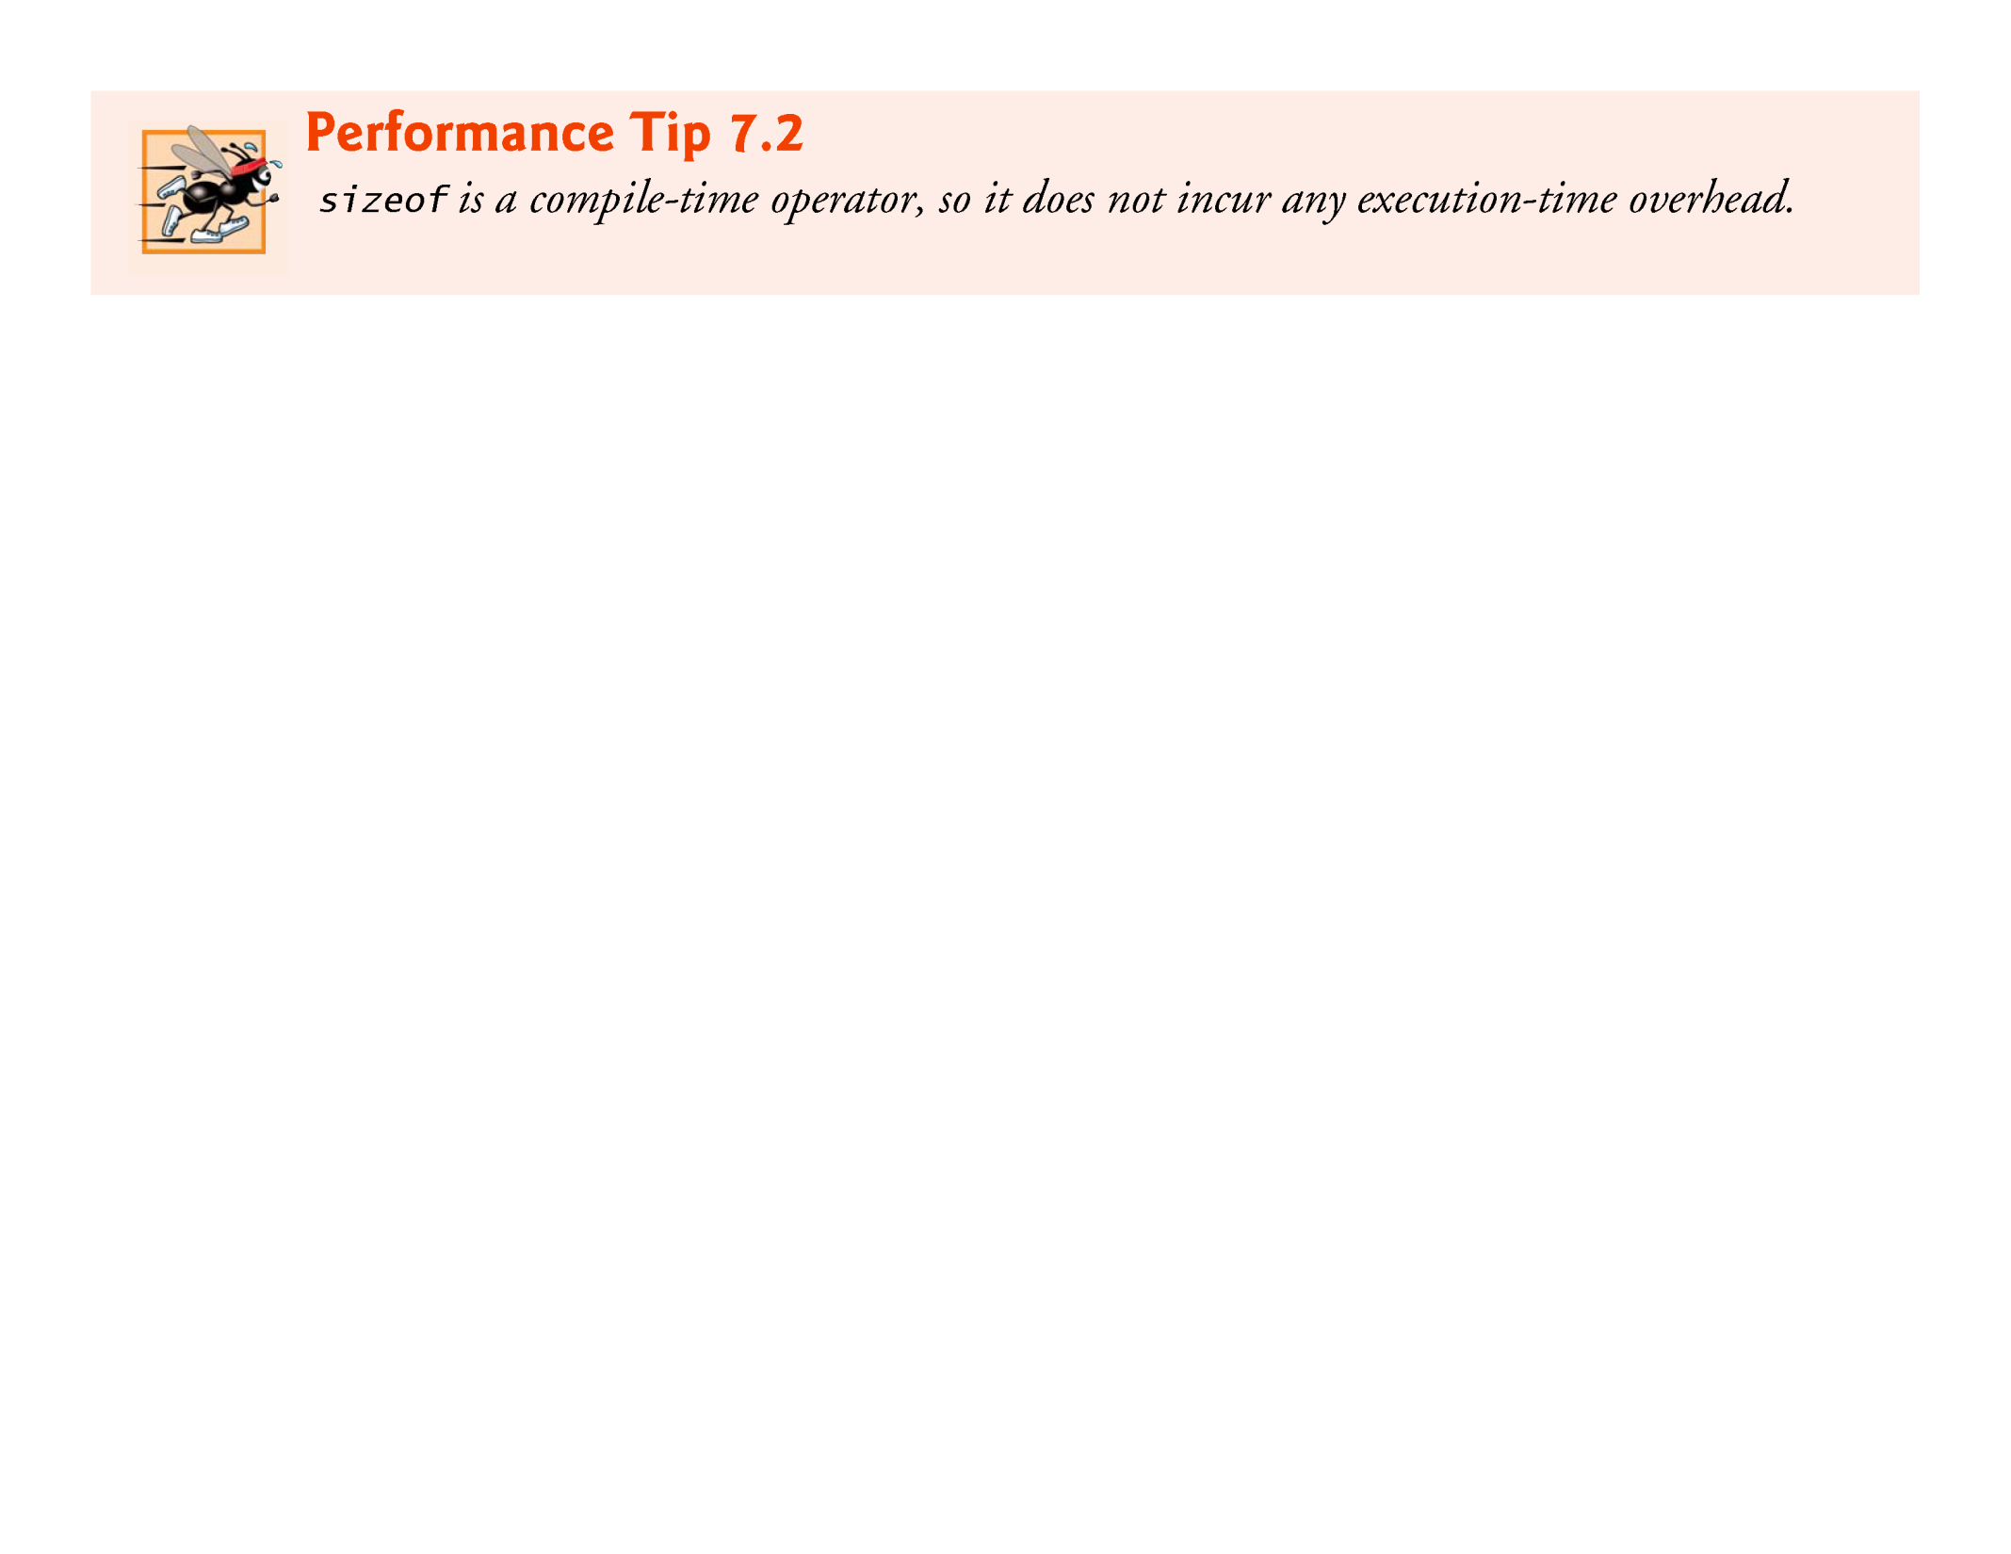

Slide 60
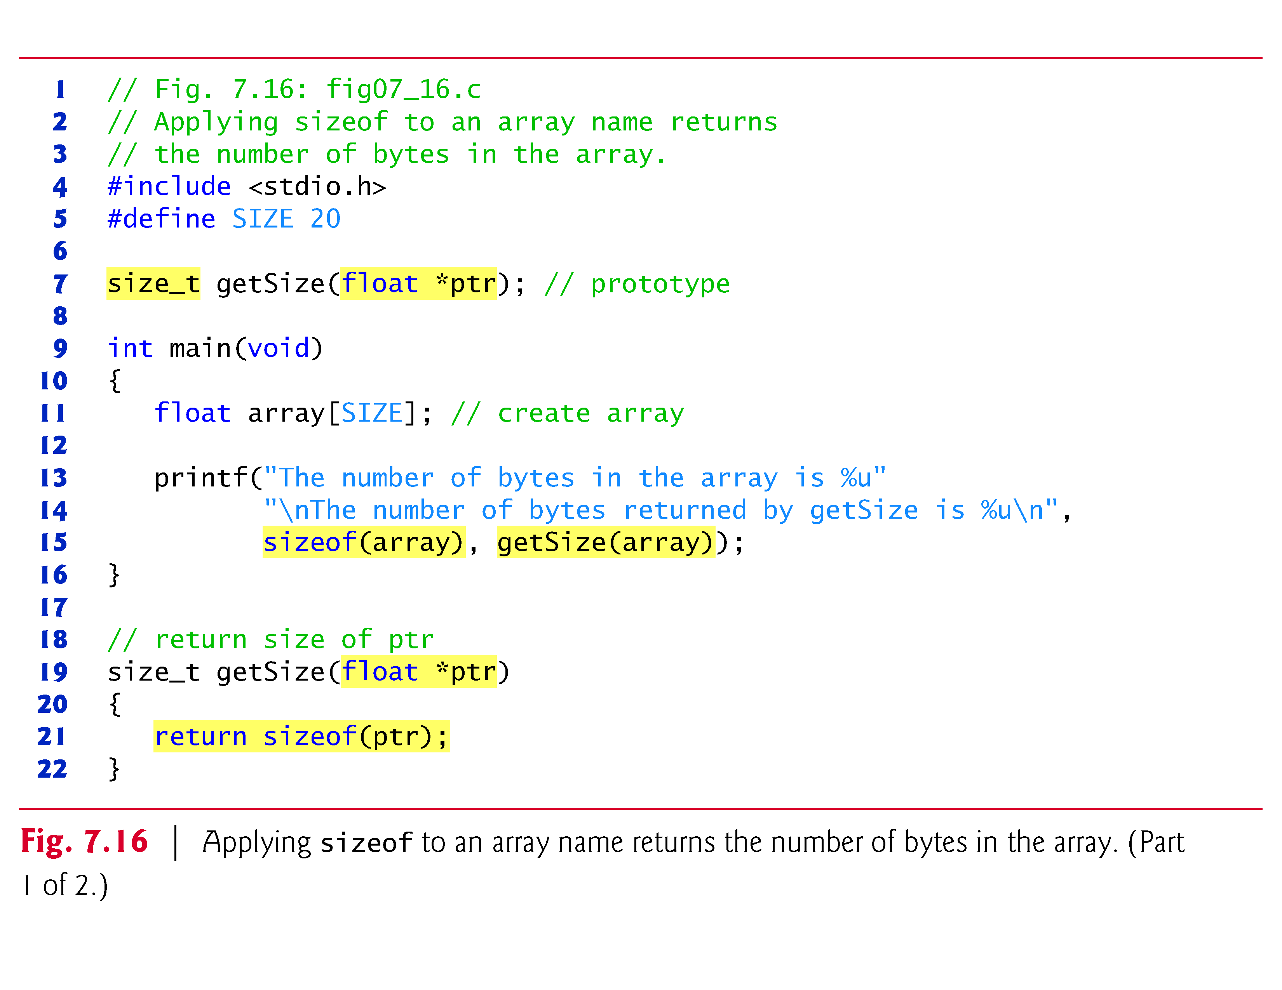

Slide 61
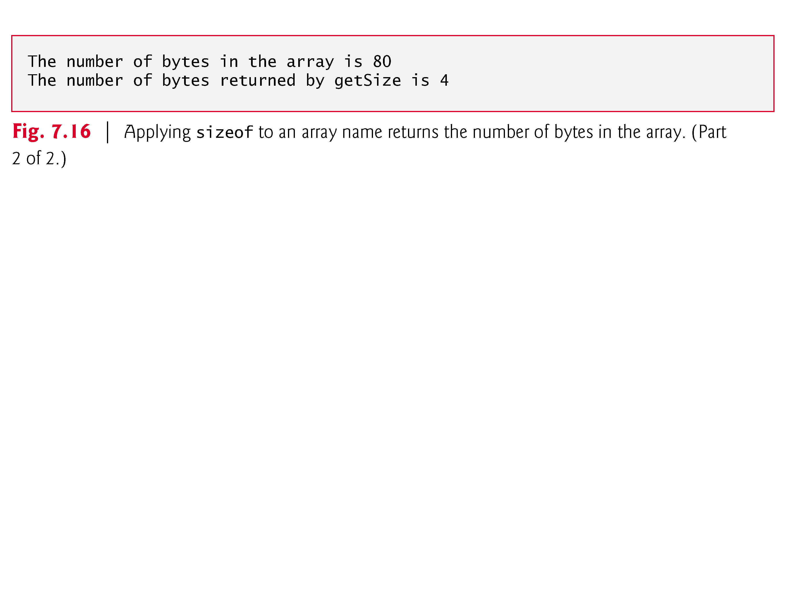

Slide 62
7.7 sizeof Operator (Cont.)
The number of elements in an array also can be determined with sizeof.
For example, consider the following array definition:
double real[22];
Variables of type double normally are stored in 8 bytes of memory.
Thus, array real contains a total of 176 bytes.
To determine the number of elements in the array, the following expression can be used:
sizeof(real) / sizeof(real[0])

Slide 63
7.7 sizeof Operator (Cont.)
The expression determines the number of bytes in array real and divides that value by the number of bytes used in memory to store the first element of array real (a double value).

Slide 64
7.7 sizeof Operator (Cont.)
Even though function getSize receives an array of 20 elements as an argument, the function’s parameter ptr is simply a pointer to the array’s first element.
When you use sizeof with a pointer, it returns the size of the pointer, not the size of the item to which it points.
The size of a pointer on our system is 4 bytes, so getSize returned 4.
Also, the calculation shown above for determining the number of array elements using sizeof works only when using the actual array, not when using a pointer to the array.

Slide 65
7.7 sizeof Operator (Cont.)
Determining the Sizes of the Standard Types, an Array and a Pointer
Figure 7.17 calculates the number of bytes used to store each of the standard data types.
The results of this program are implementation dependent and often differ across platforms and sometimes across different compilers on the same platform.

Slide 66
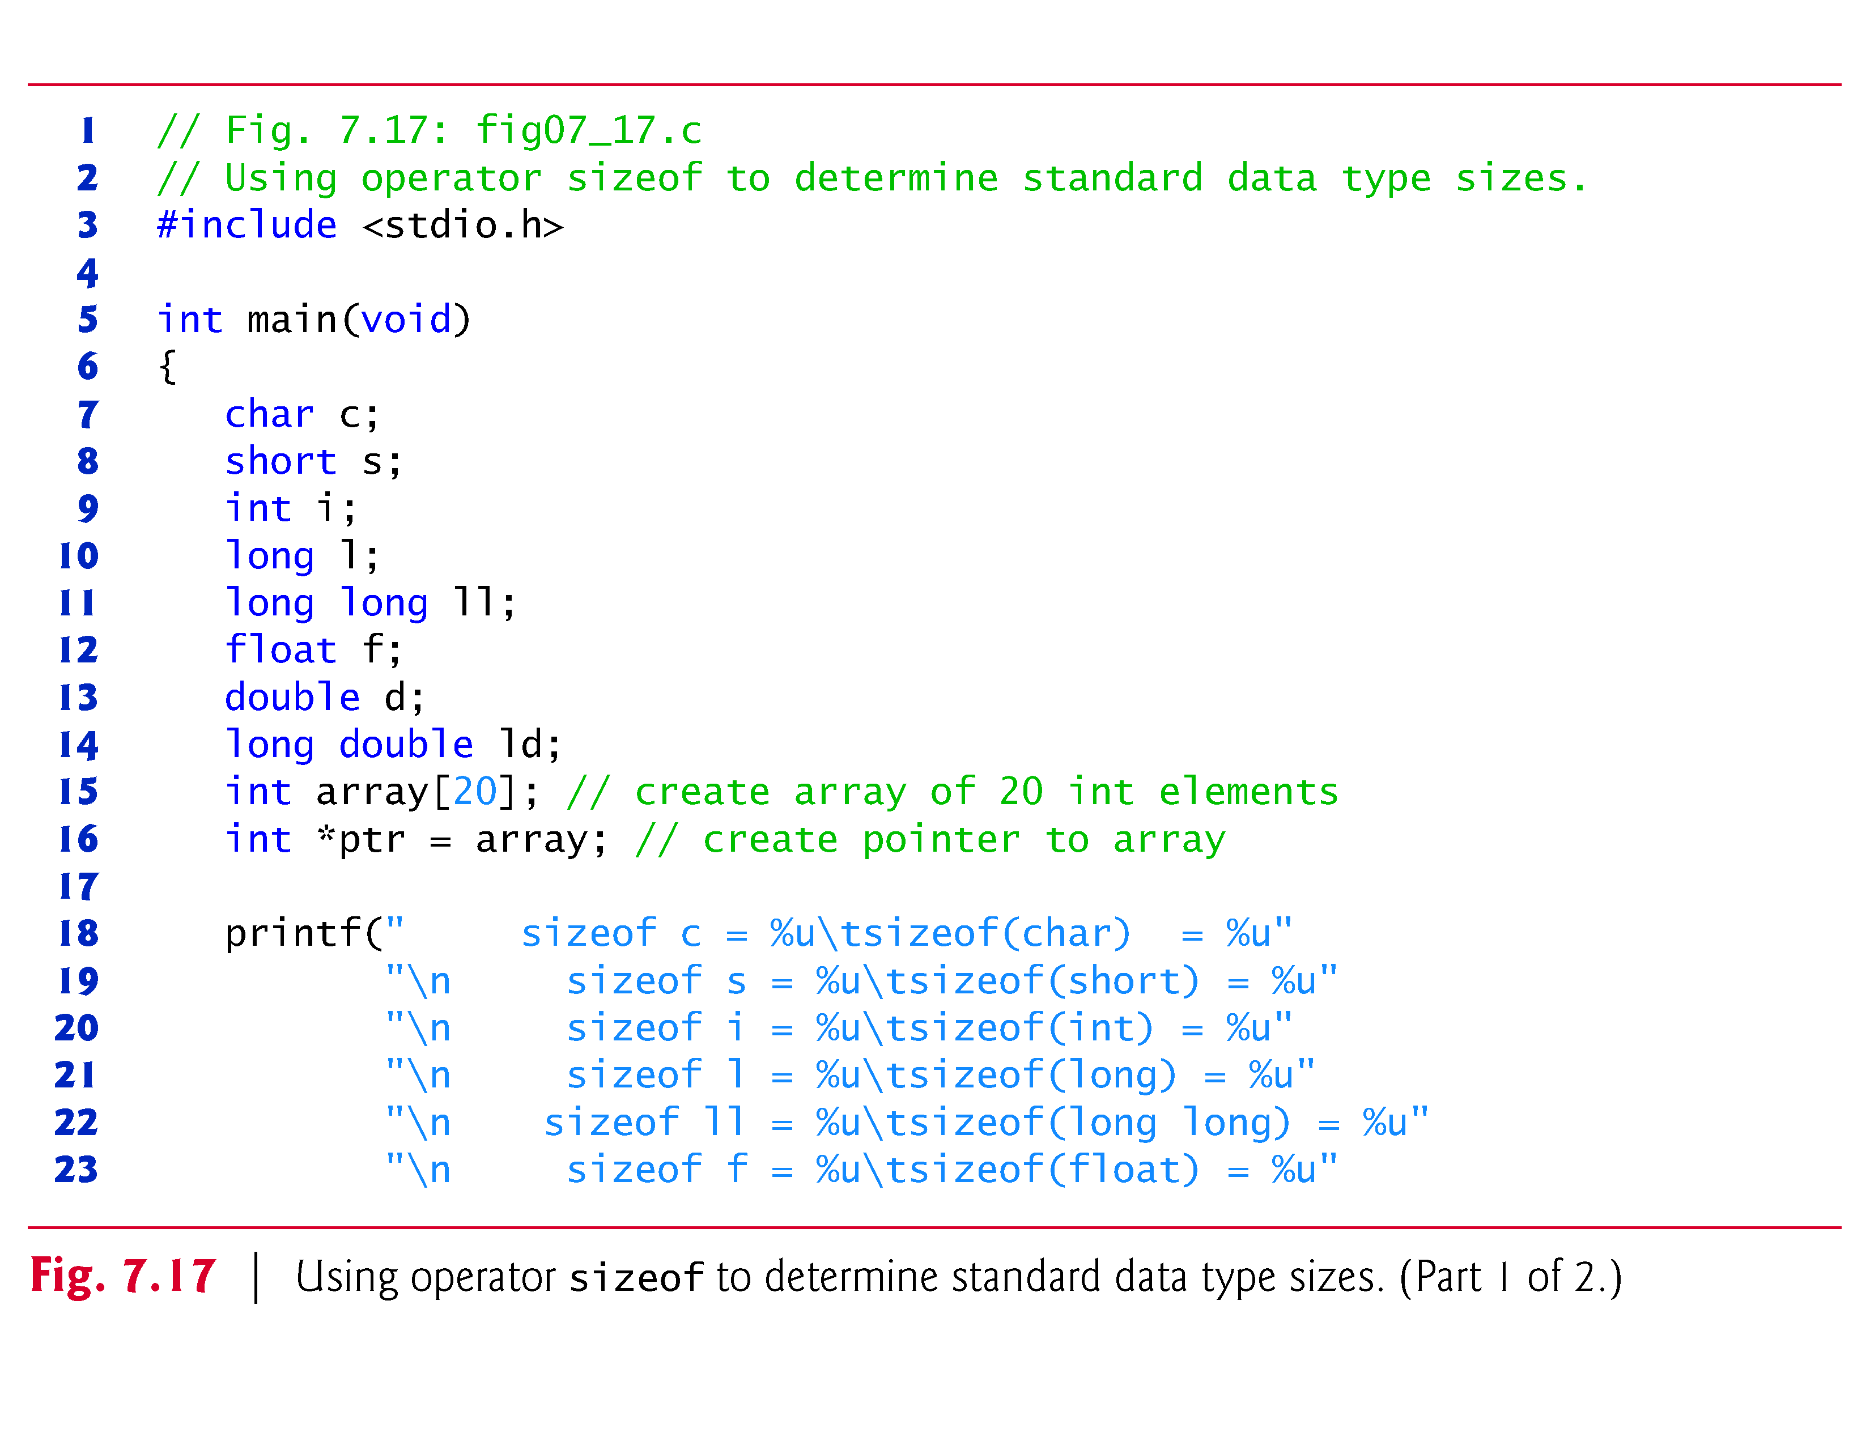

Slide 67
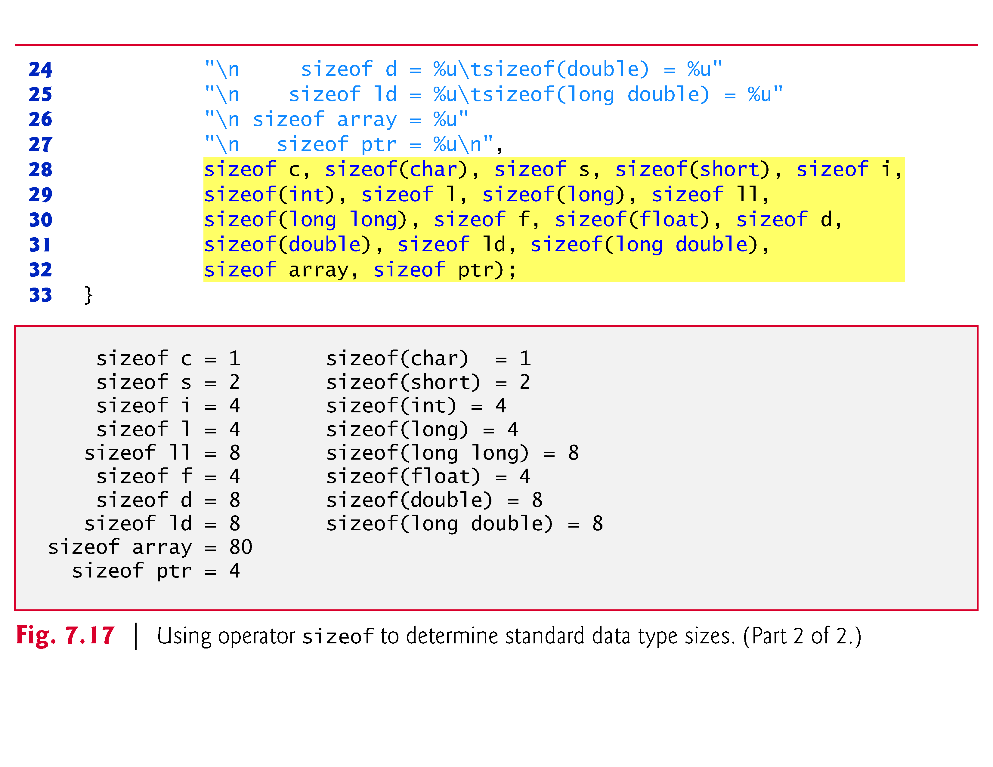

Slide 68
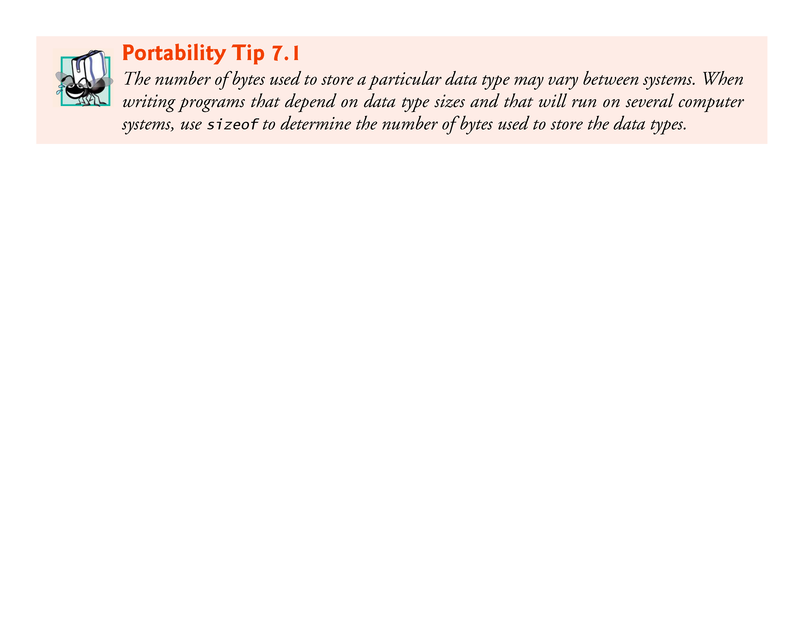

Slide 69
7.7 sizeof Operator (Cont.)
Operator sizeof can be applied to any variable name, type or value (including the value of an expression).
When applied to a variable name (that’s not an array name) or a constant, the number of bytes used to store the specific type of variable or constant is returned.
The parentheses are required when a type is supplied as size_of’s operand.

Slide 70
7.8 Pointer Expressions and Pointer Arithmetic
Pointers are valid operands in arithmetic expressions, assignment expressions and comparison expressions.
However, not all the operators normally used in these expressions are valid in conjunction with pointer variables.
This section describes the operators that can have pointers as operands, and how these operators are used.
A limited set of arithmetic operations may be performed on pointers.
A pointer may be incremented (++) or decremented (--), an integer may be added to a pointer (+ or +=), an integer may be subtracted from a pointer (- or -=) and one pointer may be subtracted from another—this last operation is meaningful only when both pointers point to elements of the same array.

Slide 71
7.8 Pointer Expressions and Pointer Arithmetic (Cont.)
Assume that array int v[5] has been defined and its first element is at location 3000 in memory.
Assume pointer vPtr has been initialized to point to v[0]—i.e., the value of vPtr is 3000.
Figure 7.18 illustrates this situation for a machine with 4-byte integers.
Variable vPtr can be initialized to point to array v with either of the statements

Slide 72
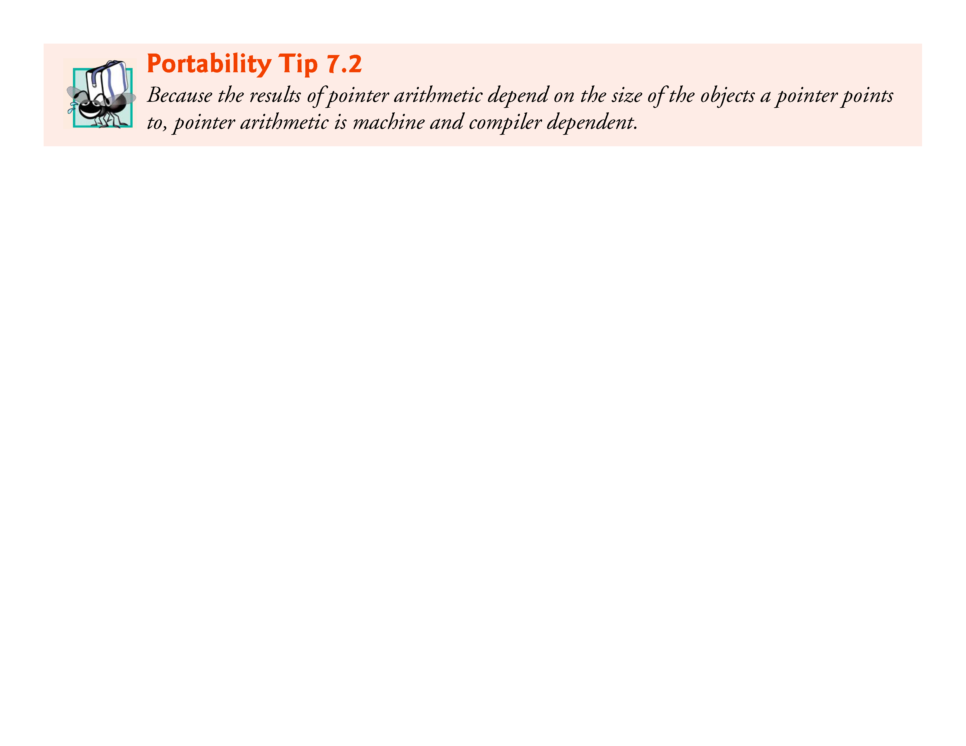

Slide 73
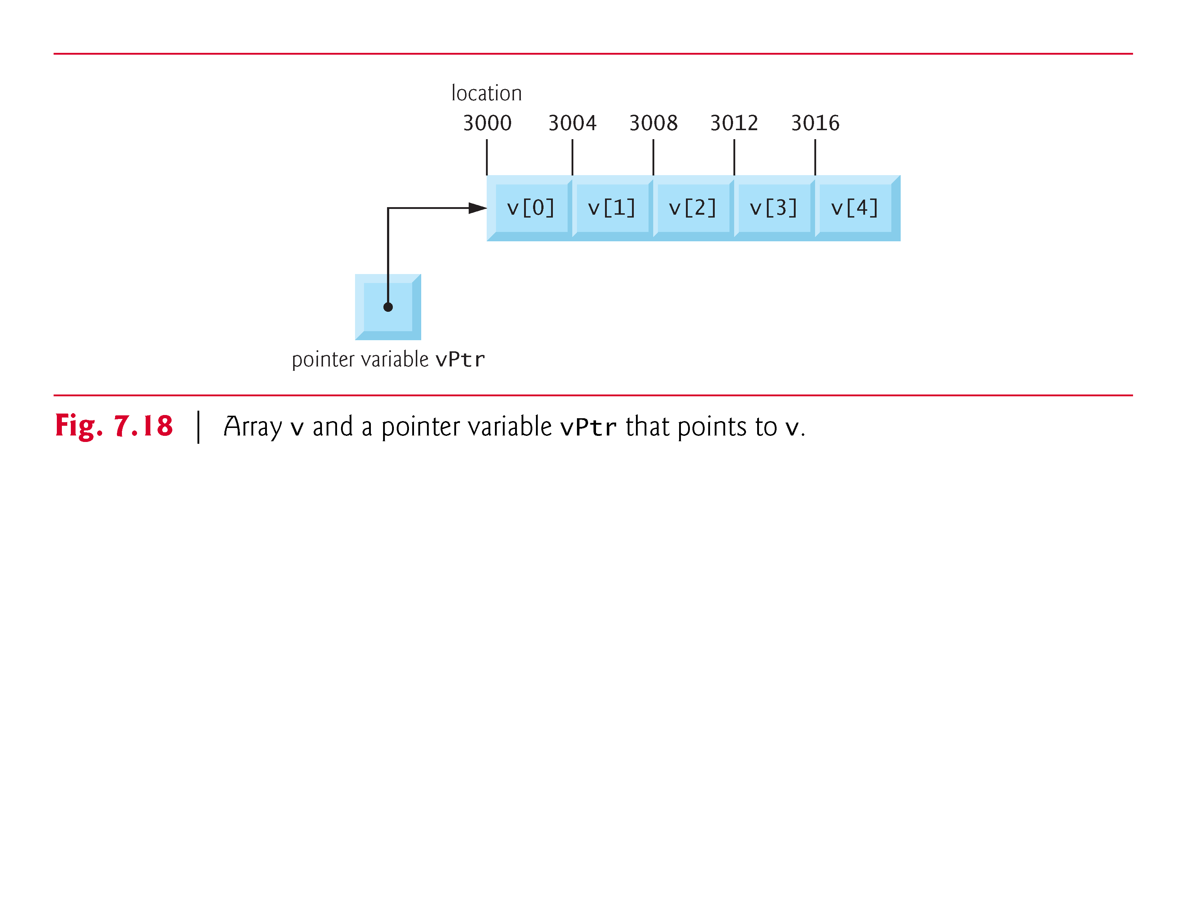

Slide 74
7.8 Pointer Expressions and Pointer Arithmetic (Cont.)
In conventional arithmetic, 3000 + 2 yields the value 3002.
This is normally not the case with pointer arithmetic.
When an integer is added to or subtracted from a pointer, the pointer is not incremented or decremented simply by that integer, but by that integer times the size of the object to which the pointer refers.
The number of bytes depends on the object’s data type.
For example, the statement
vPtr += 2;
would produce 3008 (3000 + 2 * 4), assuming an integer is stored in 4 bytes of memory.

Slide 75
7.8 Pointer Expressions and Pointer Arithmetic (Cont.)
In the array v, vPtr would now point to v[2] (Fig. 7.19).
If an integer is stored in 2 bytes of memory, then the preceding calculation would result in memory location 3004 (3000 + 2 * 2).
If the array were of a different data type, the preceding statement would increment the pointer by twice the number of bytes that it takes to store an object of that data type.
When performing pointer arithmetic on a character array, the results will be consistent with regular arithmetic, because each character is 1 byte long.

Slide 76
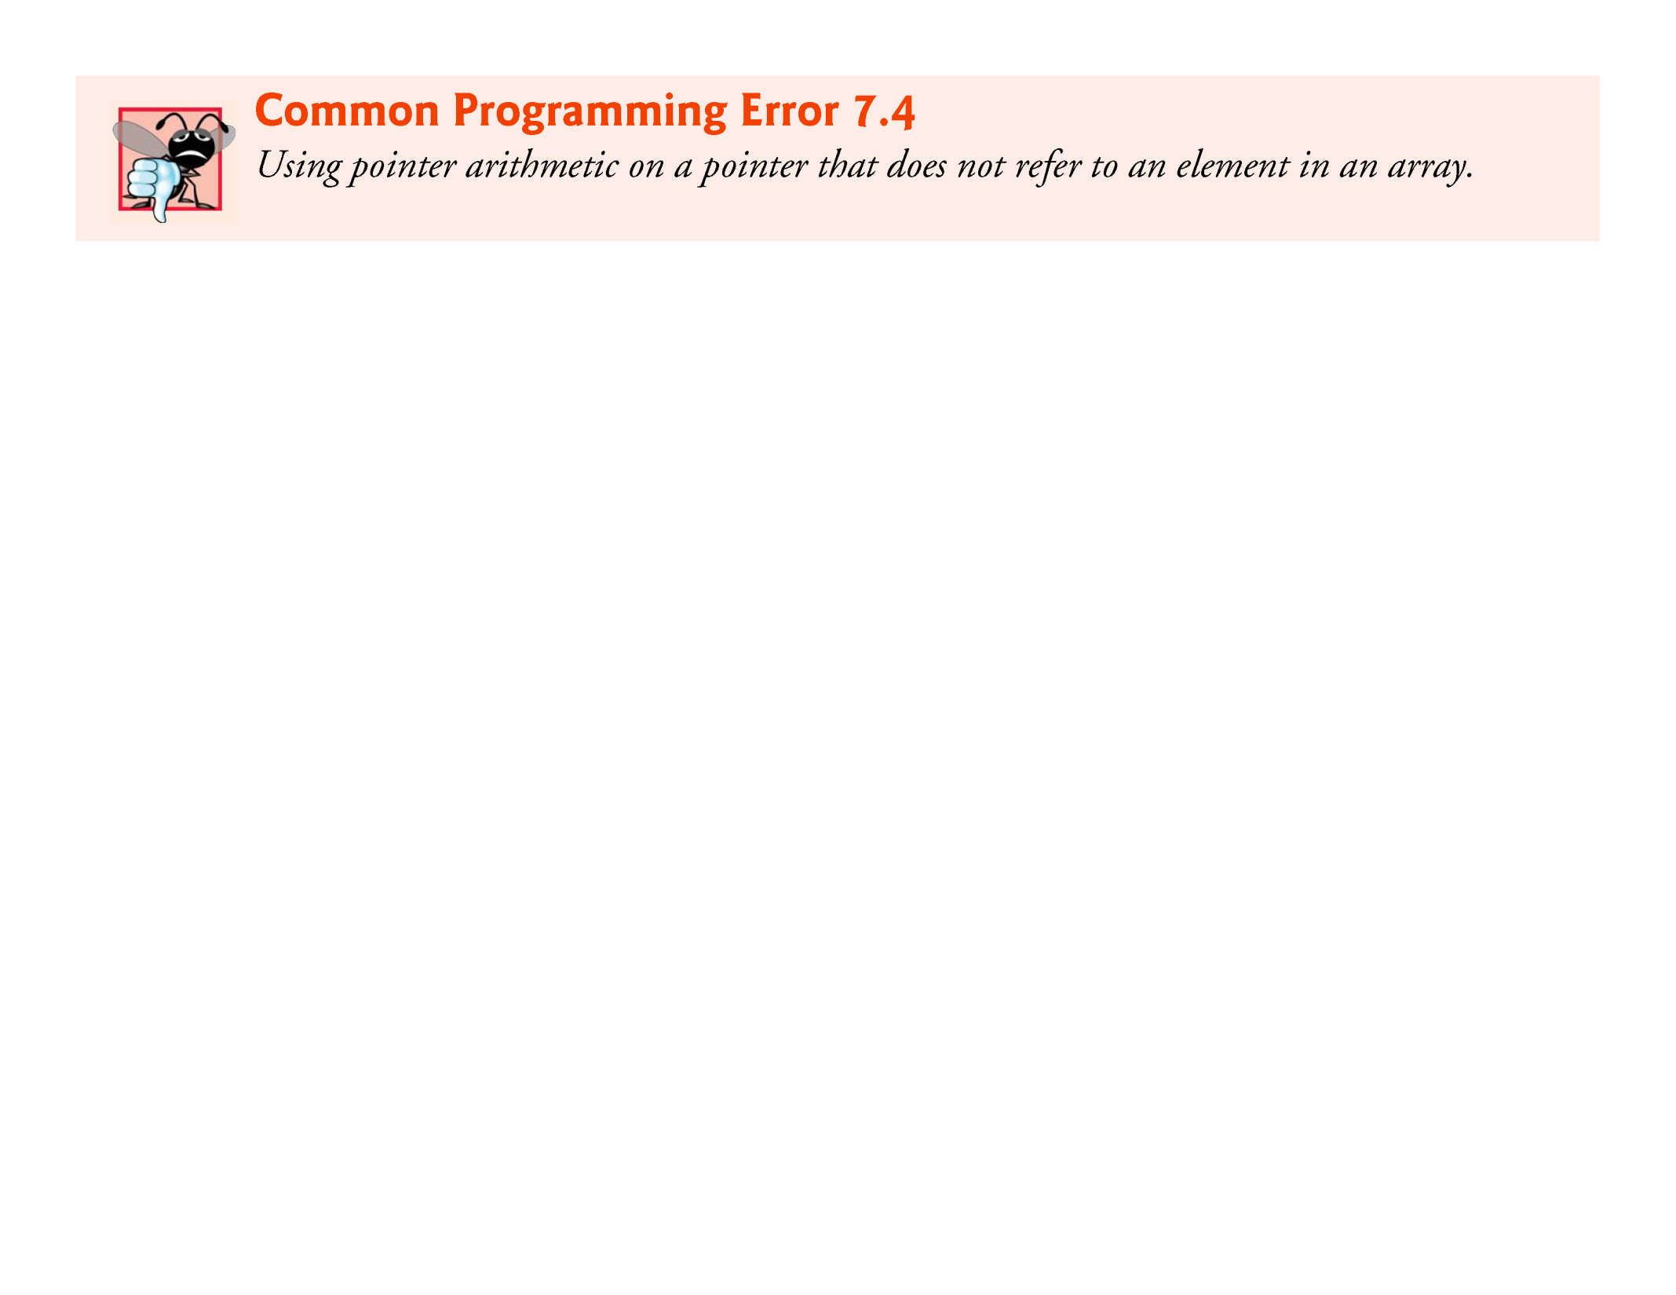

Slide 77
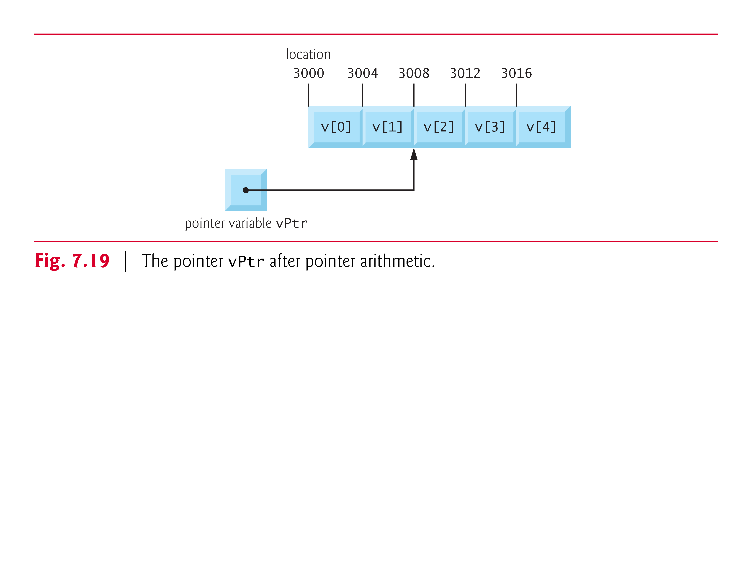

Slide 78
7.8 Pointer Expressions and Pointer Arithmetic (Cont.)
If vPtr had been incremented to 3016, which points to v[4], the statement
vPtr -= 4;
would set vPtr back to 3000—the beginning of the array.
If a pointer is being incremented or decremented by one, the increment (++) and decrement (--) operators can be used.
Either of the statements
++vPtr; vPtr++;
increments the pointer to point to the next location in the array.

Slide 79
7.8 Pointer Expressions and Pointer Arithmetic (Cont.)
Either of the statements
--vPtr; vPtr--;
decrements the pointer to point to the previous element of the array.
Pointer variables may be subtracted from one another.

Slide 80
7.8 Pointer Expressions and Pointer Arithmetic (Cont.)
For example, if vPtr contains the location 3000, and v2Ptr contains the address 3008, the statement
x = v2Ptr - vPtr;
would assign to x the number of array elements from vPtr to v2Ptr, in this case 2 (not 8).
Pointer arithmetic is undefined unless performed on an array.
We cannot assume that two variables of the same type are stored contiguously in memory unless they’re adjacent elements of an array.

Slide 81
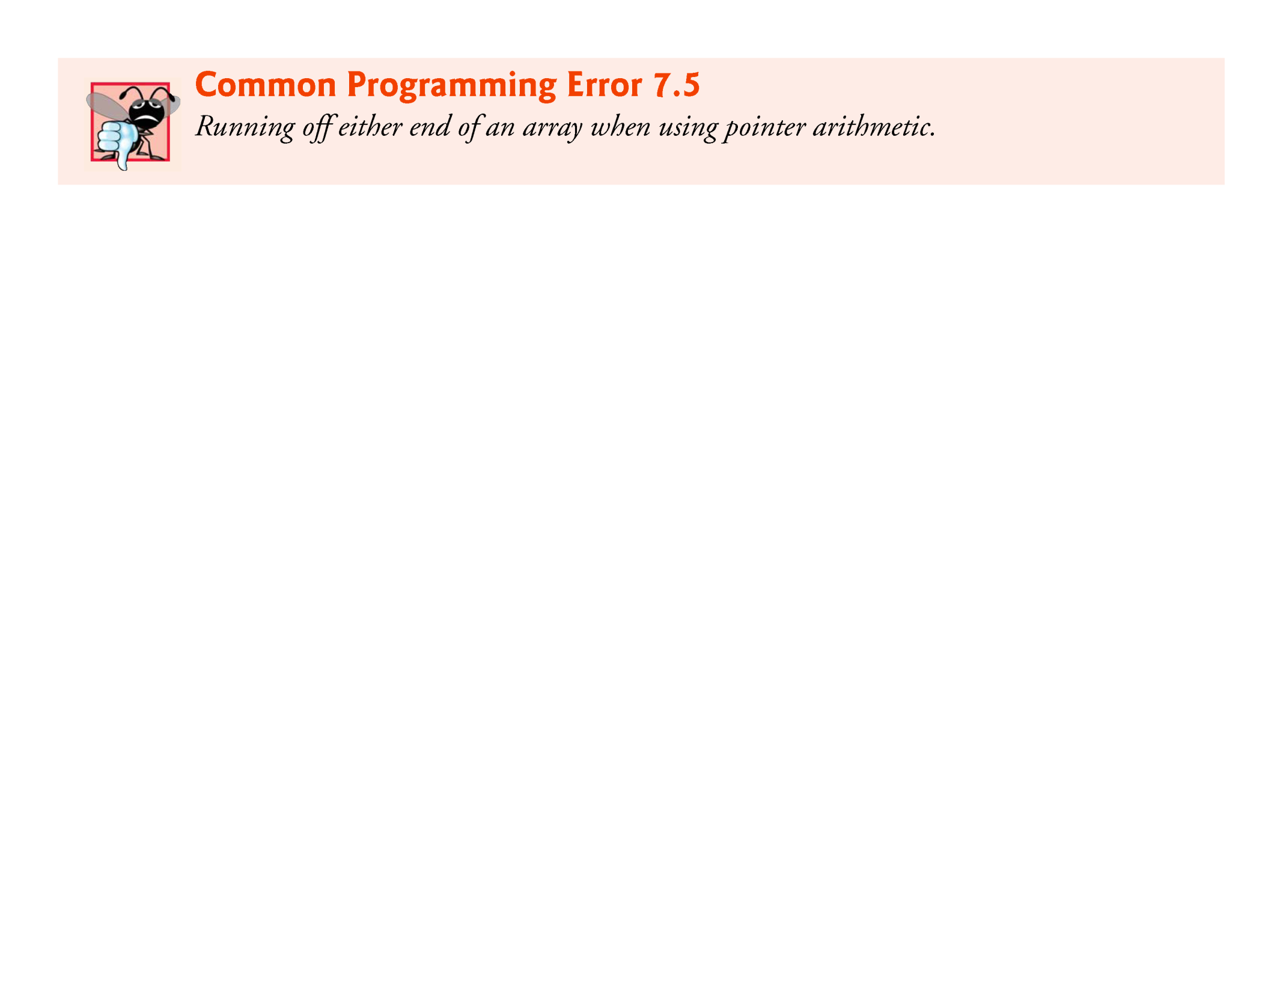

Slide 82
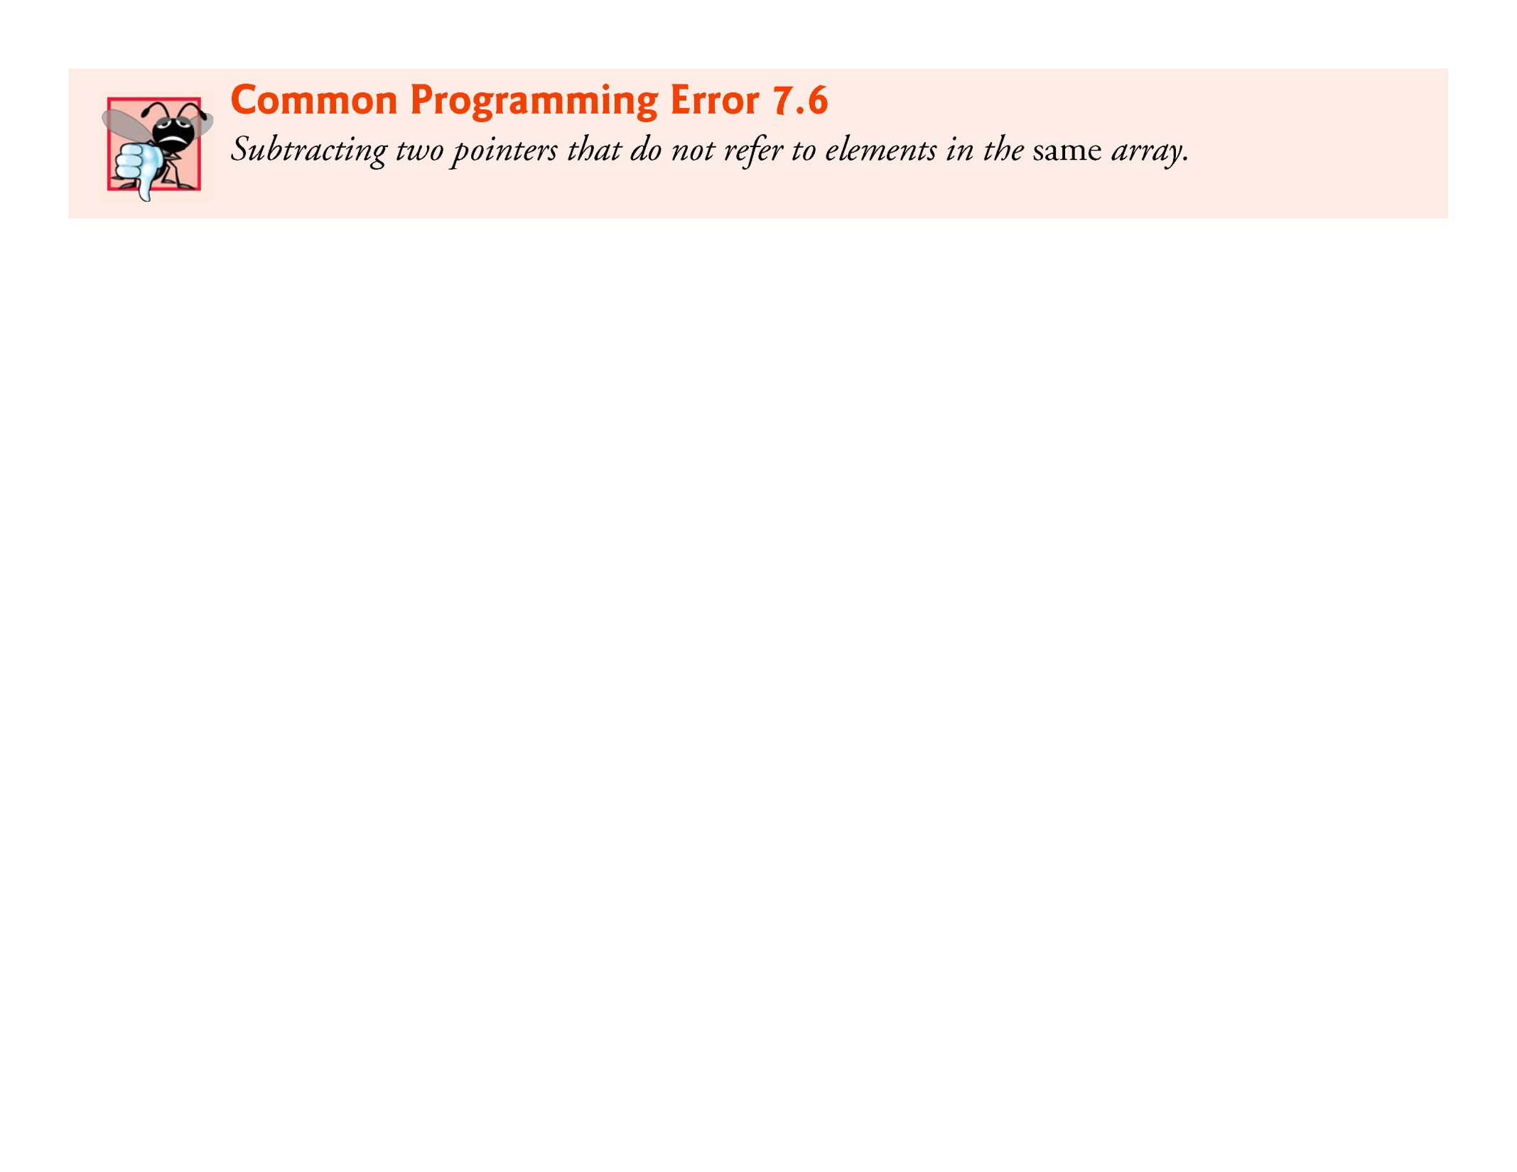

Slide 83
7.8 Pointer Expressions and Pointer Arithmetic (Cont.)
A pointer can be assigned to another pointer if both have the same type.
The exception to this rule is the pointer to void (i.e., void *), which is a generic pointer that can represent any pointer type.
All pointer types can be assigned a pointer to void, and a pointer to void can be assigned a pointer of any type.
In both cases, a cast operation is not required.
A pointer to void cannot be dereferenced.

Slide 84
7.8 Pointer Expressions and Pointer Arithmetic (Cont.)
Consider this: The compiler knows that a pointer to int refers to 4 bytes of memory on a machine with 4-byte integers, but a pointer to void simply contains a memory location for an unknown data type—the precise number of bytes to which the pointer refers is not known by the compiler.
The compiler must know the data type to determine the number of bytes to be dereferenced for a particular pointer.

Slide 85
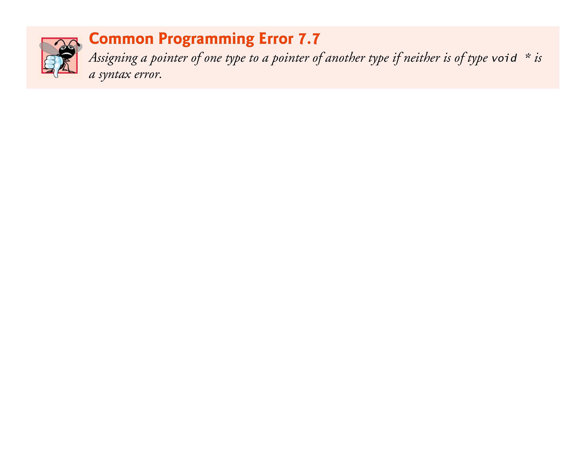

Slide 86
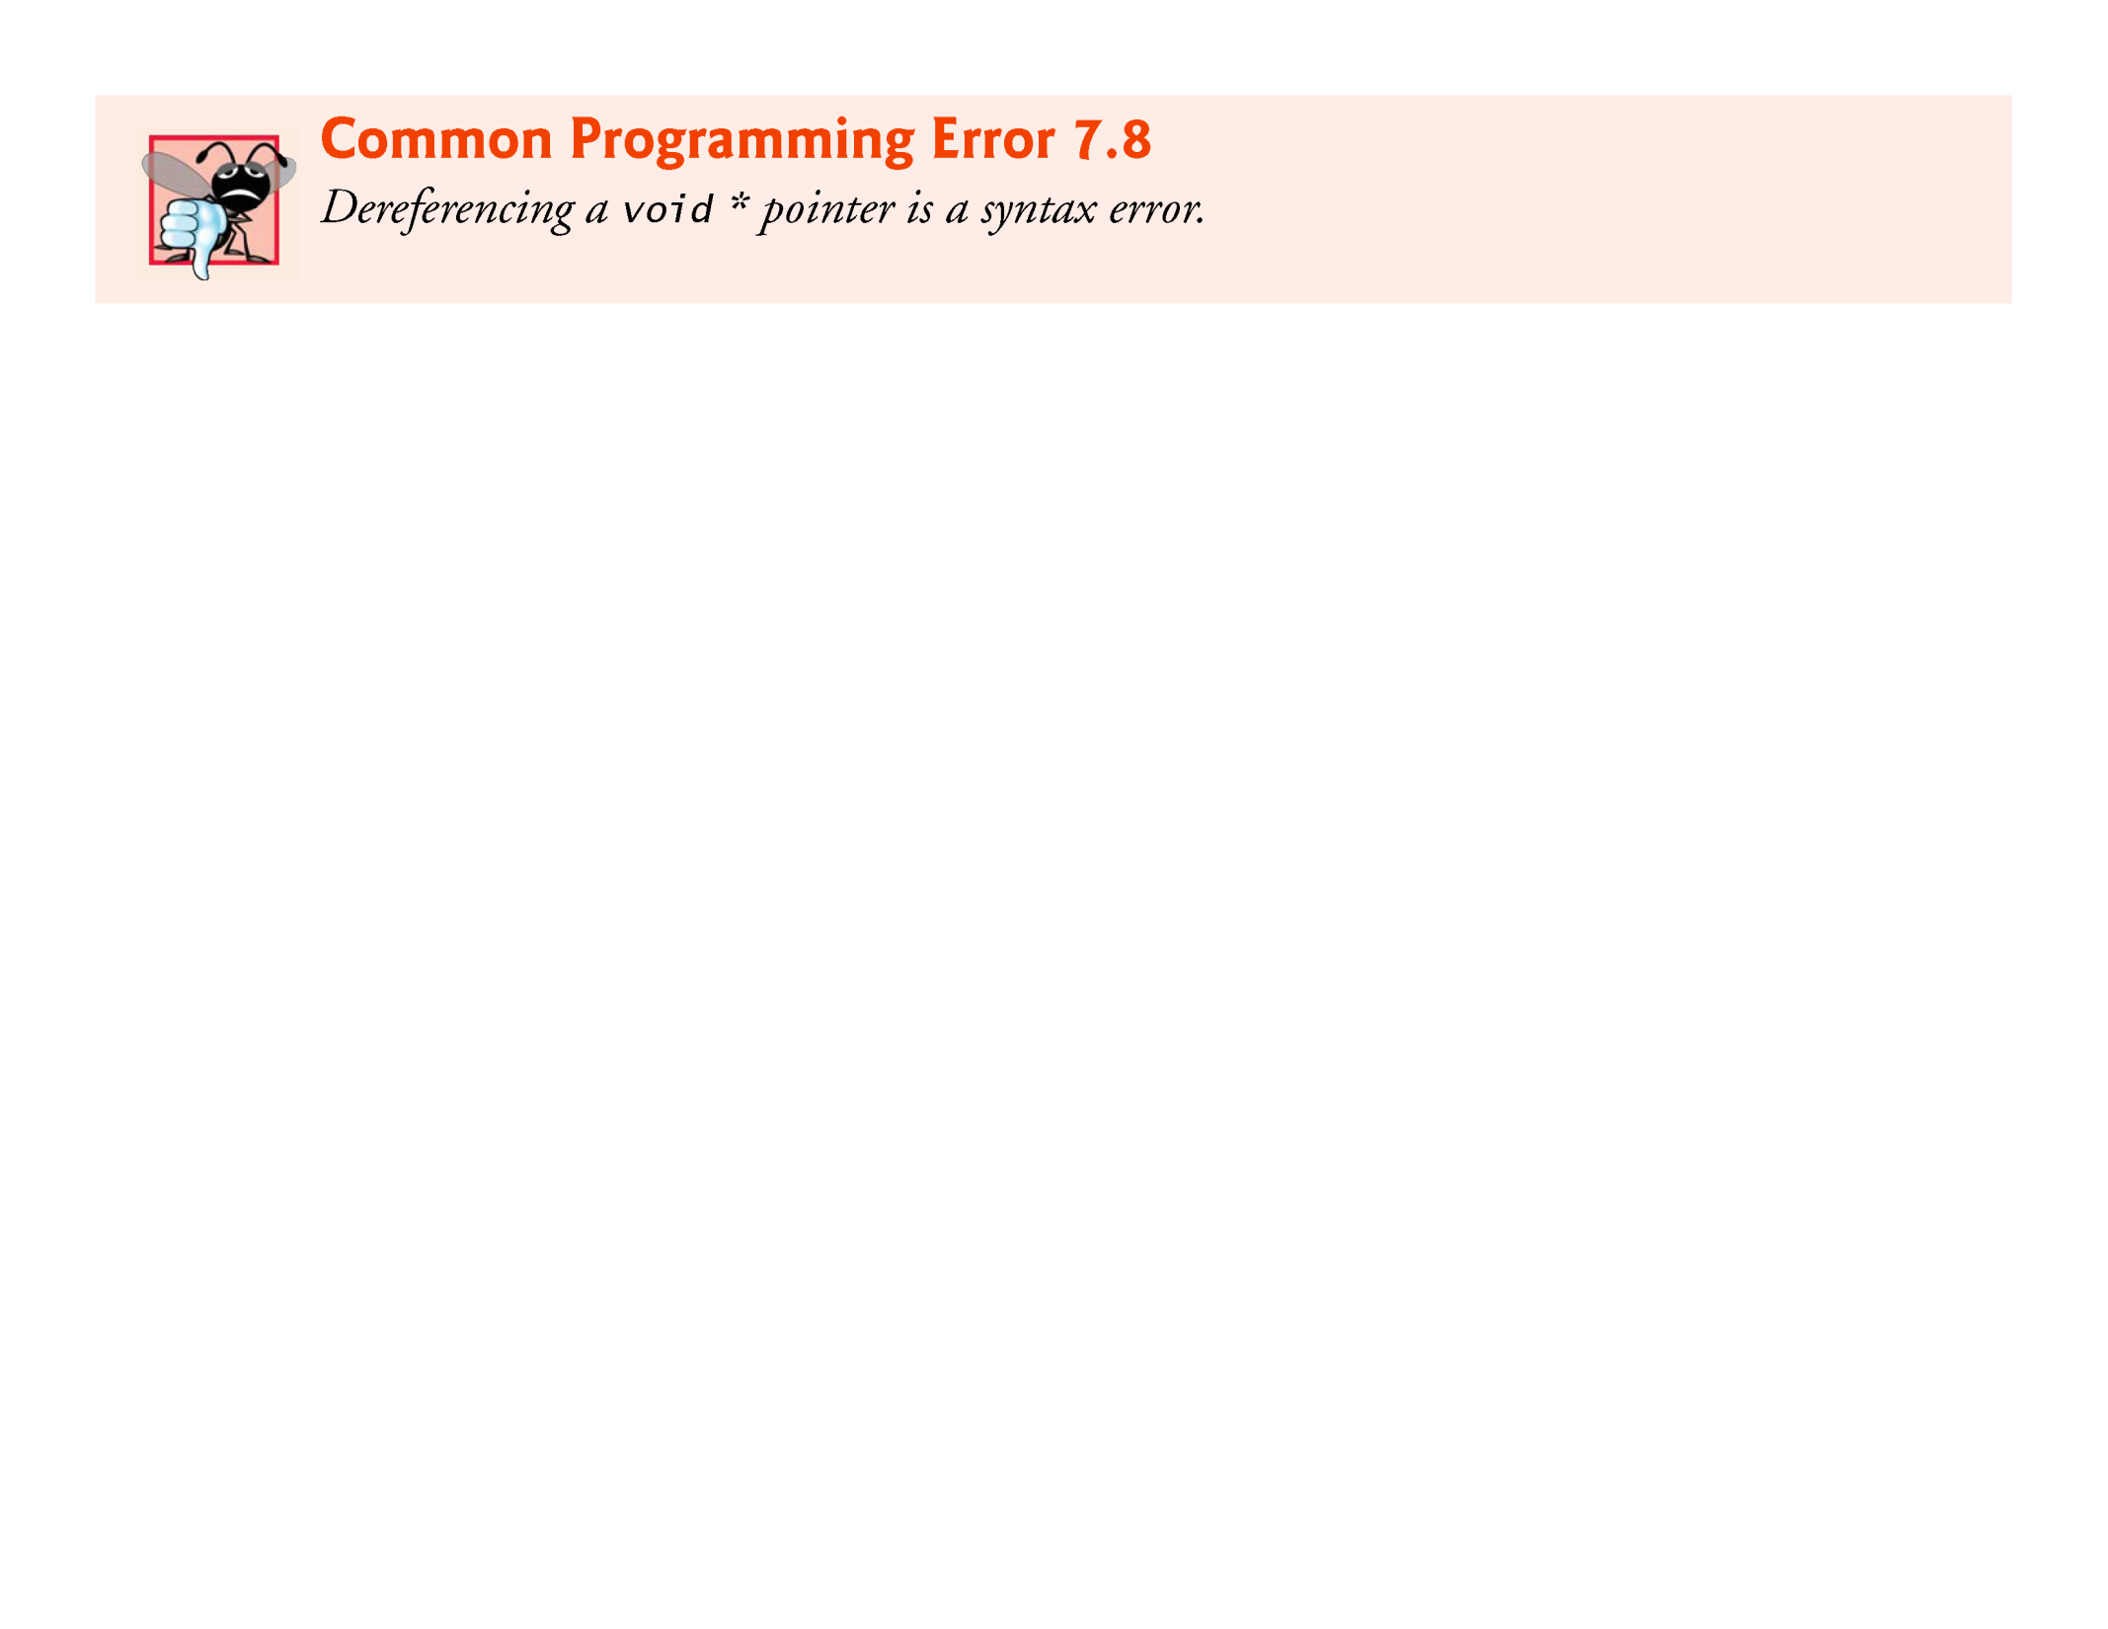

Slide 87


Slide 88
7.8 Pointer Expressions and Pointer Arithmetic (Cont.)
Pointers can be compared using equality and relational operators, but such comparisons are meaningless unless the pointers point to elements of the same array.
Pointer comparisons compare the addresses stored in the pointers.
A comparison of two pointers pointing to elements in the same array could show, for example, that one pointer points to a higher-numbered element of the array than the other pointer does.
A common use of pointer comparison is determining whether a pointer is NULL.

Slide 89
7.9 Relationship between Pointers and Arrays
Arrays and pointers are intimately related in C and often may be used interchangeably.
An array name can be thought of as a constant pointer.
Pointers can be used to do any operation involving array indexing.
Assume that integer array b[5] and integer pointer variable bPtr have been defined.
Because the array name (without an index) is a pointer to the first element of the array, we can set bPtr equal to the address of the first element in array b with the statement
bPtr = b;

Slide 90
7.9 Relationship between Pointers and Arrays (Cont.)
This statement is equivalent to taking the address of the array’s first element as follows:
bPtr = &b[0];
Array element b[3] can alternatively be referenced with the pointer expression
*(bPtr + 3)
The 3 in the expression is the offset to the pointer.
When the pointer points to the array’s first element, the offset indicates which array element should be referenced, and the offset value is identical to the array index.
This notation is referred to as pointer/offset notation.

Slide 91
7.9 Relationship between Pointers and Arrays (Cont.)
The parentheses are necessary because the precedence of * is higher than the precedence of +.
Without the parentheses, the above expression would add 3 to the value of the expression *bPtr (i.e., 3 would be added to b[0], assuming bPtr points to the beginning of the array).
Just as the array element can be referenced with a pointer expression, the address
&b[3]
can be written with the pointer expression
bPtr + 3
The array itself can be treated as a pointer and used in pointer arithmetic.

Slide 92
7.9 Relationship between Pointers and Arrays (Cont.)
For example, the expression
*(b + 3)
also refers to the array element b[3].
In general, all indexed array expressions can be written with a pointer and an offset.
In this case, pointer/offset notation was used with the name of the array as a pointer.
The preceding statement does not modify the array name in any way; b still points to the first element in the array.
Pointers can be indexed like arrays.

Slide 93
7.9 Relationship between Pointers and Arrays (Cont.)
If bPtr has the value b, the expression
bPtr[1]
refers to the array element b[1].
This is referred to as pointer/index notation.
Remember that an array name is essentially a constant pointer; it always points to the beginning of the array.
Thus, the expression
b += 3
is invalid because it attempts to modify the value of the array name with pointer arithmetic.

Slide 94
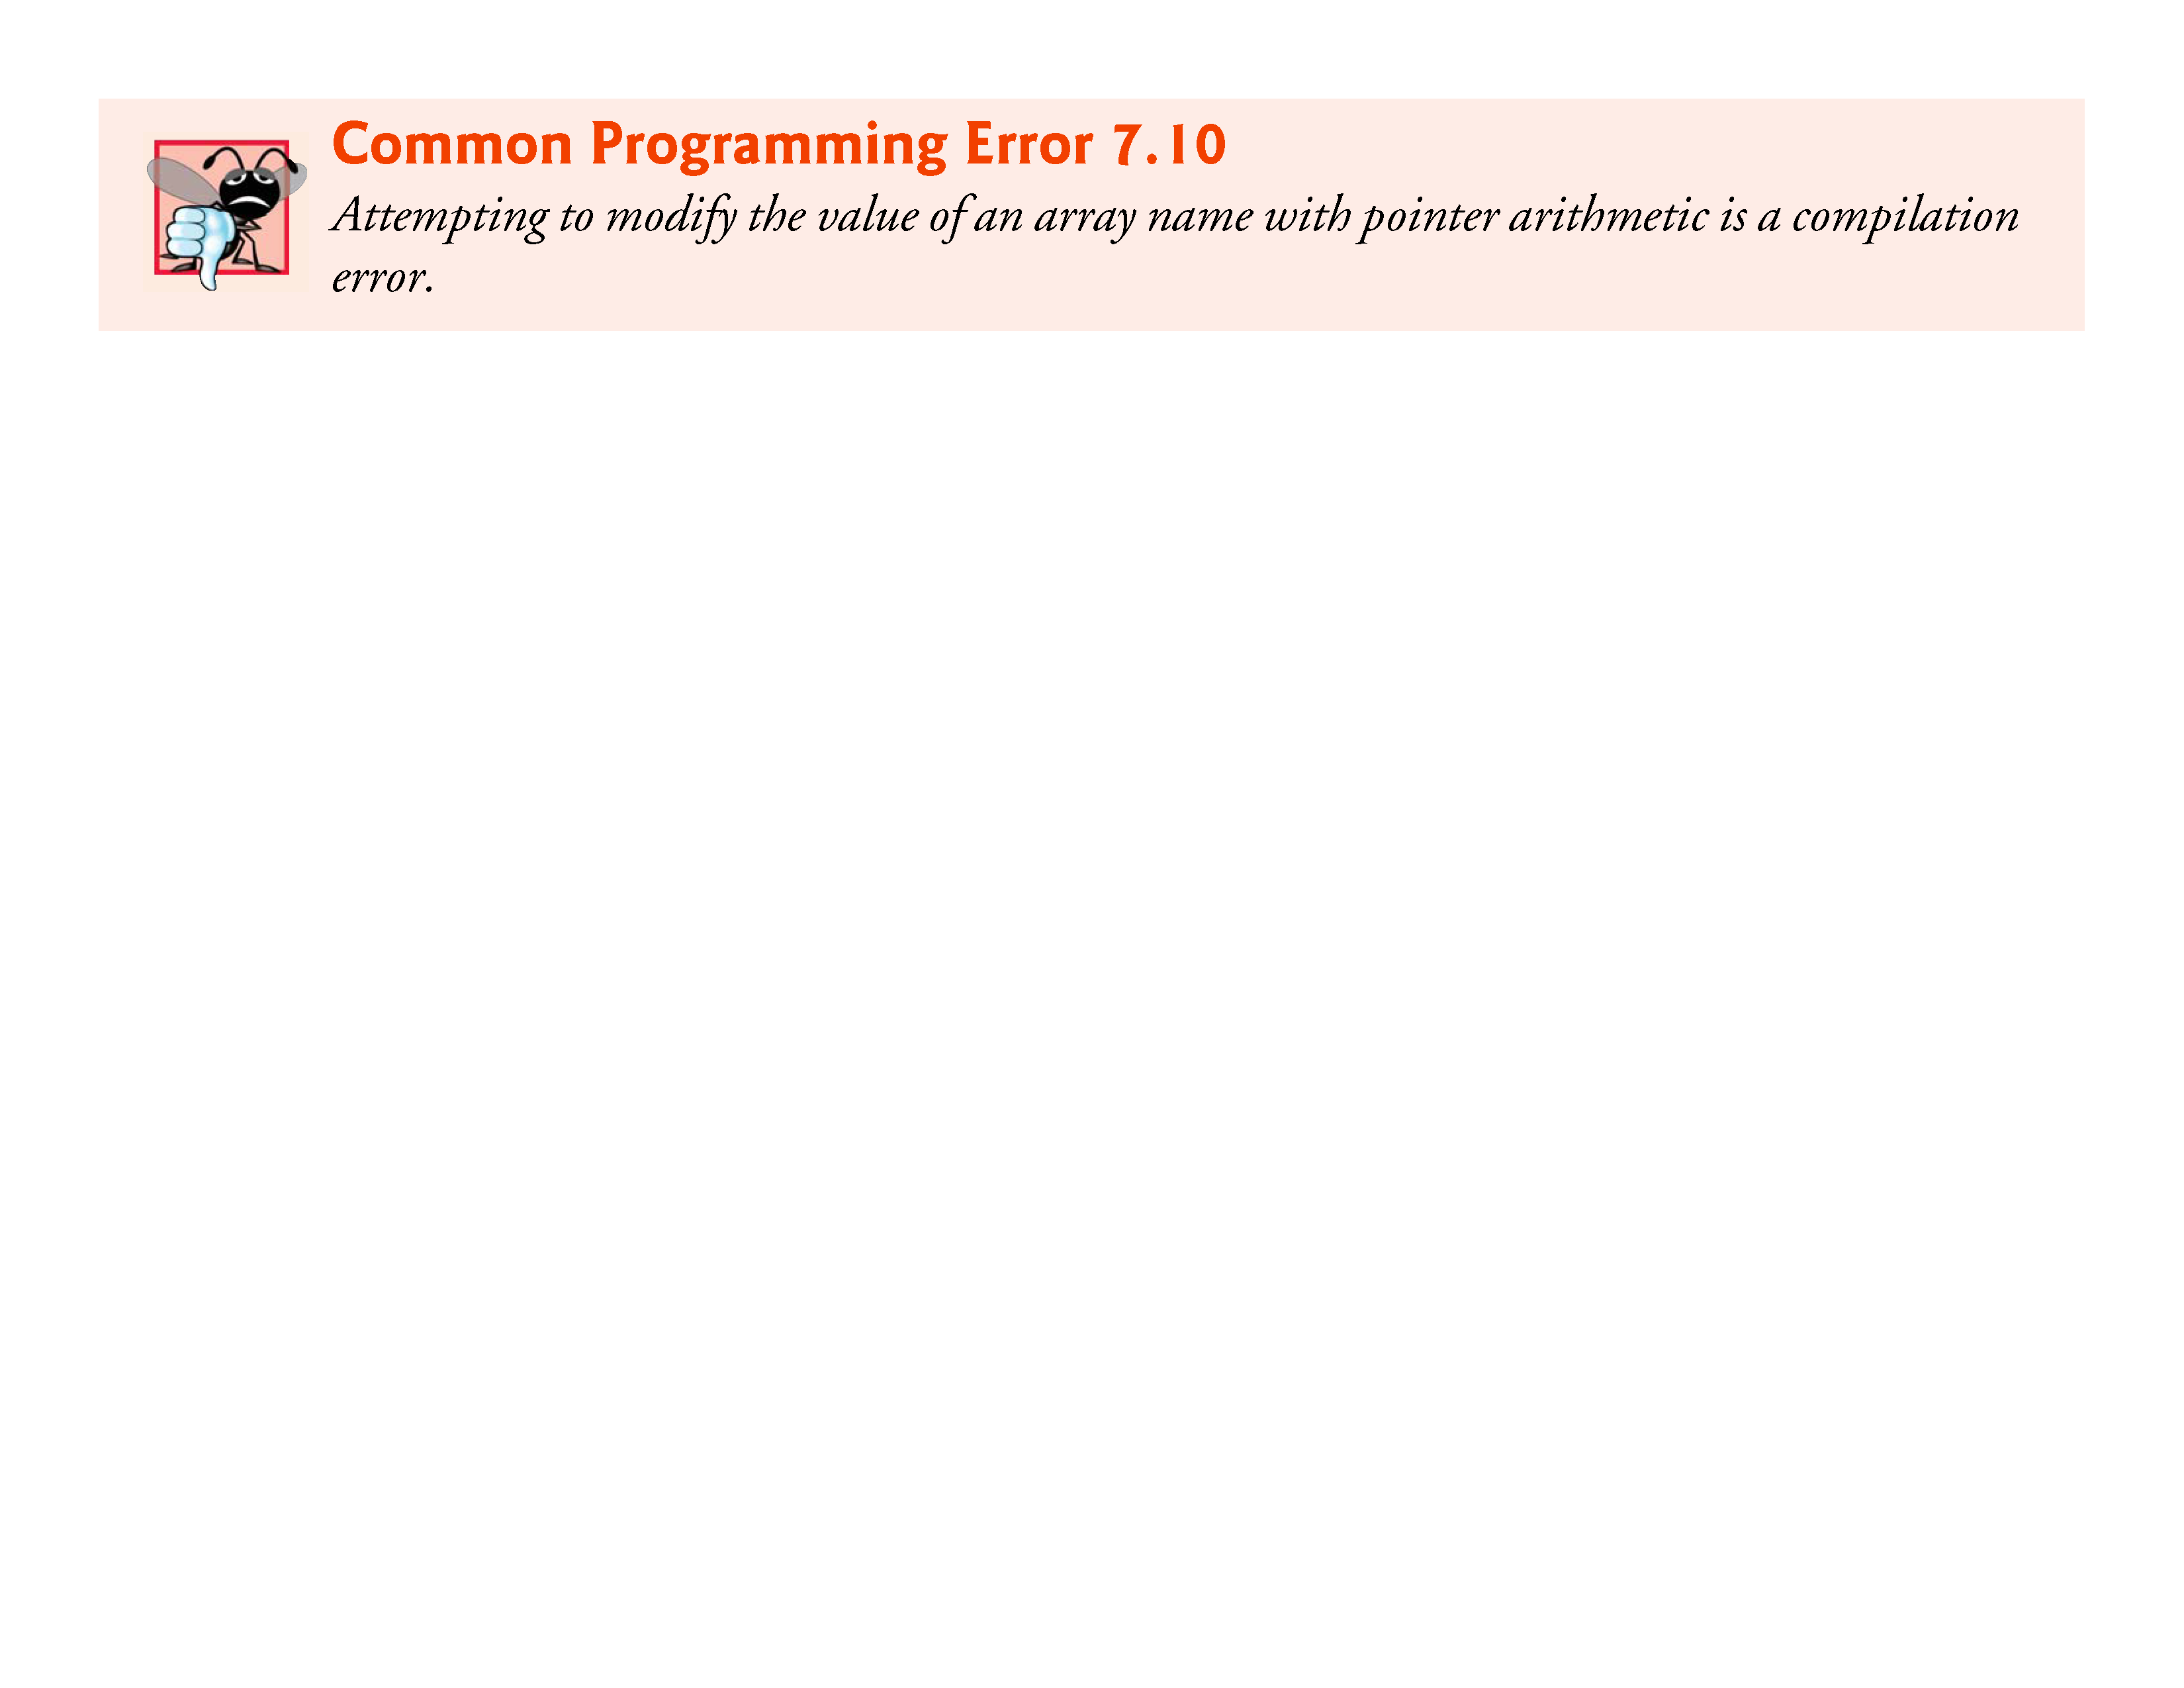

Slide 95
7.9 Relationship between Pointers and Arrays (Cont.)
Figure 7.20 uses the four methods we’ve discussed for referring to array elements—array indexing, pointer/offset with the array name as a pointer, pointer indexing, and pointer/offset with a pointer—to print the four elements of the integer array b.

Slide 96
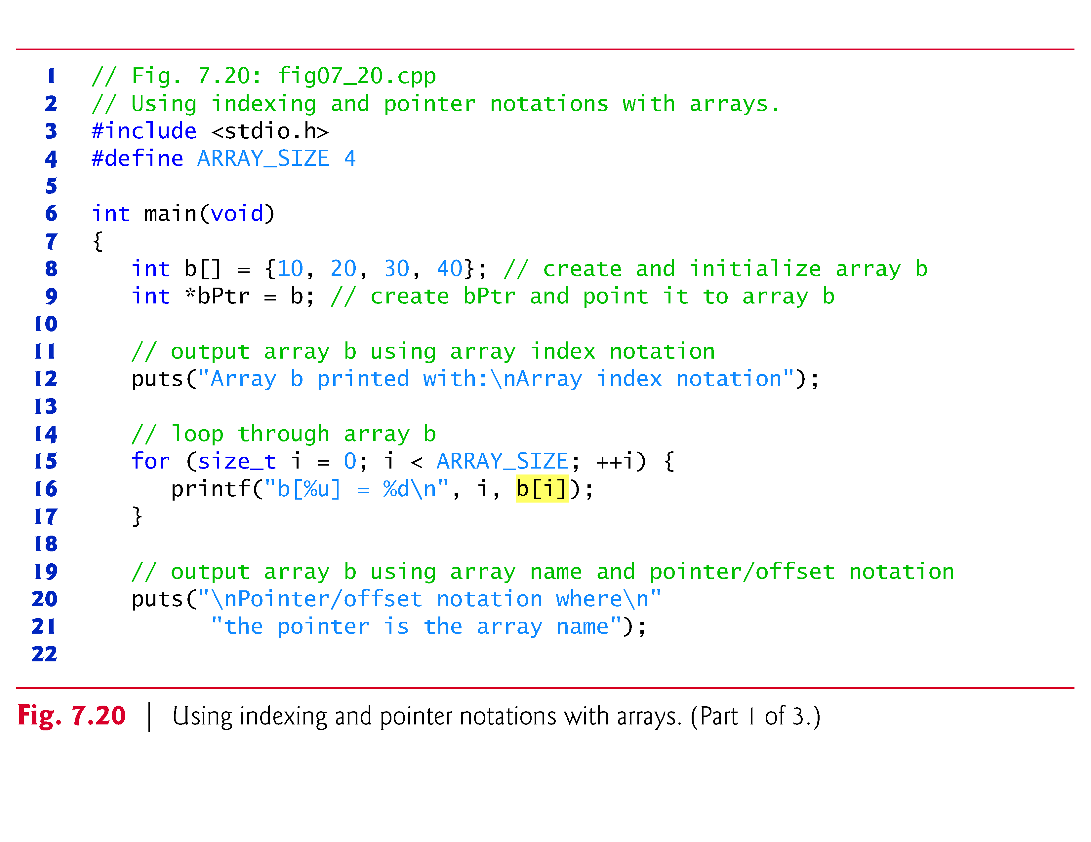

Slide 97
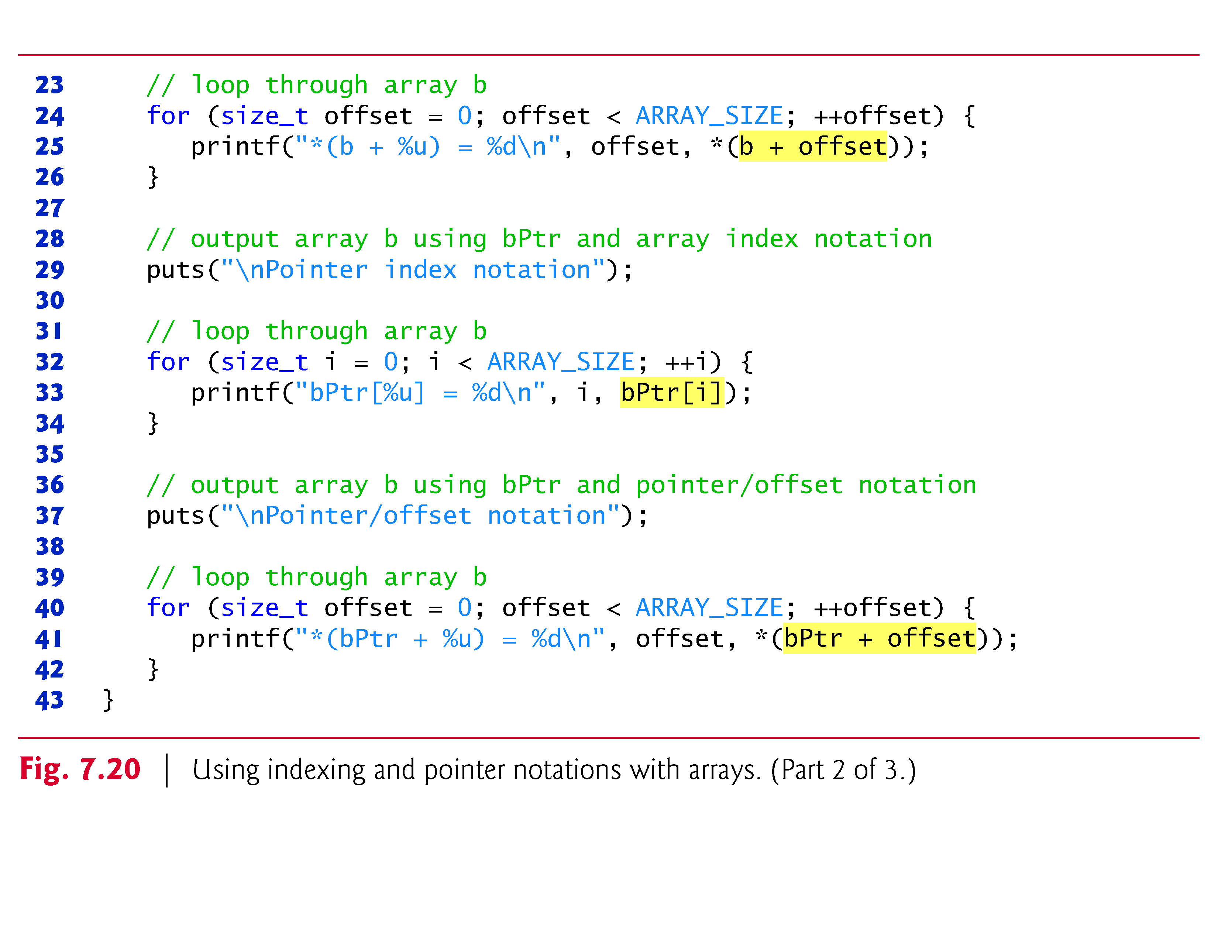

Slide 98
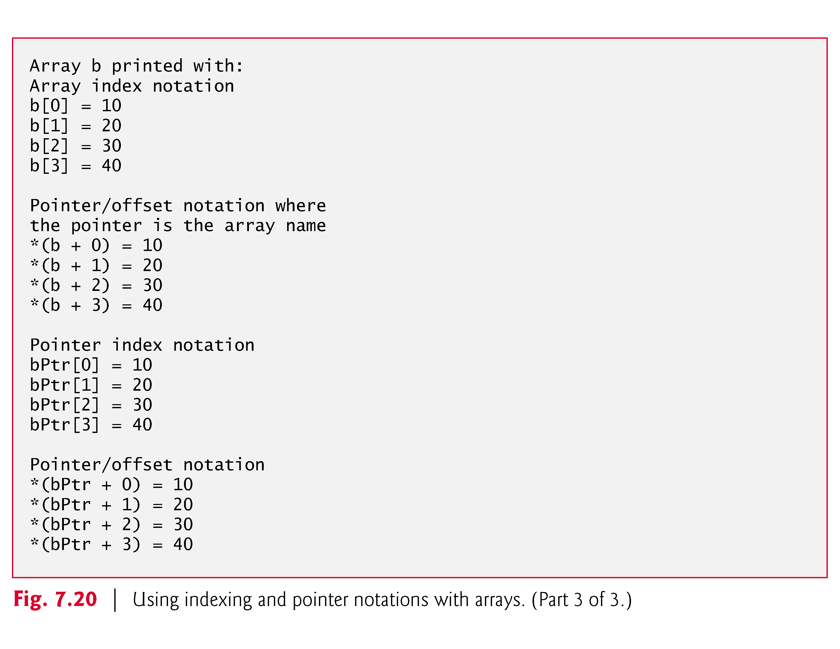

Slide 99
7.9 Relationship between Pointers and Arrays (Cont.)
String Copying with Arrays and Pointers
To further illustrate the interchangeability of arrays and pointers, let’s look at the two string-copying functions—copy1 and copy2—in the program of Fig. 7.21.
Both functions copy a string into a character array.
After a comparison of the function prototypes for copy1 and copy2, the functions appear identical.
They accomplish the same task; but they’re implemented differently.

Slide 100
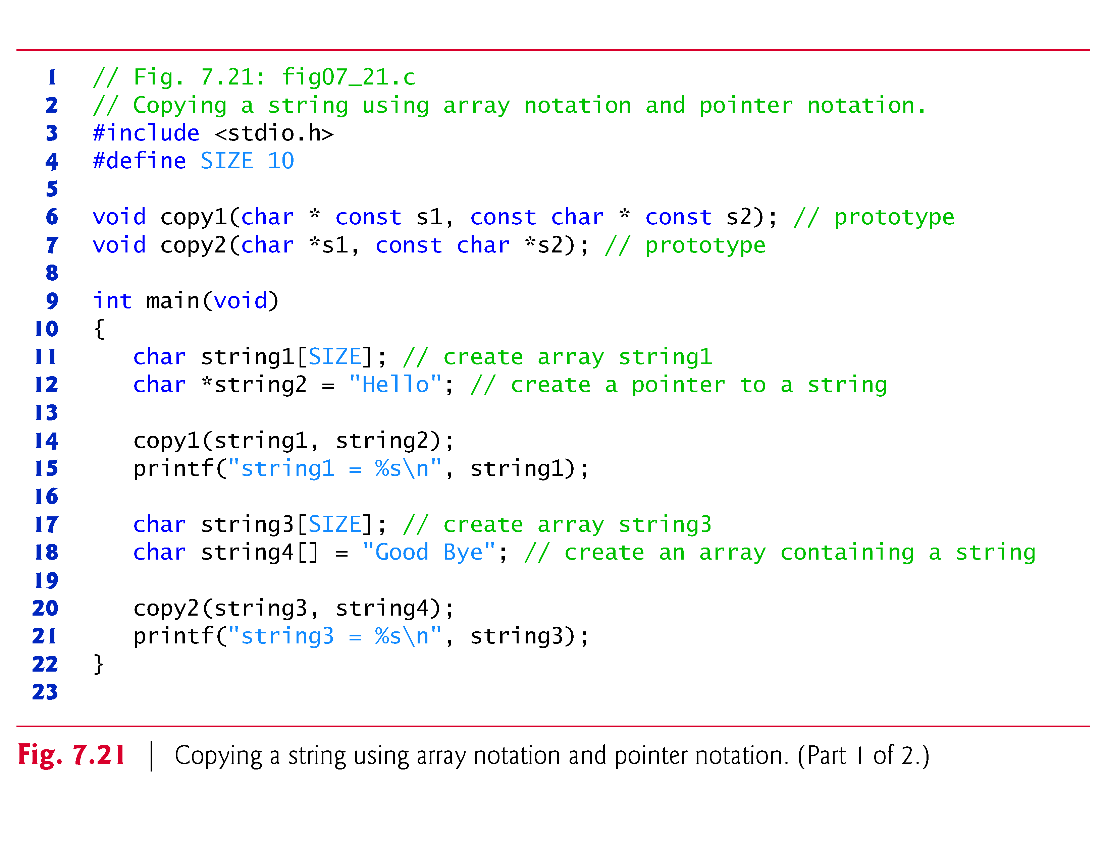

Slide 101
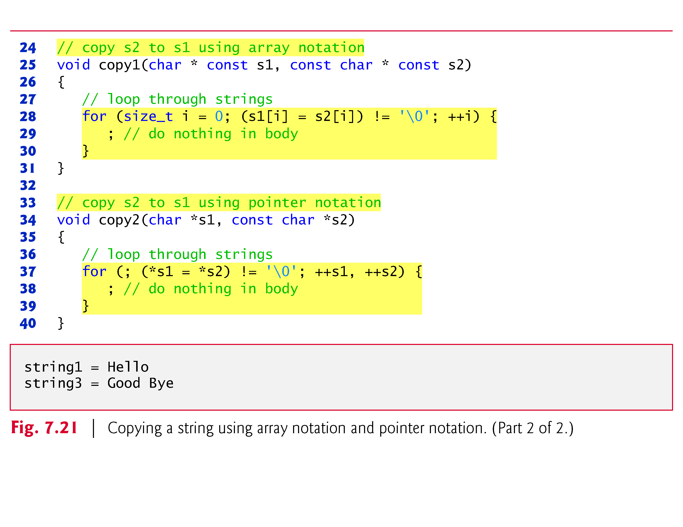

Slide 102
7.9 Relationship between Pointers and Arrays (Cont.)
Function copy1 uses array index notation to copy the string in s2 to the character array s1.
The function defines counter variable i as the array index.
The for statement header performs the entire copy operation—its body is the empty statement.
The header specifies that i is initialized to zero and incremented by one on each iteration of the loop.
The expression s1[i] = s2[i] copies one character from s2 to s1.
When the null character is encountered in s2, it’s assigned to s1, and the value of the assignment becomes the value assigned to the left operand (s1).

Slide 103
7.9 Relationship between Pointers and Arrays (Cont.)
The loop terminates when the null character is assigned from s1 to s2 (false).
Function copy2 uses pointers and pointer arithmetic to copy the string in s2 to the character array s1.
Again, the for statement header performs the entire copy operation.
The header does not include any variable initialization.
As in function copy1, the expression (*s1 = *s2) performs the copy operation.
Pointer s2 is dereferenced, and the resulting character is assigned to the dereferenced pointer *s1.

Slide 104
7.9 Relationship between Pointers and Arrays (Cont.)
After the assignment in the condition, the pointers are incremented to point to the next element of array s1 and the next character of string s2, respectively.
When the null character is encountered in s2, it’s assigned to the dereferenced pointer s1 and the loop terminates.
The first argument to both copy1 and copy2 must be an array large enough to hold the string in the second argument.
Otherwise, an error may occur when an attempt is made to write into a memory location that’s not part of the array.
Also, the second parameter of each function is declared as const char * (a constant string).

Slide 105
7.9 Relationship between Pointers and Arrays (Cont.)
In both functions, the second argument is copied into the first argument—characters are read from it one at a time, but the characters are never modified.
Therefore, the second parameter is declared to point to a constant value so that the principle of least privilege is enforced—neither function requires the capability of modifying the second argument, so neither function is provided with that capability.

